Slide 1
Service Excellence
Tufts Medicine Care at Home Module 2 Establishing Expectations

Slide 2
Tufts Medicine Care at Home
Compassionate Attentive Responsive Exceptional Service

Slide 3
Pathways to Excellence
Friendliness and Professionalism
Establishing Expectations
Communication
Privacy and Safety
Continuity of Care and Scheduling
Ending your visit

Slide 4
Setting up for Success
Call and introduce yourself offer a visit with acceptable parameters ( may I come to see you tomorrow between 10 and 12?)
Be on time and communicate if that is not going to happen keeping in mind time is valuable especially if family are meeting you there
Smile when you arrive, introduce yourself personally and our company
Set up the course of your visit so patient and family know what to expect through out your visit
Finish up your visit and introduce your team that will be caring for the patient, let patient know that other team members may see them and will be updated and aware of their care, progress and goals

Slide 5
Establishing Expectations
Upon the first visit, inform the patient about the Plan of Care. Discuss reasons for the home care, goals, and the time-frame. Acknowledge the presence and interest of others that may be present--especially the primary family caregiver.
Find out the patient’s and family’s thoughts about the situation, their goals, and their preconceived notions about how care will progress.
Ask the patient about their treatment concerns and how they feel about the limitations imposed on them by their condition.
Ask the patient what 2 or 3 things are most important to them regarding their care. Focus on these areas while interacting with them. This demonstrates to the patient that what is important to him/her is also important to you.

Slide 6
Closing Visit with Future Expectations
Let the patient and/or family know what they can expect on the next visit as well as how their services will go throughout their care.
There is an art to documenting while providing care in a personal way. We recommend that you use your language like: “Towards the end of my visit I will be spending 5 to 10 minutes documenting important information related to your care. This can give you time to think of any questions or concerns before I leave.”

Slide 7
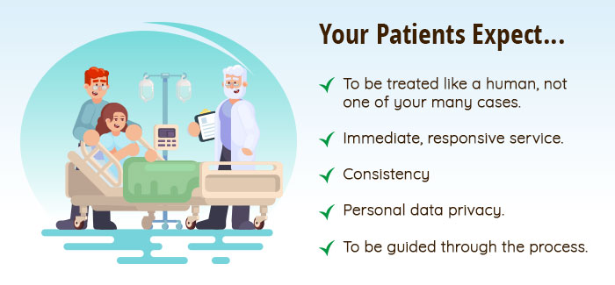

Slide 8
Exceeding Expectations

Slide 9
Why Exceed Expectations
Most patients have a choice. Despite being limited by factors beyond their control, most patients prefer to change their services just to get a better experience.
Understanding and exceeding patient expectations make everyone’s job a lot easier. Patient satisfaction leads to more accommodating patients, which makes a smoother experience for our company overall.
Exceeding patient expectations means more referrals and word-of-mouth business. When patients have a good experience, they are more likely to talk about it to their family. That means more word-of-mouth referrals, which means more patients and more growth as a company.

Slide 10
Up Next
Communication

