Slide 1
Orientation, Onboarding and Competencies

Slide 2
John Hopkins Competency Definition
Competency is the application of knowledge, skills, and behaviors that are needed to fulfill organizational, departmental, and work setting requirements and include interpersonal, technical, and critical thinking skills.

Slide 3
When Competency is Assessed
Hiring
Career Services/Recruiting
Ensure pre-employment/basic qualification met
Onboarding
Company and job specific based
On-going
Company and job specific based
Starts with onboarding
Focus on the “essence” of the job
Continual for all staff
Not a repeat of onboarding

Slide 4
Verification Methods
Tests/Exams | Peer Review
Return Demonstration | Self Assessment
Evidence of Daily Work | Discussion Group
Case Studies | Mock Scenarios
Exemplar | Presentations
 | Audits/Clinical Documentation/QI

Slide 5
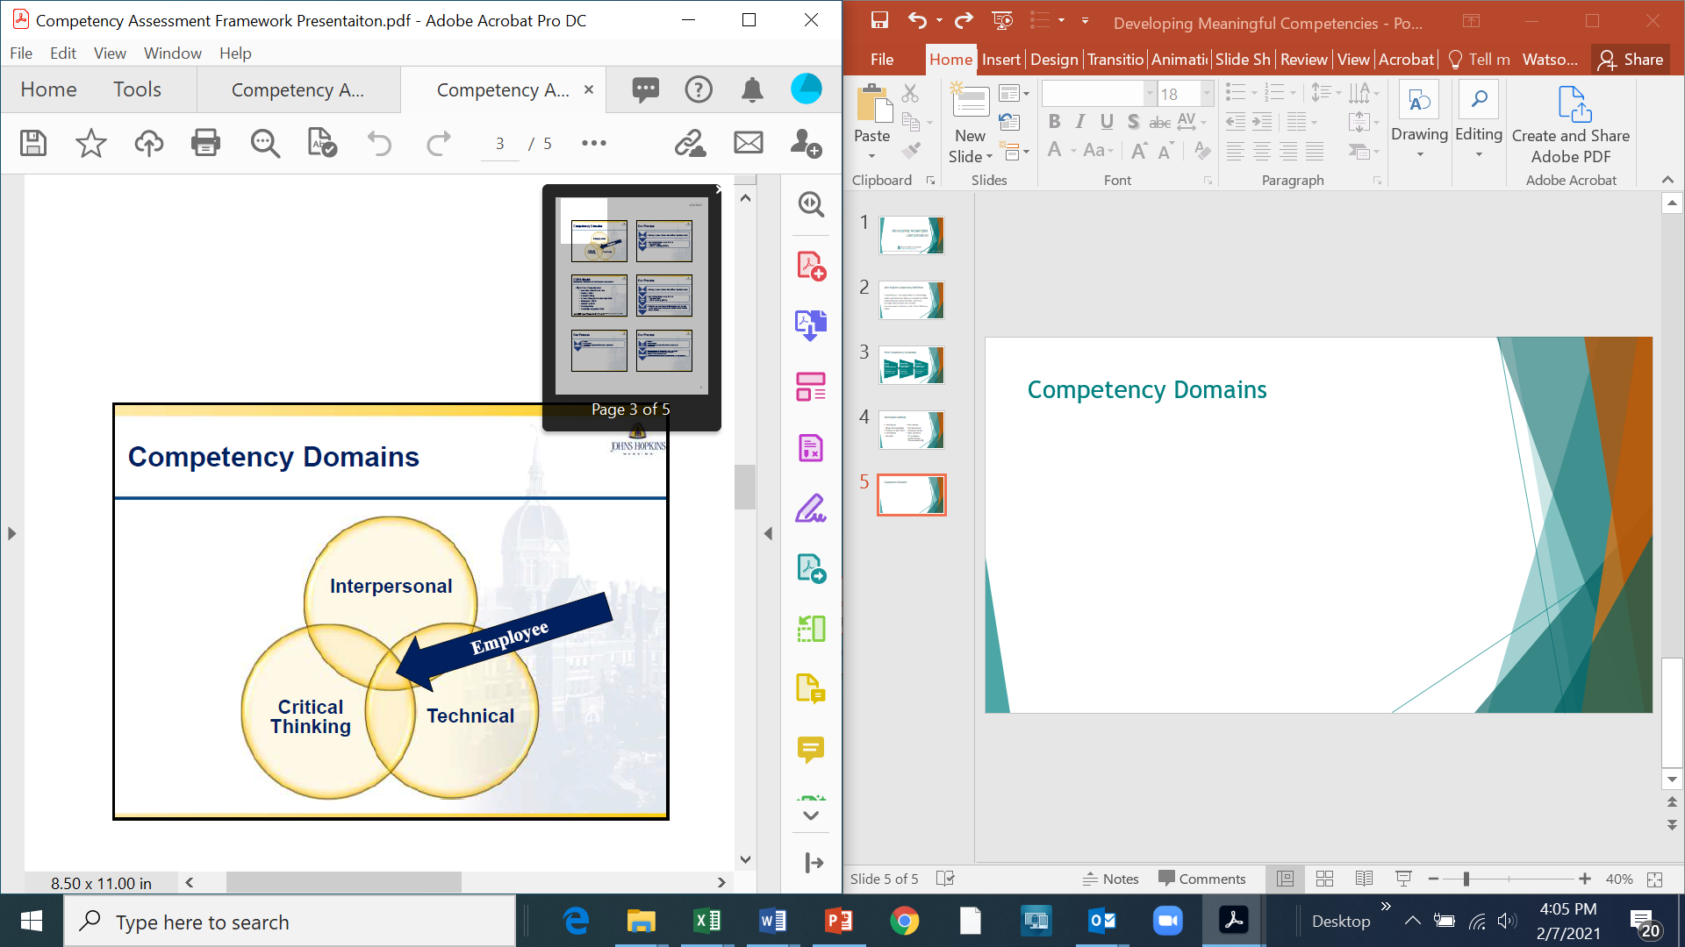
Competency Domains

Slide 6
Assessing All Domains of Skill
Clinical/Technical Skills | Critical Thinking Skills | Interpersonal Skills
Cognitive skills Knowledge Psychomotor skills Technical understanding (ability to follow directions and carry out procedures) | Problem solving Time management Priority setting Planning Creativity Ethics Resource allocating Fiscal responsibilities Clinical reasoning Reflective practice Learning Change management | Communication Customer service Conflict management Delegation Facilitation Collaboration Directing others Articulation Understanding diversity Building & nurturing team skills Listening Respecting Caring

Slide 7
COPA Model - Competency Outcomes and Performance Assessment
Eight Core Competencies
  Assessment and Intervention
  Communication
  Critical Thinking
  Human Caring and Relationship Skills
  Management Skills
  Leadership Skills
  Teaching Skills
  Knowledge Integration Skills

Slide 8
Key Points
Competencies are the transfer of knowledge into practice
Required Education does not equal competency
Make competencies meaningful
Address all 3 domains of competency
Introductory competencies focus on the “essence” of the job
Use a variety of methods to verify competency

Slide 9
Pre-Hire
Potential hire interviewed by manager
Manager would like to move forward to hire
HR sends link to Pre-Hire Medication Test and request for references. Link to Pre-Hire Medication Test https://www.proprofs.com/quiz-school/ugc/story.php?title=prehire-medication-testaa

Slide 10
Potential Hire Accepts Offer
HR adds New Hire employment data to orientation spreadsheet in Orientation Folder on Hhfs1
HR notifies Staff Development of New Hire via orientation spreadsheet.
HR notifies MIS of New Hire via orientation spreadsheet.
HR reaches out to New Hire to schedule onboarding meeting with New Hire.
HR initiates ADP Onboarding.
New Hire gathers documents and completes ADP remote onboarding.
HR sends the manager a checklist to complete.
Manager completes the checklist and sends it back to HR.
HR has onboarding meeting with New Hire. During the meeting, the New Hire provides TB history, CPR certification etc.

Slide 11
Manager Checklist

Slide 12
Manager Checklist

Slide 13
Manager Checklist

Slide 14
Manager Checklist

Slide 15
Manager Checklist

Slide 16
Manager Checklist

Slide 17
Monday One Week Prior to Orientation
HR uses the completed checklist from the manager to update equipment needs on orientation spreadsheet.
HR emails orientation spreadsheet to manager, Staff Development, MIS, Facilities.
MIS receives equipment needs from orientation spreadsheet.
MIS inputs New Hire’s work phone numbers into orientation spreadsheet.
Manager receives New Hire’s work phone numbers from orientation spreadsheet.
Facilities prepares equipment for all LPNs, RNs and PTs (nursing bags, bins, ENVO masks is needed) from information on orientation spreadsheet.

Slide 18
Wednesday of Week Prior to Orientation
HR uses completed checklist from the manager and data from New Hire to complete HCHB Import Form for Staff Development.
HR emails completed HCHB Import Form to Staff Development.

Slide 19
Thursday of Week Prior to Orientation
Staff Development enters new hire information from HCHB Import form into the HCHB training database and the HCHB production database.
Once data is entered into the HCHB database by Staff Development, MIS can set up tablet and outlook email.
Staff Development sets up promise point modules in HCHB for New Hire.
Staff Development places test patients in testing HCHB database for each New Hire.

Slide 20
Thursday of Week Prior to Orientation
Staff Development creates for each New Hire & then emails all of the forms to HR, manager and preceptor if Staff Development has preceptor information from Manager Checklist who has been assigned as the Preceptor:
  Orientation schedule/education
  90 Day Competency Checklist (contract staff do not receive a 90 Day Competency Checklist)
  Online Orientation Day 1, Day 2 & Day 3
  Preceptor Pathway for VNA New Hires (contract staff do not receive a preceptor pathway)
HR emails all of the forms to the New Hire and New Hire confirms receipt of forms.
MIS prepares cellphones and access cards.

Slide 21
Core Centralized Orientation
During COVID
  Staff completed 8 hours of online orientation on Monday of orientation at home
  Staff attended 8-hour in-person orientation on Tuesday of orientation
  Staff attended 8-hour in-person orientation with tablet, telehealth and virtual visits education
  RN, PT, OT and ST attended 2-hour remote tablet training for SOC

Slide 22
Core Centralized Orientation
Topics of Education
3-Day In-person Orientation (Monday, Tuesday and Wednesday)
Topics of Education
  Foundation Mission and Goals
  RiseHi Culture
  Human Resources presentation
  Cultural Competency
  Quid Pro Quo
  Hostile Work Environment
  Workplace Violence
  Staying Safe and Aware on the Job

Slide 23
Core Centralized Orientation
Topics of Education
3-Day In-person Orientation (Monday, Tuesday and Wednesday)
Topics of Education
  EAP
  Corporate Compliance and Privacy
  HIPAA
  Written Information Security Plan (WISP)
  Confidentiality
  Social Media
  Boundaries
  Emergency Preparedness

Slide 24
Core Centralized Orientation
Topics of Education
3-Day In-person Orientation (Monday, Tuesday and Wednesday)
Topics of Education
  Fire Safety
  Fire Response and Evacuation Plan
  Sharps Safety
  Occupational Exposures and Injuries
  Management of Agency Issued Medical Equipment and Supplies
  PACE, Element Care and NH Health Families
  Healthy You (Population Health)
  List of Infection Control Precaution Methods

Slide 25
Core Centralized Orientation
Topics of Education
3-Day In-person Orientation (Monday, Tuesday and Wednesday)
Topics of Education
  Tuberculosis Respiratory Program
  Hand Hygiene
  Infection Control PPE
  Direct Care Clinician Guidelines
  HHF Employee Benefits
  Orientation Packet
  Agency Issued Computer Equipment Policy
  OSHA Right to Know Law

Slide 26
Core Centralized Orientation
Topics of Education
3-Day In-person Orientation (Monday, Tuesday and Wednesday)
Topics of Education
  Service Excellence
  Documenting Homebound Status
  Documenting the Need for Skilled Services
  Use of ABN
  Definition of Homebound
  Examples of Homebound
  VNA Overview
  Incident Reporting

Slide 27
Core Centralized Orientation
Topics of Education
3-Day In-person Orientation (Monday, Tuesday and Wednesday)
Topics of Education
  Supervision of the HHA
  Elder Service
  Hazardous Materials and Waste
  Assessing Depression and Suicidal Ideation
  Depression vs Grief
  MOLST
  What Matters Most
  The Conversation Project

Slide 28
Core Centralized Orientation
Topics of Education
3-Day In-person Orientation (Monday, Tuesday and Wednesday)
Topics of Education
  Advance Directives
  Death Pronouncement
  Best Practices
  Medication 7 Rights
  Medication Reconciliation
  High Risk Medications
  Home Safety and Pain
  HHCAHPS Survey for VNA and CAHPS Survey for MVH

Slide 29
Core Centralized Orientation
Topics of Education
3-Day In-person Orientation (Monday, Tuesday and Wednesday)
Topics of Education
  Negative Pressure Wound Therapy
  Clinician Tool Kit
  Bag Technique
  Language Line
  Education Website
  Insulin Pen and Insulin Pen Safety Needle
  PT/INR CoaguChek
  Phlebotomy

Slide 30
Core Centralized Orientation
Topics of Education
3-Day In-person Orientation (Monday, Tuesday and Wednesday)
Topics of Education
  IV Skills
  PCR and Binax.NOW COVID Testing
  Use of Cell Phone
  Use of Access Card
  Telehealth
  Virtual Visits
  2-Hour Initial Tablet Class
  Outlook

Slide 31
Core Centralized Orientation
Competencies
Orientation Test
Needle Stick Test
Hand Hygiene
Clinical Bag Technique
Tuberculosis
Pulse Oximetry
Home Health Aide Supervision
Diabetic Foot Care
Glucometer, Insulin Pen and Insulin Pen Safety Needle

Slide 32
Core Centralized Orientation
Competencies
CoaguChek
Phlebotomy
IV Skills

Slide 33
Equipment
Given Clinical Bag and Trunk Bin on Tuesday of Orientation
Given Access Card, Laptop and Cellphone Wednesday morning

Slide 34
Forms Given to New Hires
Orientation Packet
Home Care Course for VNA
OASIS Booklet for VNA
90 Day Competency
Orientation Schedule and Independent Education to complete over the next 90 Days
Preceptor Pathway
Resource material

Slide 35
Elements to Review with New Hires Thursday and Friday of First Week
Can they use their work phone? – Have them place a call to you.
Are they checking Outlook? – Have them send you an email.
Do they know how to complete timesheet in computer?
Do they know how to reach their manager and scheduling?
Review 90 Day Competency with them.
Review Preceptor Pathway with them.
Review Independent Education to complete first 90 Days with them.
Do they know how to reach Employee Health?

Slide 36
Elements to Review Each Week of First 90 Days of Hire
90 Day Competency
Preceptor Pathway
Progress with independent education
Use of technology (access card, cell phone, EMR, Outlook)
Communicate with preceptee’s manager
Set up educational opportunities
Caseload Management

Slide 37
Staff Development Support
Will be adding a 6 week Booster Session
Will be adding a 12 week Booster Session
SOC training 3rd week of hire
OASIS Classes with Nancy Murphy, CDI Specialist

Slide 38
At End of 90 Days of Hire
Manager will complete 2 joint supervision visits
Complete 90 Day Competency (preceptee, preceptor and manager sign)
  Manager passes into HR
90 Day Evaluation completed by Manager
  Manager passes into HR
Staff to complete independent education
Preceptor will still be a contact person for preceptee over the next couple of months

Slide 39
Four Skills to Focus On
Time Management
Priority Setting
Organization Skills
Critical Thinking

