Slide 1
Nurse Residency Program Class
Medication Reconciliation and Teaching
Circle Home | Commonwealth Nursing Services | Hallmark Health VNA | Home Health VNA | Home Health VNA of NH | Merrimack Valley Hospice | York Hospital Hospice

Slide 2
Objectives
At the end of this session the participant will be able to:
Identify best practices in medication reconciliation upon admission to home care services and during each subsequent visit
Describe the importance of Medication reconciliation
Describe the best way to do a med fill and when to refer to pharmacy for packaging
Describe documentation of discrepancies, and MD/ Pharmacy follow up
Have knowledge of medication dispensing options in MA

Slide 3
Statistics in Medication errors
‘More than 40 percent of medication errors are believed to result from inadequate reconciliation in handoffs during admission, transfer, and discharge of patients. Of these errors, about 20 percent are believed to result in harm.’
One study sites : ‘Comparing pharmacy drug history with medication lists obtained (from 250 patients) by nurses/physicians revealed 3036 discrepancies. On average, discrepancies, ranged from 0 to 68, were identified per patient. Only in 20 patients (8%) there was 100 % agreement among medication lists obtained by pharmacist and physician/nurse.’
2014-04-15 14:03:22
Cynthia R. Hennen, BS, RPh; and James A. Jorgenson, RPh, MS, FASHP

Slide 4
Statistics in Medication errors

Slide 5
Medication reconciliation
Medication reconciliation is the process of:
Obtaining, verifying, and documenting the patient’s current prescriptions, over-the-counter medications—including vitamins, supplements, eye drops, creams, ointments, and herbals— when he or she is admitted to Home care. This is also checked at each visit for changes, to assess for interaction to offer patient teaching and answer questions.
This is done at SOC and reviewed at each visit thereafter.

Slide 6
Medication reconciliation
Why Med Reconciliation?
To assure that discharge prescriptions contain no errors by reconciling them with the inpatient medication DC orders and the patient’s prescriptions
To capture all discharge prescriptions in the EMR and reconcile with the PCP for continuity of information and care

Slide 7
Medication reconciliation
Why Med Reconciliation?
To educate patients on medication use, dose and S/E as well as the importance of taking their medications on the schedule prescribed.
To reinforce with patients the importance of seeing their PCPs within 14 days of discharge to discuss any changes and to assess effectiveness of the new medications prescribed.
**All of these actions have been shown to increase patient safety and decrease hospital readmissions.

Slide 8
Medication reconciliation
The SOC visit
Read the referral prior to visit, Ask patient for the DC paperwork and locate the medication list.
This should have all of the medications prescribed (and sometimes a list of the med changes and DC medications from the Hospital or Rehab stay)
Ask the Patient for ‘all of their medications’ including all OTC, herbal and substances they are using (this is important for possible interactions) Ask what they take for allergy symptoms, pain and headaches.

Slide 9
Medication reconciliation
Its easier to take all of their meds out of the box they store them in or if they are loose to place them on one side of the table.
Take the DC med list and go one by one down the list locating each medication and being sure that the Rx matches. Explain each med as you enter it into the computer then place it in the box or on the other side of the table. (in case of interruption) this also teaches the patient how to verify their meds and starts teaching them do a medi-planner fill safely.
Do this for each medication on the list.

Slide 10
Medication reconciliation
Place an identifying mark on the paper by each med that you aren’t able to locate so the patient can show family to pick up the med at the pharmacy. (document for yourself that it was missing in case they need a new Rx sent)
If there are medications left on the table when you finish the DC list ask the patient if they are still taking those meds and document for yourself to alert the PCP that they are also on the following meds, creams…etc

Slide 11
Medication reconciliation
If there are corrections- make them on the DC paperwork so the patient has an accurate medication list in their home, and leave one of our blank Medication Sheets (located in the SOC folder) so the family has the option to transfer the information to a clean sheet.
If the patient has a new high risk medication that they don’t understand even after teaching, (insulin, anticoagulants, narcotics) try to pull in a family member to assist. If that fails, BEFORE you leave the house make your manager aware so a plan can be made for that patients safety.

Slide 12
Medication reconciliation
Call the PCP and review your findings and interactions with the Nurse or MD so they are aware, and ask for any Rx needed to be sent to the pharmacy.
Add any other medications to the EMR that the MD office approves that weren’t on the facilities DC medication list.
Always be sure that the patient is safe until the next Nursing visit!

Slide 13
Medication reconciliation
Explain all of the HIGH RISK meds using teach back until there are no questions. (Document teaching and patient response)
If a family member manages the meds you may have to call them and do that teaching over the phone.
The VNA is also able to make calls to check on patients the next day if you feel that the patient would benefit.

Slide 14
Medication reconciliation
Extra information
Our EMR HCHB pulls from the patients last filled medications at the pharmacy. These may or may not be accurate. Scan through that list to get an idea of its accuracy. Sometimes the last Rx fill was years ago and the patient is no longer on any of them. That’s good to know before you start. Its easier to clear them out before going through the DC list.
Remember to add parameters if applicable, and a reason for any PRN medications. ‘Every 3-4 hours for pain level 5-10’. Or ‘may take daily as needed for seasonal allergies’

Slide 15
Medication reconciliation
Make sure you write out sliding scales. Do not write ‘take per sliding scale’ It won’t help if an MD or family member calls with a concern. There won’t be any information to give them on the dosing and we won’t be doing our best to keep the patient safe.
We know that everyone is very busy, but do your best especially with Starts of Care to get the chart completed that same day. VNA guidelines state 24 hours. If the family calls off hours or next day the ‘on-call’ Nurse will need to have information about the patient and HCHB isn’t a live system.

Slide 16
Medication reconciliation
The first week of an admission to Home Care is critical. The patient and family may have a lot of information that has changed or is completely new to them. This is the time frame when they are most likely to end up back in the hospital related to not understanding medications or self care at home.
If a patient consumes alcohol, marijuana or any other substances they should also be added to the list (or make the MD aware and document). This isn’t judging someone, its preventing possible dangerous interactions and may alter what an MD chooses to prescribe.

Slide 17
Medi-planner fill
On occasion we fill medi-planners until we can teach a family member or set the patient up with bubble packing and delivery from the pharmacy or another dispensing method.
Similarly as for the Med-Rec- compare the med list in the EMR (or if SOC, the DC med list) to the bottle for accuracy, place the dose, and when done move that med into the patients storage box or other side of the table designated for the completed medications.

Slide 18
Medi-planner fill
Take your time and be sure the med list matches the bottle. Follow the EMR list from top to bottom-don’t get caught up with the patient dictating when to place what pill first. Try to keep distractions to a minimum.
Do not give meds out of an unmarked bottle or when 2 different medication sizes or colors are in one bottle even if the patient states it’s the same medication. If the patient is insistent, they can place it themselves. (Document this) Teach on safety and attempt to get another bottle from pharmacy for the next fill. Pull in family if needed.
When finished do a count. Unless there is an every other day, or 2x week med, days and times should be uniform in count in the medi-planner; also do a visual inspection. Show the patient and have them confirm.

Slide 19
Medi-planner fills
Document that ‘the count and appearance is uniform’ and that the ‘patient agrees with the accuracy of the medication fill’
Document anything else going on. If as soon as you start to pack-up, the patient starts opening the medi-planner and touching the meds- stop and re-educate. Document that behavior and your re-educating the patient.

Slide 20
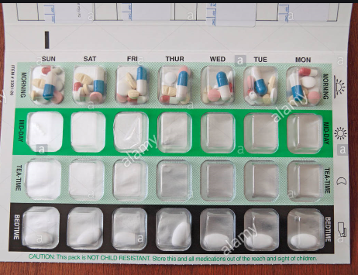
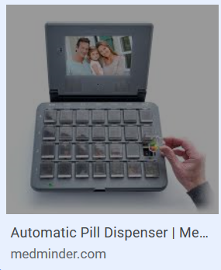
Medi-planner fills
Winchester Pharmacy- 781-570-2320 bubble packs are delivers to most areas in MA. Normally a month at a time all dated and color coded for Morning, Noon and Evening
Medminder Pharmacy 1-888-633-6463
This planner is locked and rings at the
Correct time, if the meds haven’t been
taken in 20 minutes (of ring reminders)
the system sends an alert to a
designated family member. Boston based –
delivers to most areas in MA

Slide 21
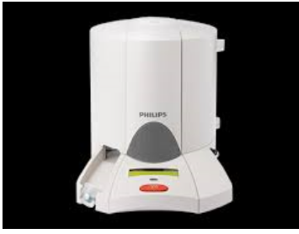
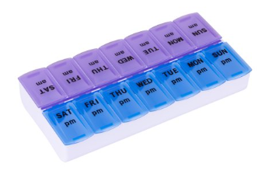
Medi-planner fills
Phillips medication dispenser 855-332-7799
Family member needs to fill the dispenser and a
Voice reminds the patient to take their meds. Meds
pop out at the correct time in a covered cup.
Local pharmacy's are now filling medi-planners also

Slide 22
Each Patient visit
Assess at each visit for any new or changed medications and correct in the EMR
If the patient has a home medication list- update it to reflect any changes
Assess for any interactions with the new or changed medications and report to the MD if needed
Be sure that the patient understands the change or any new medications Rx’d

Slide 23
Each Patient visit
Please be sure that any temporary medications like antibiotics are removed when completed. SOC Nurses may assist with this by adding an end date in the EMR when entering it to the medication screens.
Ask if they have any questions on their meds. Document all teaching done. Some Nurses teach on 2-3 meds each visit until they have completed the list.
Reminder: **Teaching is a skill and meets the COP’s for Medicare participation. Patients need to have a skilled need, be homebound and have a medical necessity documented to meet Home Care requirements

Slide 24
Any Questions?

