Slide 1
Healthy You

Slide 2
What is Influenza?
The flu is a contagious respiratory illness caused by influenza viruses.
It can cause mild to severe illness, and at times lead to death.
Seasonal flu occurs every year, in predictable patterns and infects only humans.
In New England, flu season begins in December, peaks in January or February and can last through April or May.

Slide 3
What is the impact of Influenza?
Every year in the United States:
5%-20% of the population gets the flu
More than 200,000 people are hospitalized from flu complications, and;
About 36, 000 people die from the flu.
Some people, such as elders, young children and infants and those with certain health conditions, are at high risk for serious flu complications.

Slide 4
Symptoms of the Flu
Fever (Usually high)
Headache
Extreme tiredness
Dry cough
Sore throat
Runny or stuffy nose
Muscle aches
Stomach symptoms, such as nausea, vomiting, and diarrhea, also can occur but are more common in children than adults

Slide 5
Complications of the Flu
Complications include:
Bacterial pneumonia
Dehydration
Worsening of chronic medical conditions, such as congestive heart failure, asthma, or diabetes.
Children may get sinus problems or ear infections.

Slide 6
How Flu Spreads
Flu viruses spread in respiratory droplets caused by coughing or sneezing.
Usually spread from person to person, although people may become infected by touching item that has flu viruses on it and them touching their mouth or nose.
Most healthy adults may be able to infect others beginning 1 day before symptoms develop and up to 5 days after becoming sick.
That means that you can pass on the flu to someone else before you know you are sick, as well as while you are sick.

Slide 7
Preventing the Flu
Recommendations include:
Annual flu vaccination of high-risk patients and health care workers. Up to 25% of health care workers are infected with the flu virus each year.
Pneumococcal vaccine for high risk patients.
Surveillance and testing of new cases.
Control Measures: Hand hygiene, respiratory etiquette, standard and droplet precautions.

Slide 8
Respiratory Etiquette
Perform on an every day basis and when ill:
Cover nose and mouth when coughing or sneezing.
Do not sneeze into hand, use tissue or elbow/upper arm.
Use tissues to contain respiratory secretions and dispose in nearest receptacle after use.
Perform hand hygiene after having contact with respiratory secretions and contaminated objects or materials.

Slide 9
Control Measures – Hand Hygiene
Hand Hygiene is the most effective way to prevent the spread of respiratory illnesses such as colds and flu.
Wash with soap and water when hands are visibly soiled.
Wash with soap and water or alcohol based hand rub or gel when hands are not visibly soiled.

Slide 10
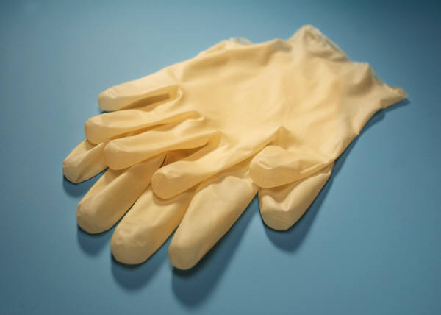
Hand Hygiene
Wear gloves when contact with blood, mucous membranes, or non-intact skin could occur.
Remove gloves after caring for patient. Do not wear the same gloves with more than one patient.
Wash hands after removing gloves.

Slide 11
Other Prevention tips
Avoid touching your eyes, nose or mouth.
Avoid close contact with others who are ill.
Clean things that are touched often: refrigerator handles, computer key boards, phones, etc.
Stay home when ill.

Slide 12
Corona Virus COVID-19
What is COVID-19 ?
  Respiratory Virus
  Cousin of the SARS and MERS virus
Symptoms:
  Runny nose
  Cough
  Sore throat
  Heachache
  Fever
Who is at highest risk?
  Elderly
  Young children
Treatment?
  Symptom management

Slide 13
Preventing the spread of COVID-19
Stay home except to obtain medical care
Separate yourself from other people and animals in the home
Call ahead before visiting your doctor
Wear a facemask
Cover your coughs and sneezes
Practice good hand hygiene
Avoid sharing personal household items
Clean all high-touch surfaces daily
Monitor/treat your symptoms

Slide 14
Adult Vaccination and Important Step in Protecting your Health
The CDC recommends that all adults get the following vaccines:
Influenza vaccine- every flu season
Td vaccine- every 10 years to protect against tetanus
Tdap vaccine-once instead of Td vaccine to protect against tetanus and diphtheria and whooping cough and during each pregnancy

Slide 15
Tetanus (Lockjaw)
Rare in the US
It causes painful muscle tightening, usually all over the body
Can lead to tightening of muscles in head and neck. Swallowing and breathing are affected.
Tetanus kills about 1 out of 10 people who are infected even with medical care
Tetanus enters the body through cuts, scratches, burns and wounds

Slide 16
Diphtheria
Also rare in the US
It can cause a thick coating to form in the back of the throat.
It can lead to breathing problems, heart failure , paralysis and death.

Slide 17
Pertussis (Whooping cough)
Causes severe coughing spells, which can cause difficulty breathing, vomiting and disturbed sleep
It can also lead to weight loss, incontinence, and rib fractures.
Up to 2 in 100 adolescents and 5 in 100 adults are hospitalized or have complications
Diphtheria and pertussis are caused by bacteria, spread by coughs and sneezing

Slide 18
The “Numbers”
Before vaccines, as many as 200,000 cases of diphtheria, 200,000 cases of pertussis and hundreds of cases of tetanus each year.
Since vaccination began, reports of cases of tetanus and diphtheria have dropped by 99% and for pertussis by 80%

Slide 19
Other Adult Vaccines
Other vaccines you need as an adult are determined by factors such as age, lifestyle , job, and health conditions
These vaccines include:
Hepatitis B, Shingles, Pneumonia
Measles, mumps, rubella, chickenpox
Meningococcal disease

