Slide 1
Welcome to Tufts Medicine Care at Home

Slide 2
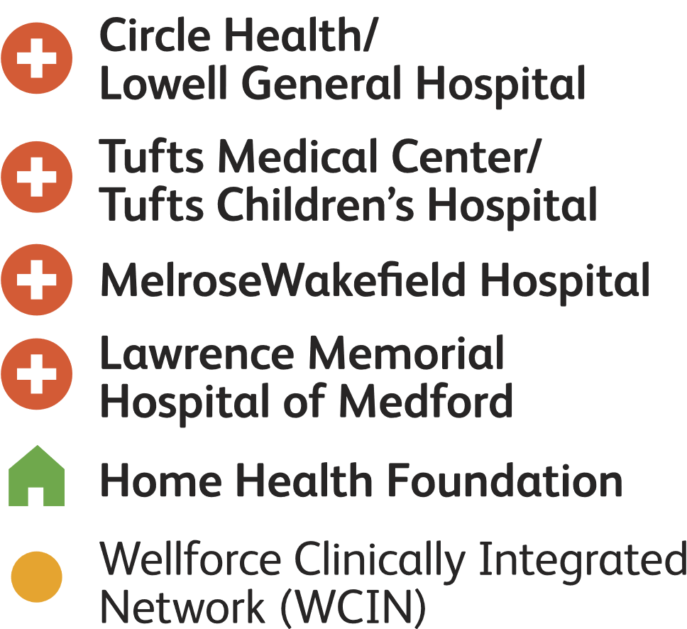
Tufts Medicine System
Market presence from Cape Cod to
the NH Seacoast
Sizing up the system
2,100+ physicians, 1 integrated network
1 Academic medical center
4 Community hospital campuses
1 Home healthcare organization
13,000 Employees
System statistics
1,010 Licensed beds
60,000 Inpatient discharges & bedded outpatients
1.4 Million outpatient visits
15,000 Home visits
190,000 Emergency room visits
23,000 Outpatient surgeries and OR cases

Slide 3
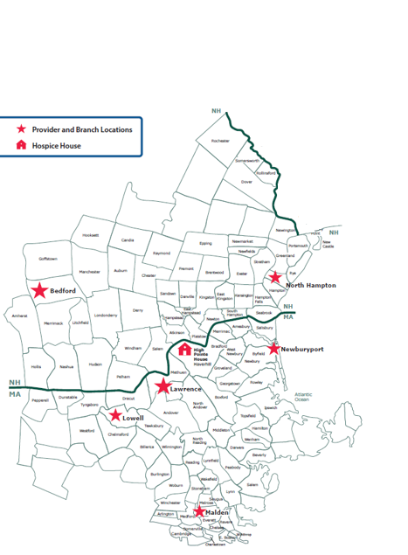
About Tufts Medicine Care at Home
Our continuum of care
Home health
Palliative
Hospice
Supportive services
Bereavement support
Volunteers
550+ healthcare professionals
RN, LPN and NP
Physicians
PT, OT and SLP
MSW, Chaplains, bereavement counselors
Administrative support
Serve 100+ communities in MA and NH

Slide 4
Care at Home Executive Leadership
President
Patricia O’Brien
Executive Assistant
Chief Medical Officer
VP of Quality, Compliance & Risk
Clinical Operations Manager
Dir of Referral Mgt & Transitions of Care
VP,
Home Health Services
Home Health Clinical Directors
Director of Supportive Care
Senior Hospice Clinical Manager
Referral/ Transitions of Care Manager
HHA
Manager
Home Health Clinical Managers
HR Director
Sr Director of Revenue Cycle
Director, Dev & Corp Comm
Senior Director of Finance
Interim Hospice Director
A/P Manager
Patient Access Manager
HPH Building Manager
Manager of Bereavement Services
Health Information & Compliance Manager
Accounting Supervisor

Slide 5
Notes:
Speaker: Mike D
Our Mission. This is why TuftsMedicine exists,why we all get up everyday.
It explains the impact we want to bring to every person in every community we have the honor to serve.

Slide 6
Notes:
Speaker: Mike D
Our Vision.
This is where we are headed, our guiding light and our true north.
Our vision directs our focus on goals and priorities.
It illuminates our shared purpose so we can focus on what matters most and will have the greatest impact on the communities and people we serve

Slide 7
Notes:
Speaker: Mike D
They define our how we serve and deliver care—to our colleagues, consumers and community.
They set expectations for how we act and treat each other—empowering all to feel valued, heard,and belong
They tell the world how we are different and the future vision we strive for.
They guide how we make decisions and ultimately how we fulfill our mission and vision.

Slide 8
Notes:
Speaker: Mike D
Our Six Values
One team sets the tone

Slide 9
Notes:
Speaker: Mike D hands off to Tanya Hahn to talk about the journey to identify our TVP

Slide 10
Notes:
Speaker: Tanya Hahn
And this….is our TVP

Slide 11
We are gamechangers for quality of care, by creating a frictionless experience and providing the safest environment for our team members and consumers.
Team Member
Value Proposition
Healthcare with Heart
Everyone is Included
We are dedicated to revolutionizing healthcare through teamwork and inclusivity. We strive to ensure that individuals are heard and respected, in an environment where they can be their authentic selves and opportunities are provided equally to everyone.
Notes:
Speaker: Tanya Hahn
So how are we going to bring the TVP to life?
There are four cornerstones to the value prop we arrived at. [Cite the four cornerstones] These are going to serve as the themes what we will bring to life in our recruitment advertising…whether it is on our careers site, in our sponsored job ads, the stories we highlight in social and paid media, in the collateral that we use throughout the talent life cycle….
We want to make sure that all of you, as leaders, help us reiterate these promises that we are making to our team members---both in the way you manage, develop and support them, as well as the way you talk to talent about why they should want to join us.
So we want you to feel well versed in what the meaning and intent is behind each of these pillars. [briefly talk through each one]

Slide 12
Diversity, Equity and Inclusion
Tufts Medicine Care at Home embraces diversity at all levels of our organization and strive to deliver culturally competent care to all of our patients. We are committed to exploring, understanding and respecting the differences that exist among our patients and our coworkers. Through these efforts, we can provide the most effective and highest quality of care to our ever-changing communities and create a culturally sensitive environment for our employees.

Slide 13
Leadership philosophy

Slide 14
Leadership philosophy
Everyone is valuable. They possess important ideas, are trustworthy, and have gifts to be shared with the organization.
People are deserving of respect, growth opportunities, shared responsibility and autonomy in their work.
TMCAH is best served by rewarding and showing appreciation to staff who feel their work is meaningful.
The workplace environment fosters growth, creativity, healing and trust. It is a place where people can express themselves with confidence.
Leaders should serve the needs of the people and the workplace in a manner that is authentic and humble.
I want to hear from you!
Ask-Listen-Change
Open door policy- contact Louisep@homehealthfoundation.org to make an appointment for a 1:1 chat

Slide 15
Thank You
Tufts Medicine Care at Home
360 Merrimack Street Suite 425 Lawrence, MA 01843

