Slide 1
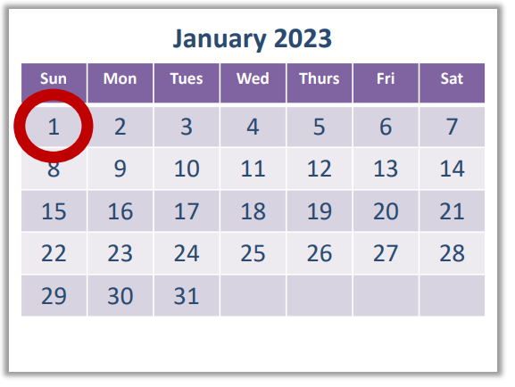
Oasis E Roll Out – Key Priorities
✓
✓
Effective Date: 1/1/2023
Report Date: 10/20/2022
✓
✓
 | Check Point Threat Extraction Secured This Document |  | Get Original

Slide 2
Why Oasis D to E

Slide 7
Dorothy/Comfort Changes

Slide 8
Social Determinants of Health – New Section A

Slide 10
✓
✓
✓

Slide 11
EPIC Question – BIMS – C0100

Slide 12
Brief Interview for Mental Status (BIMS) – C0200

Slide 13
EPIC Question – BIMS – C0200

Slide 14
EPIC Question – BIMS – C0300

Slide 15
EPIC Question – BIMS – C0400 and C0500

Slide 16
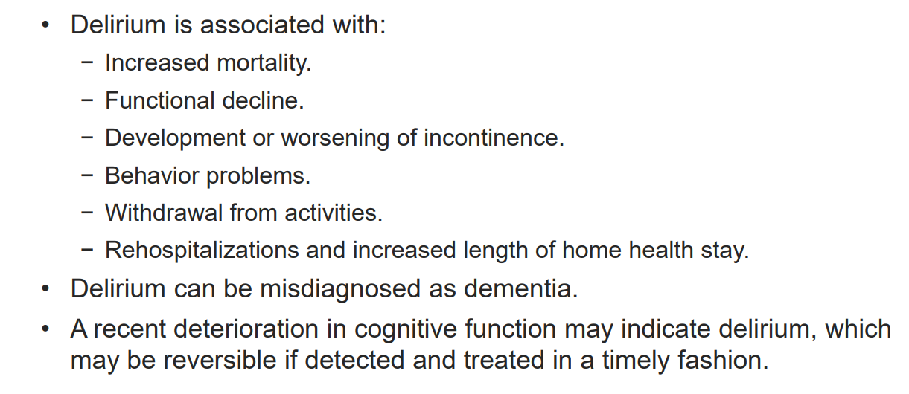
Key Definitions in CAM – C1310

Slide 19
EPIC Questions – PHQ - 9

Slide 20
Oasis Assessment Type Reference Sheet

Slide 21
Oasis D to Oasis E Crosswalk of Changes by Section

