Slide 1
SafetyNet
Tufts Medicine’s patient, employee and risk reporting and event management platform
Report Writer Training
March 2023
Kimberly Volpe, System Senior Director Patient Safety & High Reiliability
Christian DellaPiana, Quality Systems Analyst

Slide 2
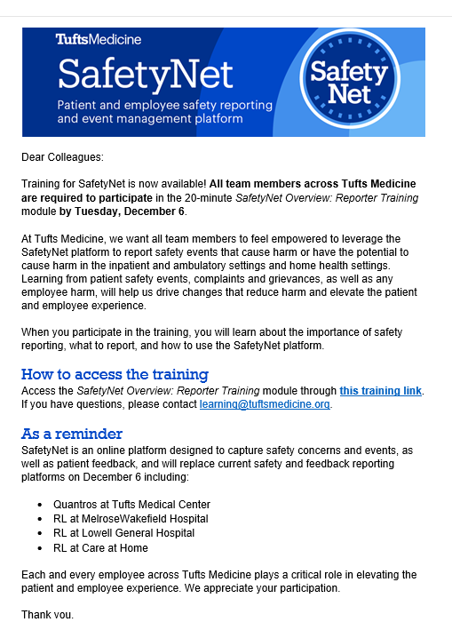
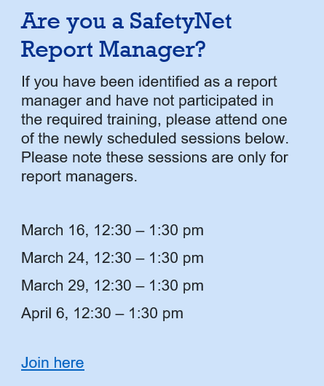
SafetyNet Report Writer Training
Prerequisite: Reporter Training and Report Manager Training
Mandatory 20 Minute Video Training for All Employees
Mandatory Virtual Live Session for File Managers

Slide 3
Security Role: What you are able to do in the system
Role: Front Line User
Access to report an event in the system. All TM employees can report an event in SafetyNet.
Role: File Manager
Access to manage an event in the system and write and/or view reports. There are different types of File Managers.
Role: System Admin
Manages access, software and related requests. Can also build “schedules”.

Slide 4
Scope: What you can see in the system
Front Line User
Scope is not applicable
File Manager
Scopes are built and maintained by system admins based on your entity, location, event type, position and/or other specific fields.
System Admin
Scopes are assigned based on a specific entity (local) or all entity (system-wide admin).

Slide 5
Who can write/build reports?
Current State: All file managers can write and/or view reports. (Over 1000 TM staff)
April 1st: Report writing will only be permitted by file managers who participate in the require training.
File managers who do not attend the required training will have report view-only access.

Slide 6
Why will report writing be limited?
Report writers are able to download reports from Safety Net (excel, PDF) and share the reports in a presentation.
The information listed in Safety Net reports = Patient Safety Work Product.

Slide 7
The Patient Safety & Quality Improvement Act of 2005 (PSQIA)
  The Patient Safety and Quality Improvement Act of 2005 (Public Law 109-41), signed into law on July 29, 2005, was enacted in response to growing concern about patient safety in the United States and the Institute of Medicine's 1999 report, To Err is Human: Building a Safer Health System.
  The 1999 Institute of Medicine report established that:
  Preventable adverse healthcare events resulted in 44,000 to 98,000 deaths per year in the U.S.;
  Preventable errors were costing $29 billon annually in unnecessary healthcare expenses; and
  State “peer review” protections were limited in scope and inadequate to encourage and accelerate data collection and analysis, particularly across state lines or nationally.
PSQIA purpose:
  Create a secure environment for reporting, sharing, and learning about medical errors.
  Establish platform to evaluate medical errors & patient harm
  Reduce cost of care associated with errors and harm
  Develop standardized format for PSOs to collect, analyze, and aggregate data.

Slide 8
What is Patient Safety Work Product (PSWP)?
PSWP is the information protected by the privilege and confidentiality protections of the Patient Safety Act and Patient Safety Rule. PSWP may identify the providers involved in a patient safety event and/or a provider employee that reported the information about the patient safety event. PSWP may also include patient information that is protected health information as defined by the Health Insurance Portability and Accountability Act (HIPAA) Privacy Rule (see 45 CFR 160.103).
https://pso.ahrq.gov/
Tufts Medicine High Reliability Institute – system-wide education to be provided during FY23.

Slide 9
How do you share PSWP and comply with the Patient Safety Act?
“ Patient Safety Work Product: Peer Protected, Privileged and Confidential” is auto-listed as a footer in each page of report. Do not delete this footer when downloading or sharing.
The following three slides must be added to all slide presentations that contains PSWP.

Slide 10
Confidential / Privileged
SUBJECT TO TUFTS MEDICINE SYSTEM-WIDE CONFIDENTIALITY AGREEMENT
By joining today’s discussion, you agree to afford the Confidential Information generated by one Tufts Medicine Provider the same privileges and immunities of M.G.L. Chapter 111, §§ 204 and 205, and 243 CMR 3.00, as the generating Tufts Medicine Provider would. The sharing of information is subject to the Tufts Medicine System Confidentiality Agreement with the purpose of improving patient safety and quality.

Slide 11
Confidential / Privileged
SUBJECT TO PATIENT SAFETY ACT AND CONFIDENTIALITY OBLIGATIONS
This safe table is subject to the Patient Safety and Quality Improvement Act of 2005 (the “Patient Safety Act”), 42 U.S.C. § 299b-21 et seq., and the regulations promulgated thereunder at 42 C.F.R. Part 3 (the “Patient Safety Rule”) (together, the “Patient Safety Act and Rule”), and pursuant to Tufts Medicine’s membership with the CRICO AMC PSO.
The purpose of this safe table is to improve the safety and quality of patient care delivery.

Slide 12
Confidential / Privileged
SUBJECT TO PATIENT SAFETY ACT AND CONFIDENTIALITY OBLIGATIONS
All discussions and deliberations are Patient Safety Work Product, which is confidential quality information, but your learnings can be shared with your provider entity and colleagues.
All notes and other written information developed during this meeting should be marked as “PSWP Confidential.” The information is privileged even without the marking.
Providers cannot disclose “Patient Safety Work Product” except under a permitted disclosure and are subject to penalties of up to $11,000 per violation for knowingly or recklessly violating the confidentiality provisions. The privacy rights are enforced by the Office of Civil Rights.

Slide 13
SafetyNet System: Report Writing

Slide 14
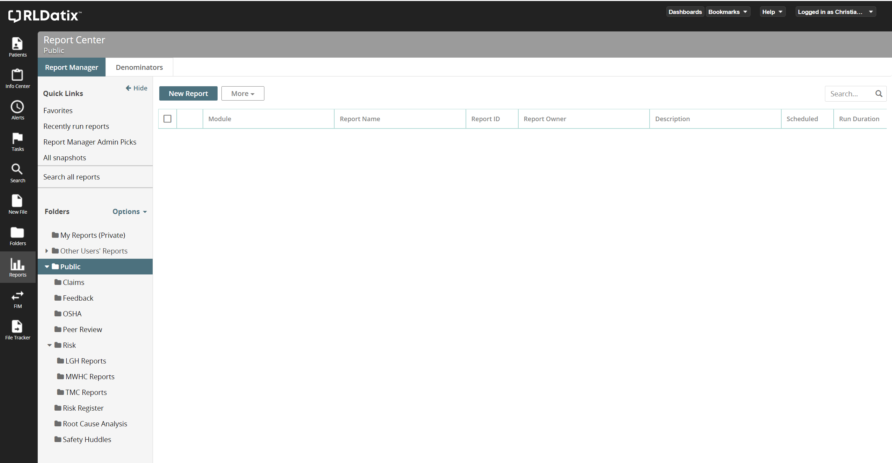
SafetyNet Reporting
Notes:
Reports Icon – Used to open Report Center
New Report Button – Click to create a new report
My Reports (Private) – Personal folder where you can save your reports so that only you can see/use them.
Recently Run Reports – Shows all of the reports that you have recently run. If you make a change and the report has an error, you can go here to open up a previously run version of the report before the change was made.
Favorites – Checking the star icon next to a report so that it fills in will add it to your Favorites menu.
Public Folder – This is where all public reports are shared
Risk Folder – Risk Module reports should be saved within the Risk folder or a subfolder of Risk. Exceptions can be made. Example the OSHA folder has OSHA related reports.
Subfolders – Subfolders have been set up for Entity specific reports.
Search – Current Folder – This search will only search the current folder of reports.
Search All – This will search will give you a dialog box to enter keywords, folders, dates, etc to focus your search. It is not limited to just one folder.

Slide 15
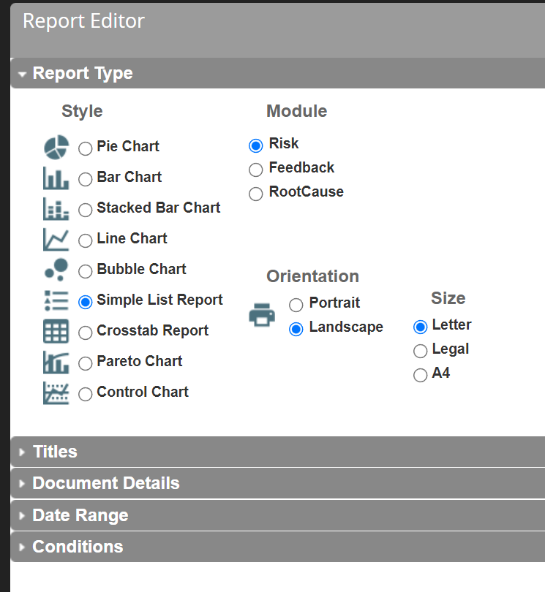
Report Type
2
3
1
4
Notes:
Style – Chose which style of report you want to build. Important to note, if you switch from list report to a chart report, all data will be erased. Going from Line to Bar Chart is ok.
Module – Most won’t have an option here, but if you do, select Risk as that is the only module we are currently utilizing. Our Feedback data is in the Risk module.
Orientation – Choose what layout will work best for your report. Most reports will benefit from the extra width of a landscape report.
Paper size – The default is letter.

Slide 16
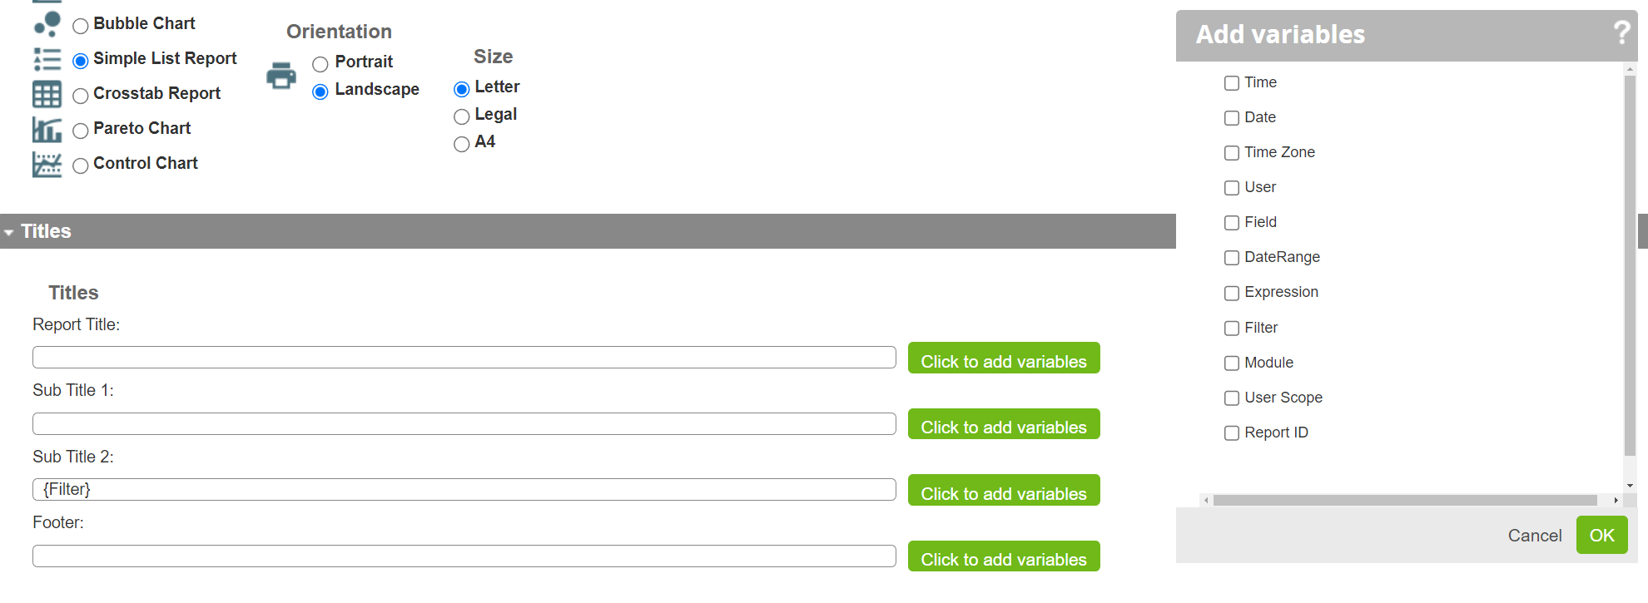
Report Titles
5
1
2
3
4
Notes:
Report Title – This is the top title of the report and is in the largest font.
Sub Title 1 – This is a smaller font line just under the Report Title
Sub Title 2 – This is the second sub title under the Report Title.
Footer – This is the line at the bottom of the report, but above the privacy statement on all reports.
Variables – These are the available variables that can be added to any of the title or footer lines. Filter (list of all the conditions) is being used on line 3 in this image. You can have multiple variables on one line and can add additional text around the variables.

Slide 17
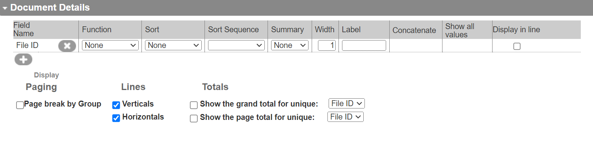
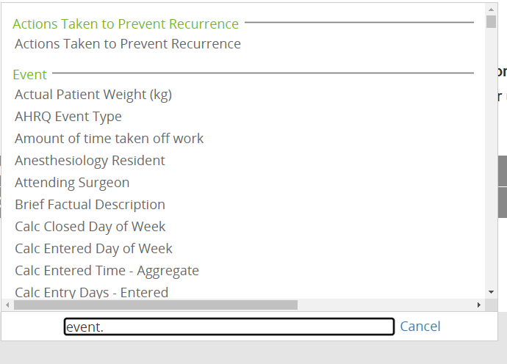
Document Details - Simple List Report
Notes:
Document Details – Clicking the + is how to add a new field to the report output. The box on the right is the field list. By entering a word with a period at the end with filter the section headers. In this case event. is being used to get all of the fields in the event category. You can also just type the field name to do a search for the field if you know the exact name.
You can also add page breaks, visual lines on the report, and page and grand totals.

Slide 18
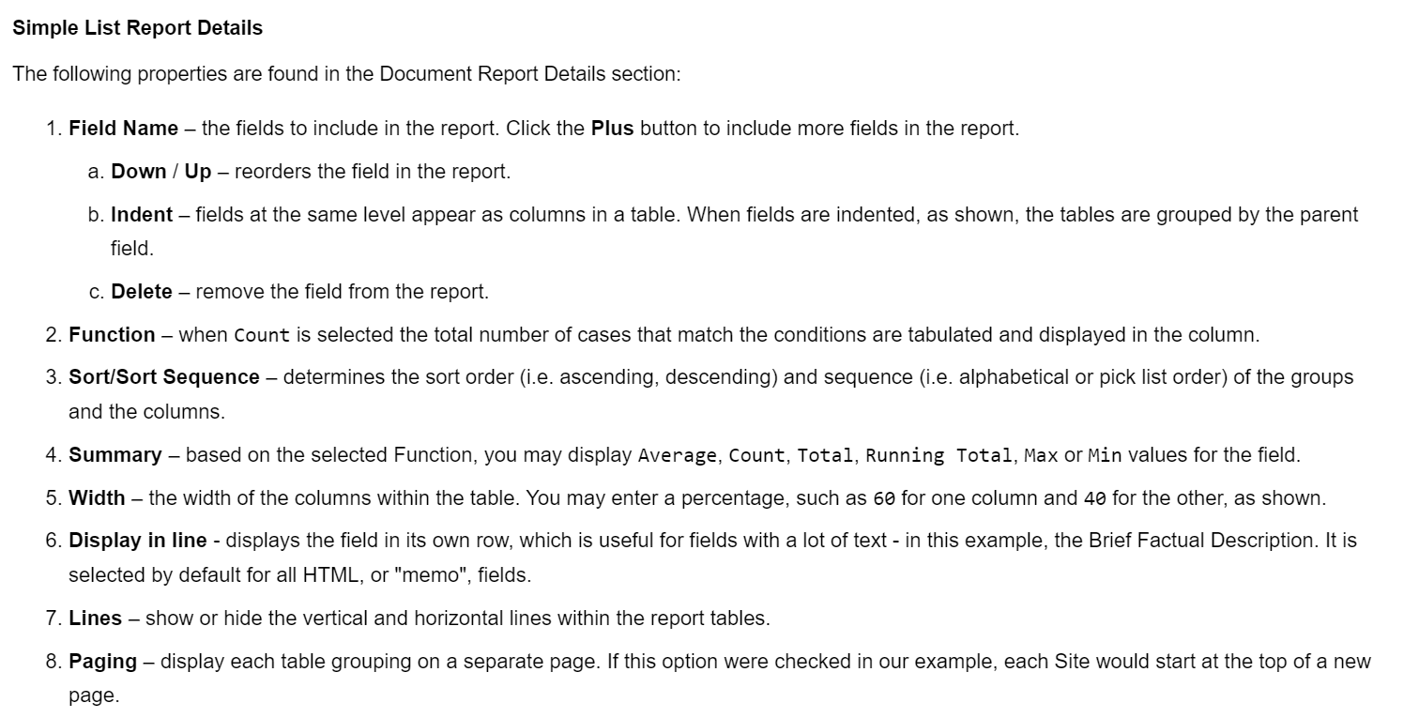
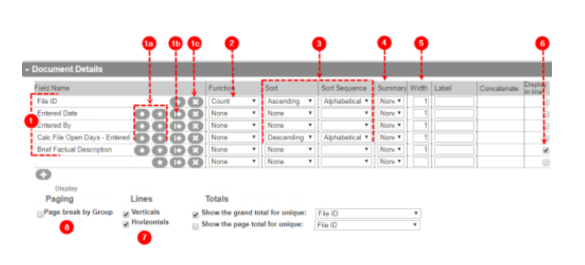
Document Details - Simple List Report

Slide 19
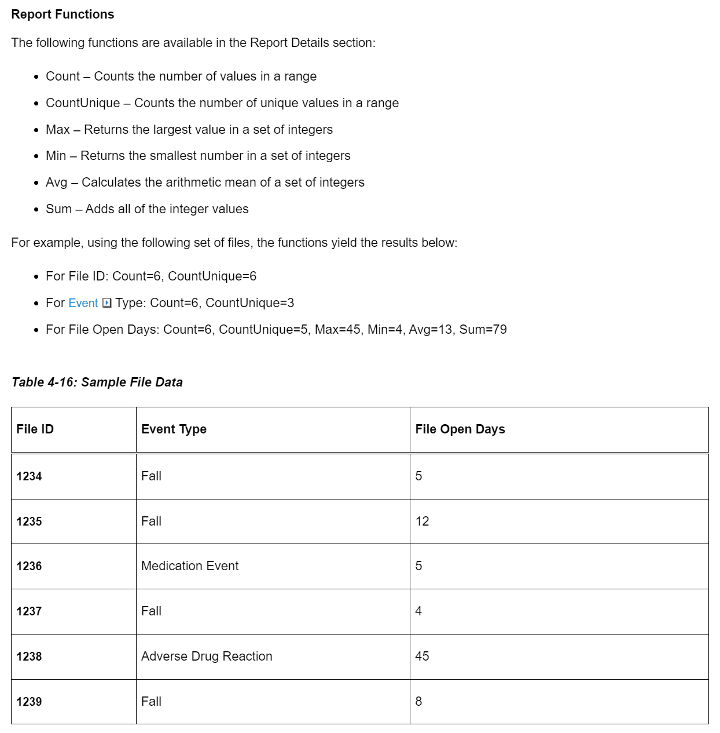
Report Functions

Slide 20
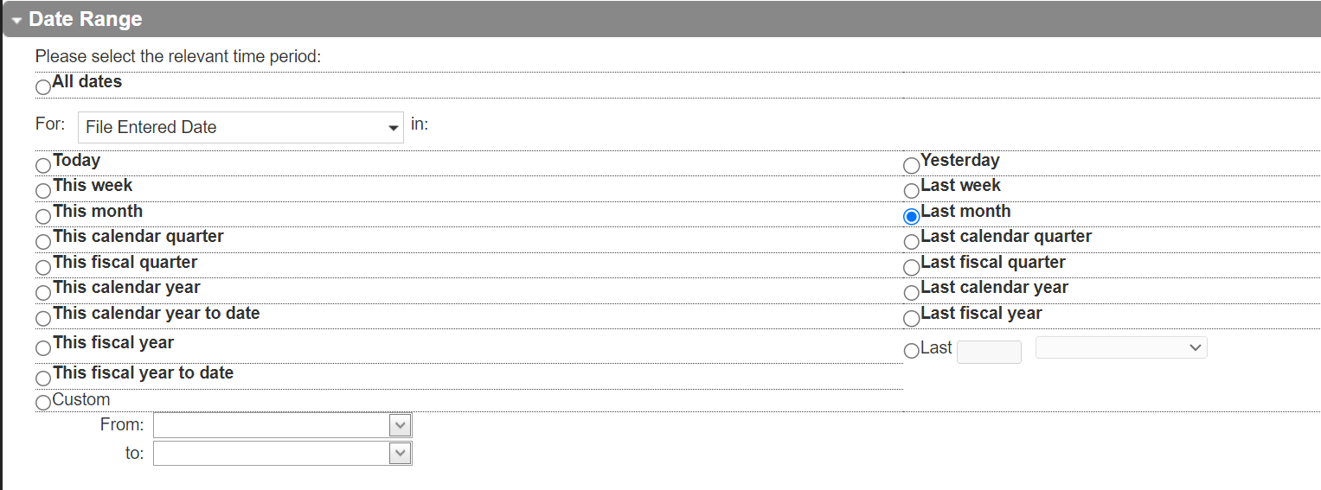
Date Range
4
1
2
3
6
5
Notes:
All dates – use this option when you want all events regardless of date
For Date – In order to use any of the specific date elements, you must select which date field to use for the range.
Left Side – These are for Today or the current time (ie. Current week, month, quarter, year, etc)
Right Side – These are for Yesterday or the past time (ie. Last week, month, quarter, year, etc)
Last X – This option allows you to specify the last so many of whatever time frame you want to use. (ie. Last 12 months, last 7 days, last 2 years, etc)
Custom Range – This allows you to enter a specific start and end date.

Slide 21
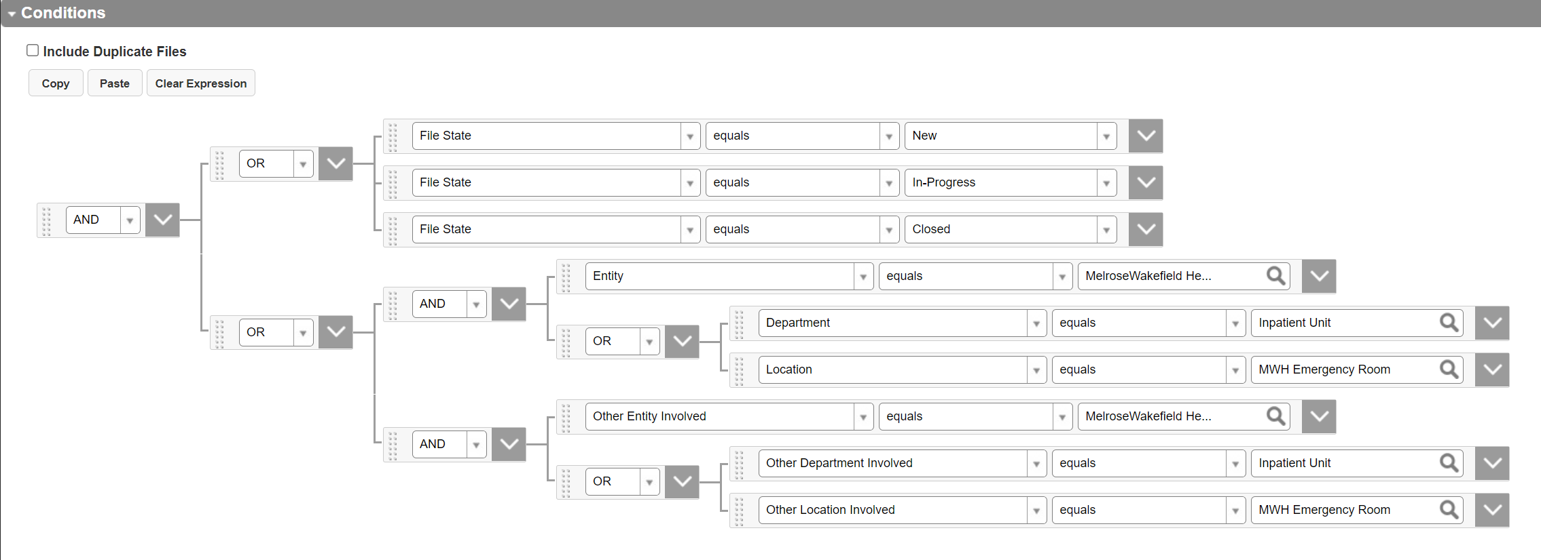
Conditions
Notes:
Ands and Ors –
AND – All lines must be true
OR – One line must be true
IS ONE OF – Can be used in place of multiple Equals lines with OR function.

Slide 22
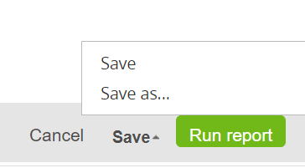
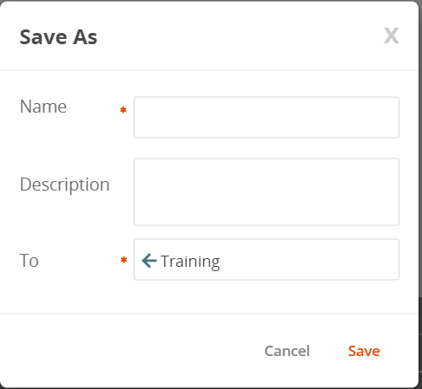
Saving and Running a Report
Click Save to get Save and Save As options.
Save will overwrite existing report
Save As will allow you to save the report with a new name and/or new location
Click Run Report to generate the output of the report
Notes:
Click Save to get Save and Save As options.
Save will overwrite existing report
Save As will allow you to save the report with a new name and/or new location
Use left arrow in the To box to go back a level in the folder heirarchy
Click Run Report to generate the output of the report

Slide 23
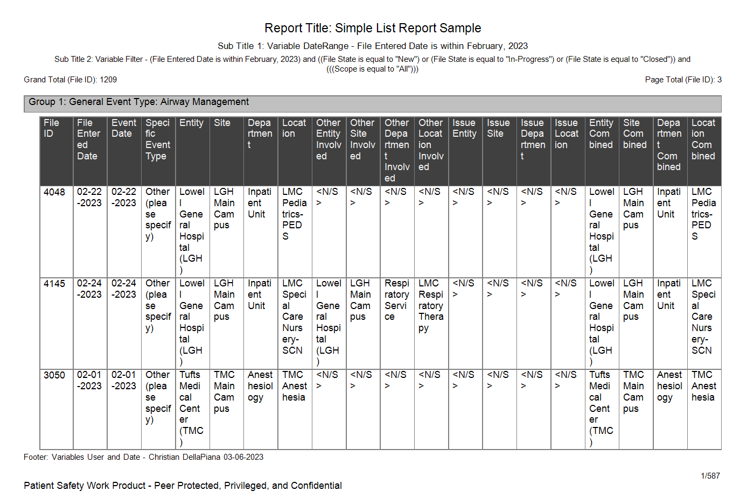
Simple List Report
Notes:
Simple List Report –
Headers/Footers
Privacy Statement
Group 1 – Indenting on the details section creates groups
Field List – If you want a long field to have its own line, select display in line
Totals – Grand Total / Page Total
Page counter

Slide 24
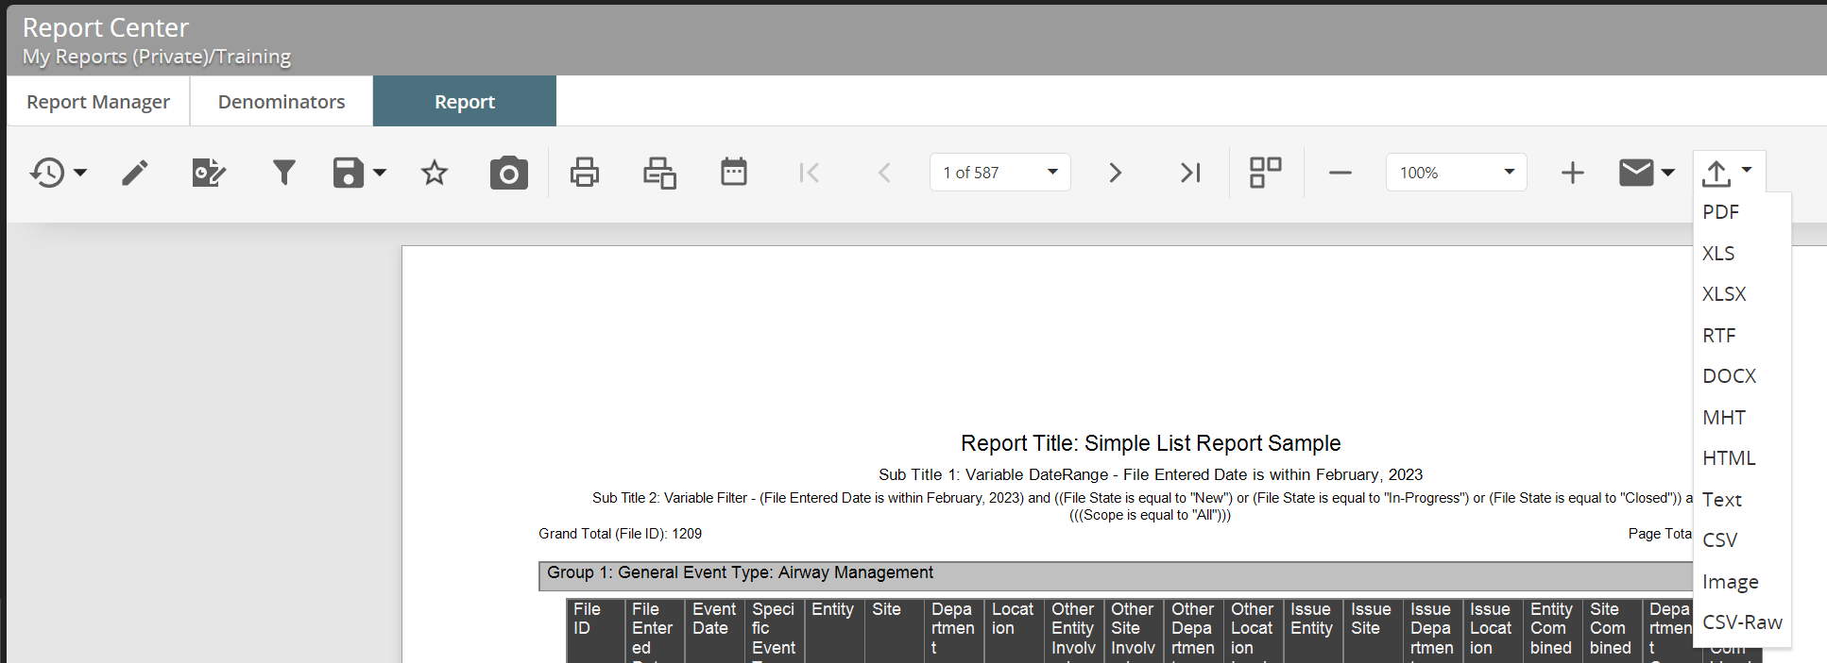
Report Output Screen
1
2
3
4
5
6
7
8
Notes:
Previously Run Reports – List of previously run reports
Edit Report – Click this to go back in to edit the report
Filter – Click this to bring up a pop-up window of the conditions that can be edited on the fly.
Save – Save or save as
Star – Favorite this report
Camera – Snapshot – Make a snapshot of this report, Saves the data from this exact report so that it can be referenced in the future without any data changing.
Date Range – Click this to edit the date range of the report on the fly.
Export formats – Select csv-raw to get an unformatted report with all fields for each record on a single line.

Slide 25
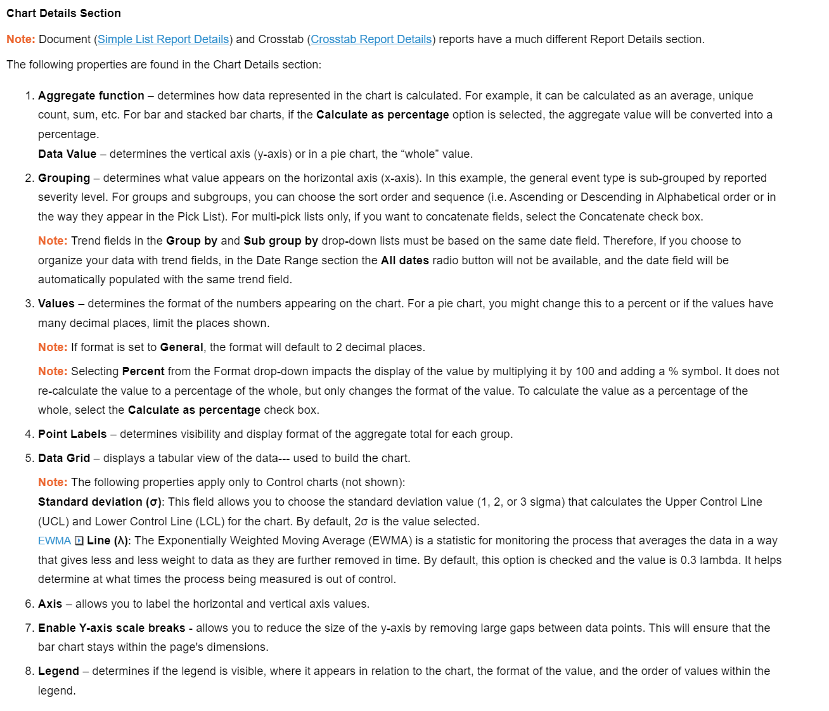

Slide 26
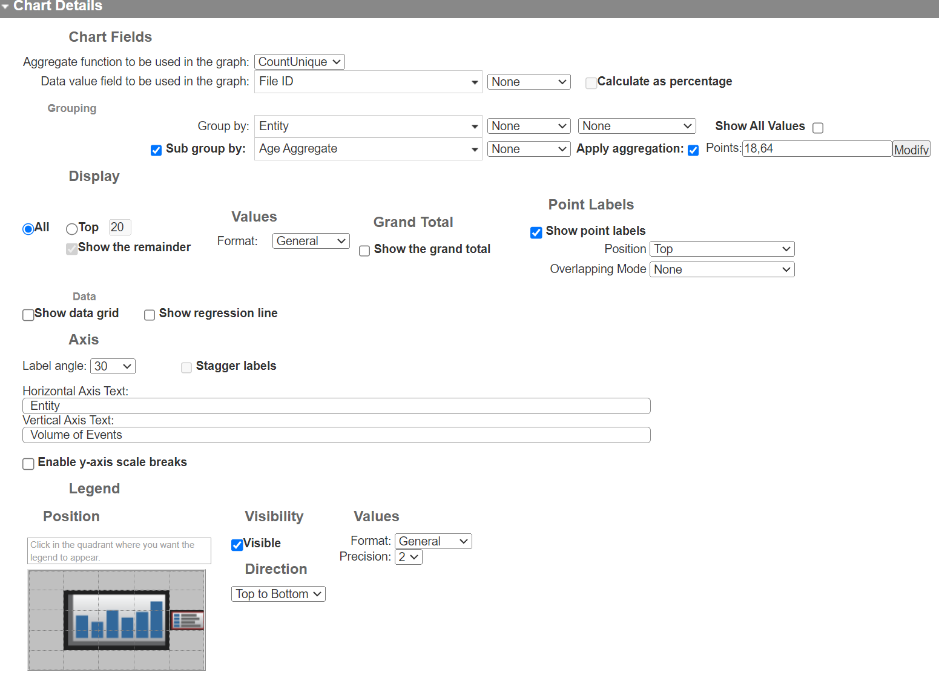
1
2
3
4
5
6
7
8

Slide 27
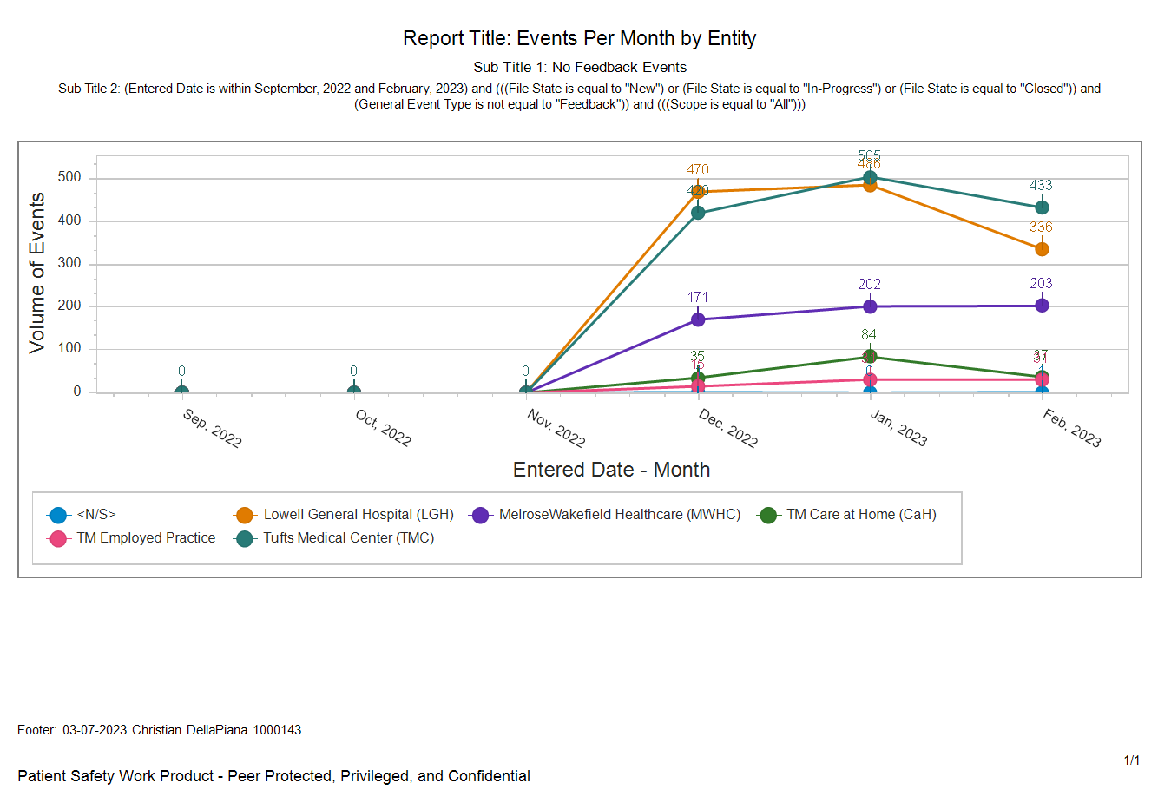
Line Chart
Notes:
No Data prior to go-live Dec 6, 2022.
N/S means no value in the Entity field

Slide 28
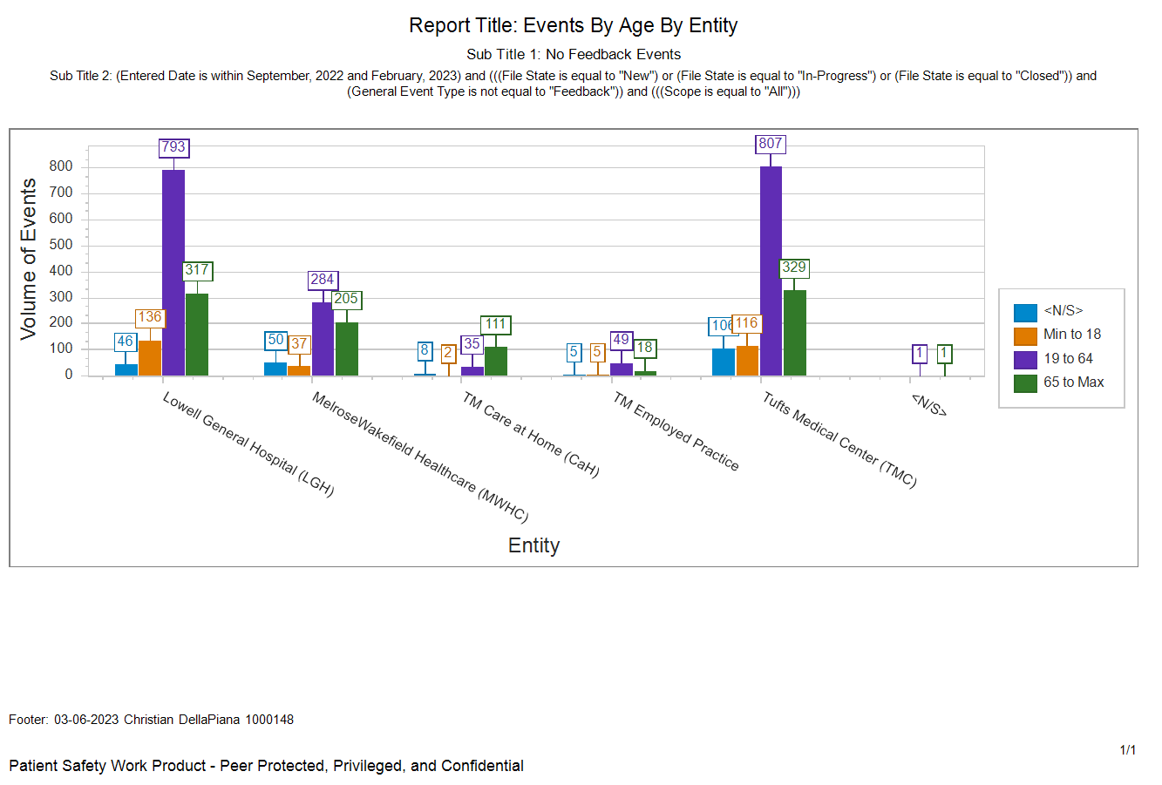
Bar Chart
Notes:
This report uses the aggregation option where you can specify ranges for a numeric field. In this case, age is bucketed into 0-18, 19-64, and 65+. N/S means the event isn’t associated with a person or the age is not available.

Slide 29
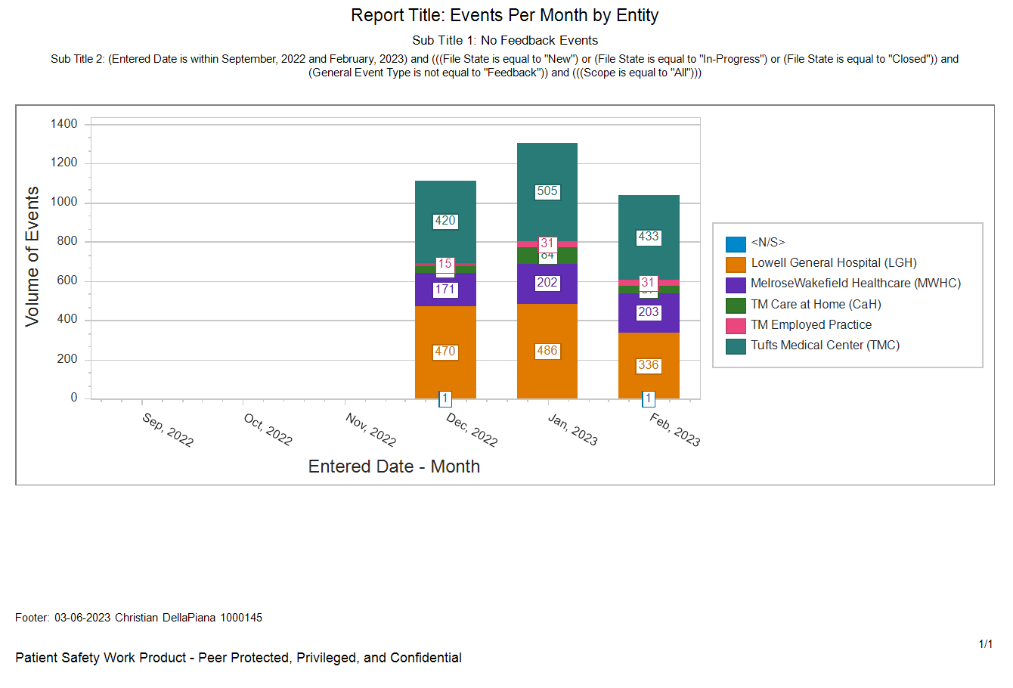
Stacked Bar Chart

Slide 30
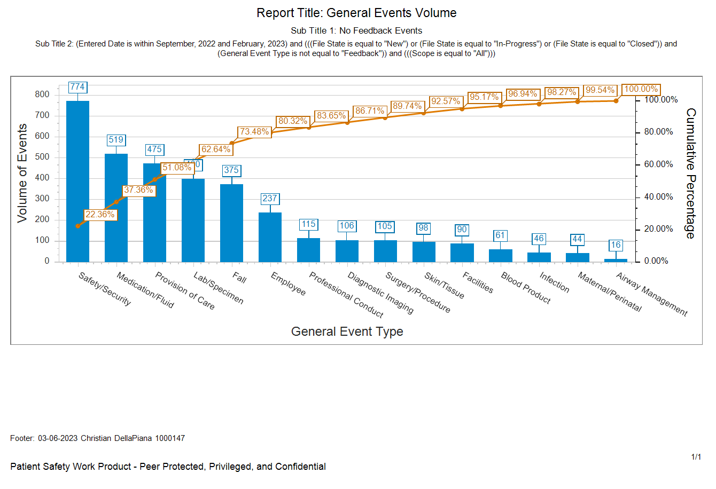
Pareto Chart
Notes:
Pareto – 80/20 rule. 80% of the effects come from 20% of the causes

Slide 31
SafetyNet System: Report Writing
What’s Next?

Slide 32
We are here to help!
A second training session (duplicate) will be schedule prior to the end of March.
Open Hours: Virtual Open Hours will be held every Friday from 10-11am starting on March 17th. Use this link to join:
Join on your computer, mobile app or room device
Click here to join the meeting
Meeting ID: 223 955 344 43
Passcode: XkZKBC
Email if you need immediate assistance when attempting to build a report.
Initiate a Service Now ticket if you would like us to create a report for you.

Slide 33
Risk, Patient Safety, Quality & Report Management Assistance is always available:
Lowell General Hospital
Barbara Fox Miles (Risk Management & SafetyNet System Administrator) Barbara.FoxMiles@tuftsmedicine.org
Melrose Wakefield Hospital
Kayla McEachern Kayla.M.McEachern@tuftsmedicine.org (Risk Management)
Meaghan Vercellin Meaghan.Vercellin@tuftsmedicine.org (Risk Management)
Christian DellaPiana Christian.DellaPiana@tuftsmedicine.org (SafetyNet System Admin)
Tufts Medical Center
Beth Jackson bjackson4@tuftsmedicalcenter.org (Risk Management)
Christina Kazazian ckazazian@tuftsmedicalcenter.org (SafetyNet System Admin)
Tufts Medicine Care at Home
Donna Beaudin Donna.Beaudin@tuftsmedicine.org (Risk Management)
Jennifer Moran Jennifer.Moran@tuftsmedicine.org (SafetyNet System Admin)
Shirley Jackson Shirley.Jackson@tuftsmedicine.org (SafetyNet System Admin)
Tufts Medicine Corporate & TMIN
Kimberly Volpe Kimberly.Volpe@tuftsmedicine.org (SafetyNet System Admin)

