Slide 1
Skills Fair 2020
OAsis

Slide 2
Poll instructions
Text Corporatecom189 to 22333
Text 1 to start then you should receive a reply with the link

Slide 3
rules to follow
Report what the patient can do safely not just what the patient can do
report pt ability not willingness
Direct observation is best practice
Score from the bottom up
Consider physical impairments, medical restrictions, and environmental barriers
Assistance is verbal cues, reminders, standby assist or hands on assist
report at what the patient can do safely not just what the patient can do

Slide 4
Additional documentation requirements
1. Pain/discomfort interfering with movement/activity
2. Dyspnea
3. Ambulation: Ability to walk safely once in a standing positon or wheel self once in the wheel chair
4. Transfers: Ability to move from supine to sitting to the nearest seating surface
5. Toilet Transfer: Ability to get to and from and transfer on off toilet or use beside commode
6. Dressing LE
7. Dressing UE
8. Bathing:
9. Pt requires what level of assistance with task of bathing
10. Oral Medication management: Pts current ABILITY not willingness to take medications
11. Grooming

Slide 5
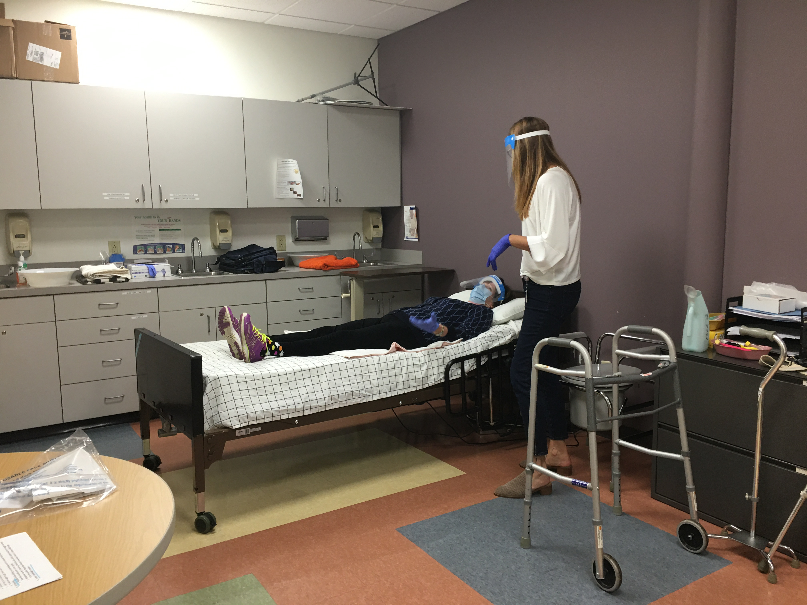
OASIS Video

