Slide 1
Hospice Services: Eligibility, Levels of Care, & Documentation

Slide 2
What Is Hospice Care?
- Philosophy of care focused on comfort, not cure 🕊️
- Serves individuals with life-limiting illnesses and prognosis of ≤ 6 months 📆
- Interdisciplinary team approach 👨‍⚕️👩‍⚕️🧑‍⚕️
- Emphasis on quality of life and dignity ❤️

Slide 3
Eligibility for Hospice Services
**CMS Requirements (42 CFR §418.20):** & **Massachusetts (105 CMR 141):**
- Terminal illness with life expectancy ≤ 6 months
- Election of hospice benefit
- Certification by physician and hospice medical director

Slide 4
Election of Hospice Benefit
- Patient/legal rep signs election statement
- Acknowledges:
• Palliative not curative
• Waiver of curative Medicare benefits
- Effective first day of hospice care

Slide 5
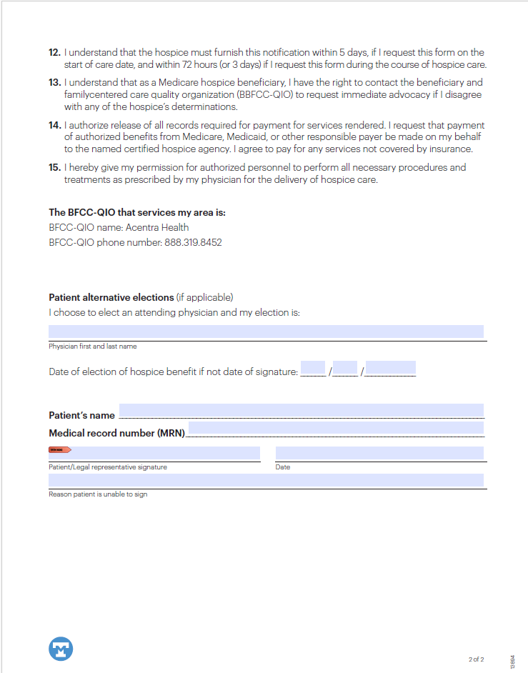
Notice of Election –Patient Form (TMCAH)

Slide 6
Notice of Election - MassHealth

Slide 7
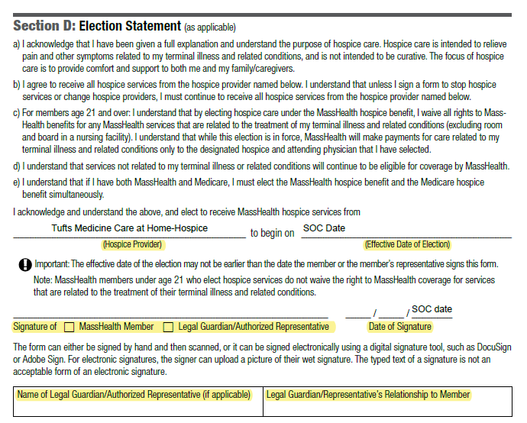
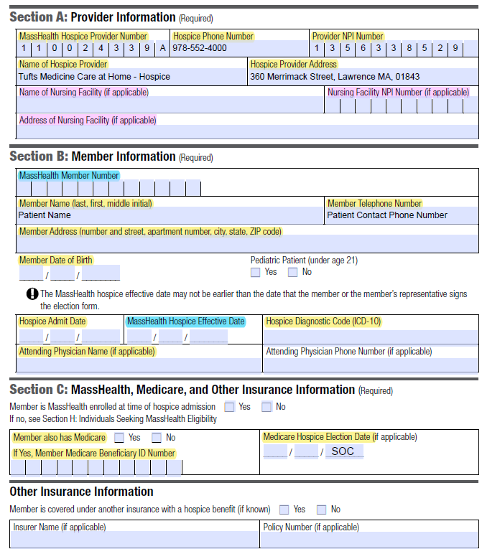
For Existing MA Health Member – ELECTING HOSPICE – Sections A, B, C and D

Slide 8
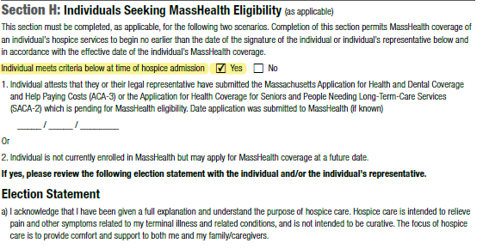
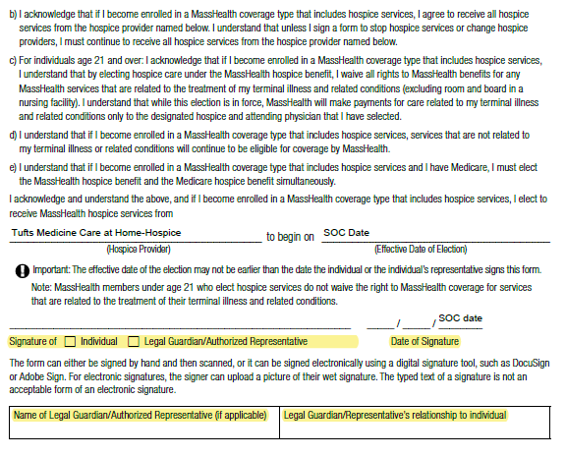
For Individuals SEEKING MA Health– SEEKING ELIGIBILITY/MA HEALTH PENDING – Sections A, B, C and H
OR Individual is IN A SKILLED NURSING FACILITY

Slide 9
Levels of Hospice Care
1. Routine Home Care – Default, at home 🏠
2. Continuous Home Care – Crisis, ≥8 hrs/day 🛌
3. General Inpatient Care – Acute symptom mgmt. 🏥 (High Pointe House)
4. Respite Care – Short-term inpatient relief 💤 (High Pointe House)

Slide 10
Interdisciplinary Team (IDT)
- IDT develops and updates plan of care every 15 days
🤝
👨‍⚕️
Physician
🧹
👩‍⚕️
✝️
🧑‍🤝‍🧑

Slide 11
Required Services
- Nursing, medical social, and physician services
- Counseling: spiritual, bereavement, dietary
- Aide and homemaker services
- Therapies: PT, OT, ST as needed
- Meds, DME, supplies related to terminal illness
💊
🩺
Meds& Supplies
🏃
🧘
🧹

Slide 12
Plan of Care (POC) Requirements
- Developed at admission, reviewed every 15 days
- Includes:
• Diagnosis/prognosis
• Medications
• Interventions
• Psychosocial/spiritual needs
- CMS: 42 CFR §418.56

Slide 13
Documentation Requirements
- Initial/Comprehensive Assessment: within 48 hrs (HIS/HOPE)
- Visit Notes: timely, accurate
- POC Updates: IDT meetings documented
- Physician Certification:
• Initial: within 2 days
• Recert: Day 90, 180, then every 60 days
- MA: 105 CMR 141.210 – Clinical Records

Slide 14
Massachusetts-Specific Regulations
- Maintain MA DPH licensure
- Compliance with:
• Infection control
• Emergency preparedness
• Personnel requirements
- Medical record retention: ≥5 years

Slide 15
Quality Assurance & Compliance
- QA/PI program (CMS §418.58)
- Monitor:
• Symptom mgmt
• Documentation timeliness
• IDT effectiveness
- Report to CMS/MA: HIS, CAHPS

Slide 16
Summary
- Comfort care for terminal illness
- Requires physician certification & election
- Four levels of care
- Documentation ensures compliance
- MA rules align with CMS with added detail

Slide 17
Questions & Discussion

