Slide 1
Home Health Services:
Criteria, Eligibility & Compliance
Tufts Medicine Care at Home
June 2025

Slide 2
What Are Home Health Services?
💉 Skilled healthcare delivered 🏠 At the patient's home.
Supports recovery, chronic illness management, 💪 Independence.
Governed by 🧾 Regulations: CMS, State

Slide 3
CMS Conditions of Participation (CoPs)
Patient rights and responsibilities.
Comprehensive assessment & plan of care.
OASIS
Coordination – IDT and Physician
QAPI - Quality Assurance and Performance Improvement
SafetyNet
PIC-Performance Improvement Committee
Emergency preparedness
Organization
Patient
Employees
Staffing
Credentialing initial/on-going
CORI

Slide 4
Who Is Eligible for Home Health?
✅ Homebound? As define by CMS
✅ Need for skilled care? (Skilled nursing, PT, OT, Speech)
✅ Face-to-face visit? (90 prior to SOC or 30 days after SOC)
✅ Under plan of care?
✅ Under the care of a physician /allowed practitioner

Slide 5
Homebound Criteria
Leaving home requires considerable effort.
Allowed for limited absences: medical, religious, adult day care.
Brief non-medical outings allowed (e.g., family event).
Meets Criteria | Does Not Meet Criteria
Lab test | Daily nursing home visit
Funeral | Family vacation
Adult Day

Slide 6
Medicare-Covered Home Health Services
🩺 Nursing
🏃 PT/OT/ST
🧠 MSW
🧑‍🦯 Aide
🦽 DME (billed separately)

Slide 7
Admission Criteria
Physician referral and plan of care.
Initial assessment within 48 hours.
Plan of care must detail all services, frequency, and goals. Must be related to the referral
Plan of care must be reviewed and signed every 60 days.
60-day recertification required.
(Build a timeline)
Physician referral → Assessment (48 hrs) → Plan of Care → Review every 60 days

Slide 8
Limitations & Non-Covered Services
🚫 24-hour care
🚫 Homemaking and meal delivery (unless medically required)
🚫 Personal care outside aide duties

Slide 9
Discharge from Home Health
Goals achieved or services no longer needed.
No longer meet eligibility (e.g., not homebound).
Patient requests or safety concerns.
(insert flow chart)
Eligibility ends → Safety/Request → Notice provided → Care ends

Slide 10
Discharge from Home Health
HHCCN - Home Health Change of Care Notice
This notice is used to inform Medicare beneficiaries of changes to their plan of care, such as reductions or terminations of services. It's also used to inform beneficiaries of changes in their plan of care due to a physician's orders or the home health agency's decision to reduce or stop providing services.
NOMNC - Notice of Medicare Non-Coverage
The NOMNC informs the beneficiary that their care is ending and provides information on how to request an expedited determination from a Beneficiary and Family Centered Care Quality Improvement Organization (BFCC-QIO)

Slide 11
HCCN

Slide 12
NOMNC

Slide 13
Patient Rights & Responsibilities
Rights | Responsibilities
To Be Informed | Report Changes
To Make Decisions | Cooperate with Plan of Care
To be Notified of Services and Frequency | Provide Safe Environment for Care
To Refuse Care | Provide Accurate Insurance info
To Appoint a Family Member to Exercise Your Rights | Inform TMCAH about POA/HCP
Privacy | Inform TMCAH of Issues or Concerns
Non-discrimination | Treat Clinicians with Respect
Accessibility
File complaints
*Additional Rights and responsibilities are outlined in the patient handbook

Slide 14
Agency Responsibilities
Staff Credentialing (initially qualified and ongoing education)
Timely Service and Coordinated Services.
Compliance with CoPs, QAPI, emergency preparedness.

Slide 15
Timely Service and Coordinated Service Notice Of Admission
Legal documentation
Must be submitted to Medicare with 5 days of SOC
Must leave a copy in the patient’s home.

Slide 16
Timely Service and Coordinated Service Notice Of Admission /Consent Forms

Slide 17
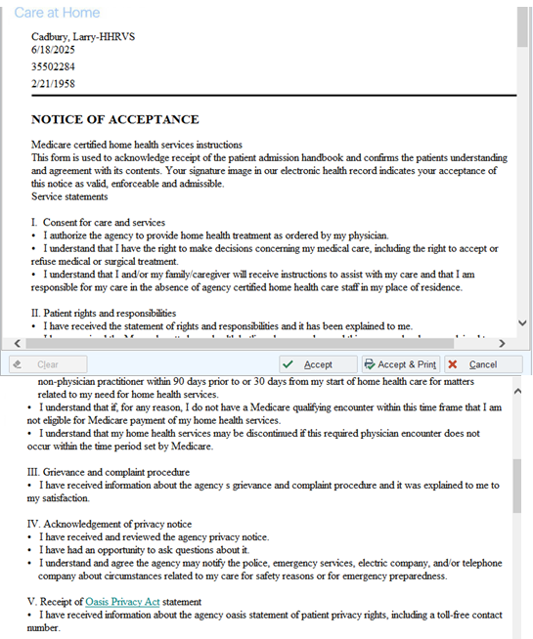
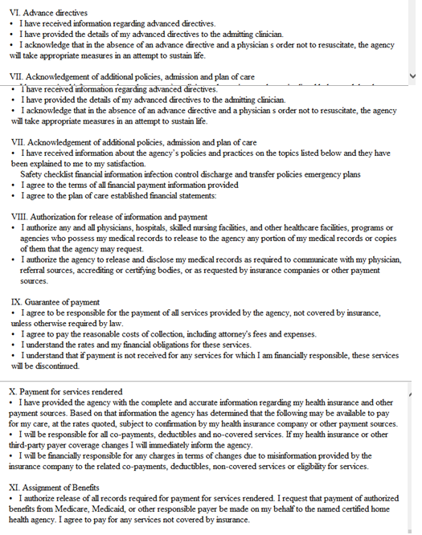
Timely Service and Coordinated Service Notice Of Admission -EPIC

Slide 18
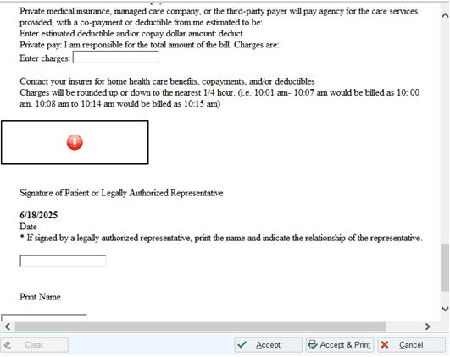
Timely Service and Coordinated Service Notice Of Admission -EPIC

Slide 19
Timely Service and Coordinated Service Notice Of Admission –EPIC/Remote Client

Slide 20
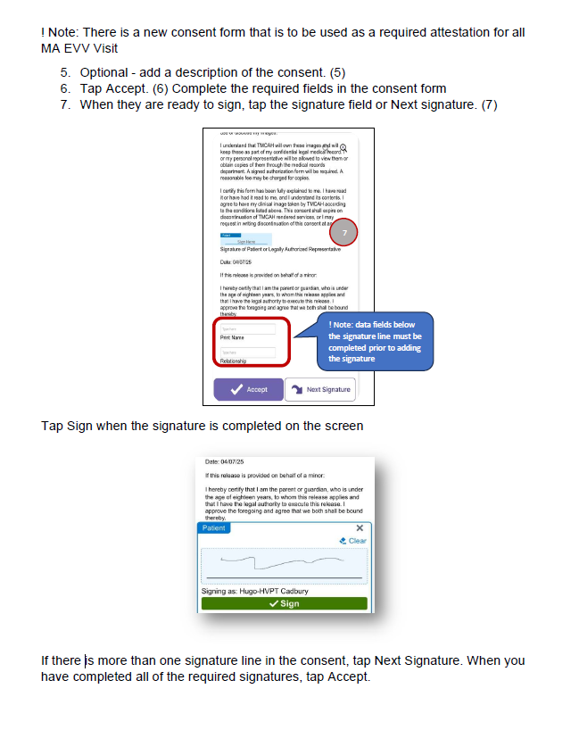
Timely Service and Coordinated Service Notice Of Admission –EPIC/Rover

Slide 21
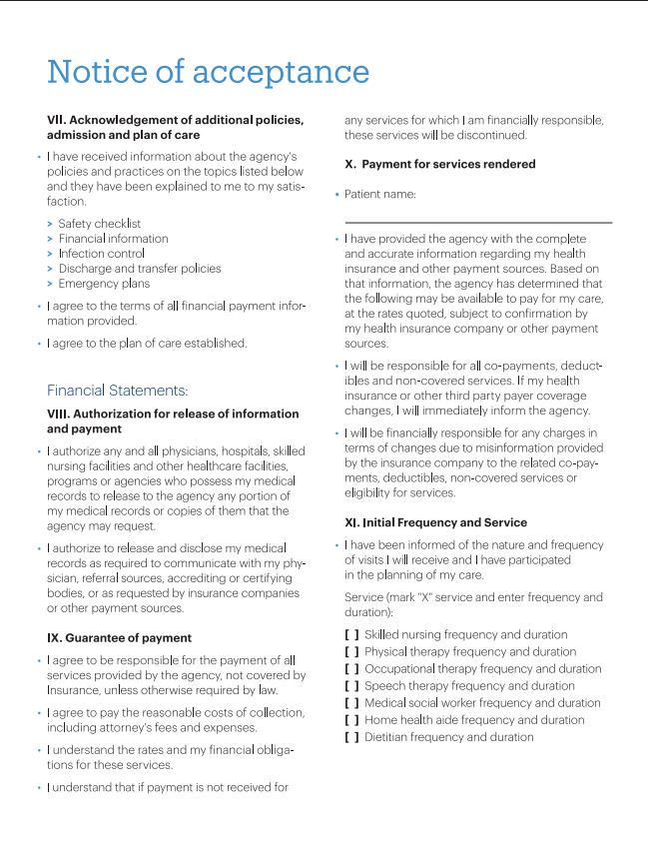
Timely Service and Coordinated Service Notice Of Admission –Patient Handbook

Slide 22
Timely Service and Coordinated Service Notice Of Admission –Patient Handbook

Slide 23
Quality Measures & Compliance
OASIS data collection.
HHCAHPS survey results. (should I add SHP link?)
CMS star ratings. https://www.medicare.gov/care-compare/
State audits and reviews.

Slide 24
Emergency Preparedness Requirements
🚨Risk assessment and all-hazards planning.
🏃Evacuation/shelter-in-place protocols.
Annual training and full-scale exercises.
📞Communication plan with stakeholders.

Slide 25
Summary
✅ Eligibility must be met
✅ CoPs guide compliance
✅ Continuous quality improvement

Slide 26
Questions & Discussion

