Slide 1

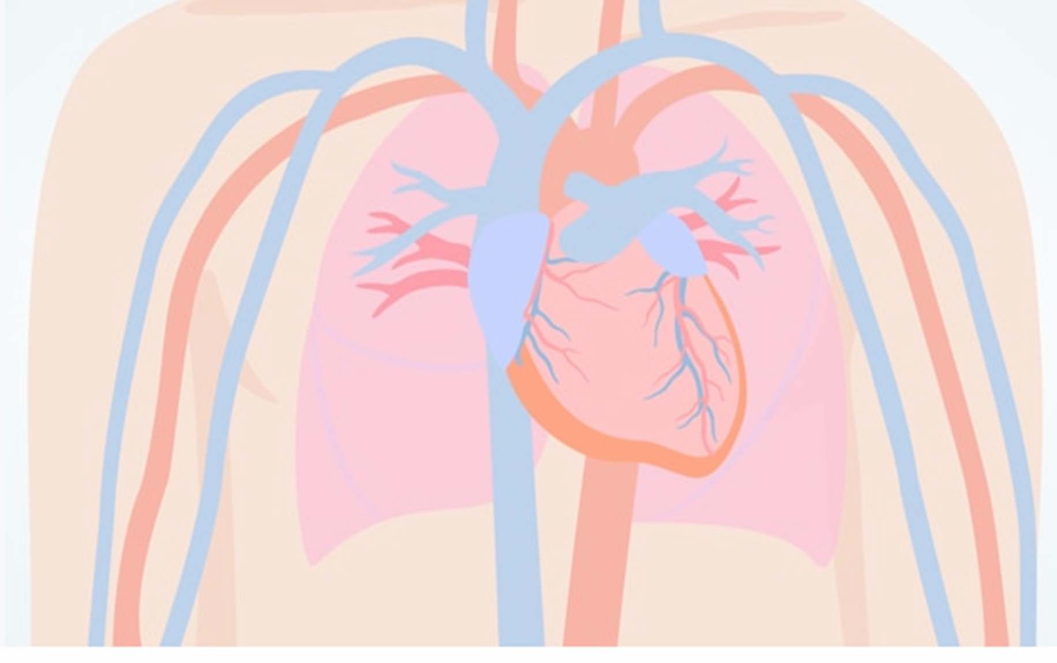
Heart Failure
TMCAH Staff Development Department 2026
Notes:
https://kidshealth.org/en/parents/heart.html

Slide 2
Objectives
Learners will be able to:
Define Heart Failure
Identify goals of treatment for heart failure patients
Identify at least two groups of medication used to treat heart failure
Describe the process of measuring orthostatic blood pressure
Identify three heart failure symptoms

Slide 3
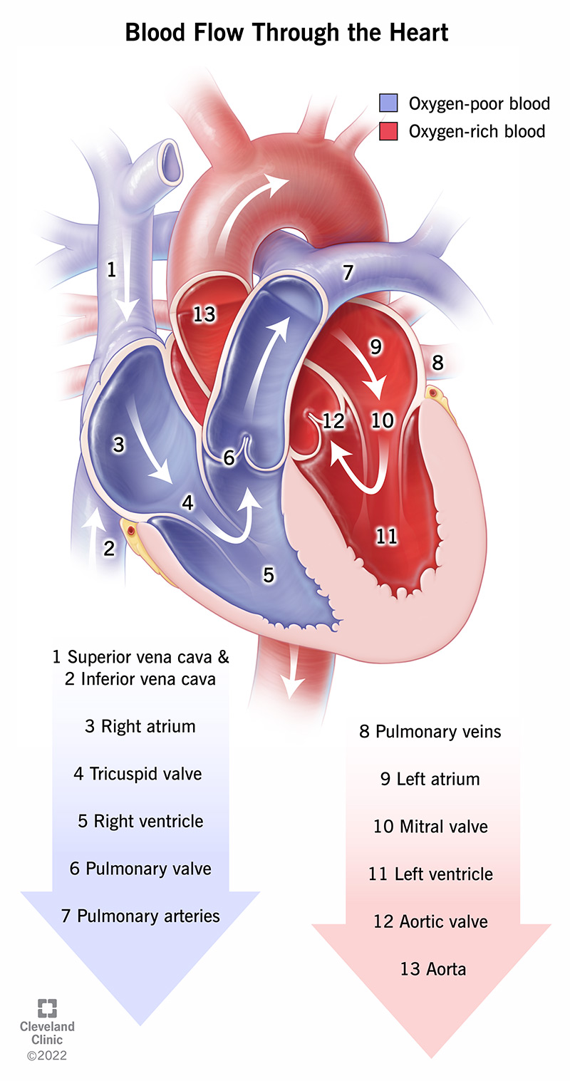
NORMAL BLOOD FLOW THROUGH THE HEART
https://www.youtube.com/watch?v=jBt5jZSWhMI
googleimages.com,2026

Slide 4
What Is Heart Failure?
HEART FAILURE IS:
Leading cause of Medicare patient hospital readmission in the US
Hospital leaders believe many HF hospitalizations are preventable
HF occurs when the heart muscle doesn’t pump enough blood for the body’s needs
Caused by conditions such as Coronary Artery Disease (CAD), Hypertension (HTN) which gradually leave heart too weak or stiff to fill and pump efficiently
Heart failure is a chronic, debilitating cardio-renal-metabolic condition affecting over 60 million people worldwide
Around half of all people with heart failure are expected to die within five years of diagnosis.
The risk of death increases with each hospitalization for heart failure
Basic heart function: 3 min video (control + click) https://www.youtube.com/watch?v=CWFyxn0qDEU
Notes:
https://www.osmosis.org/learn/Congestive_heart_failure:_Clinical_sciences
HHVNA Circulatory System Procedure (VNAA)

Slide 5
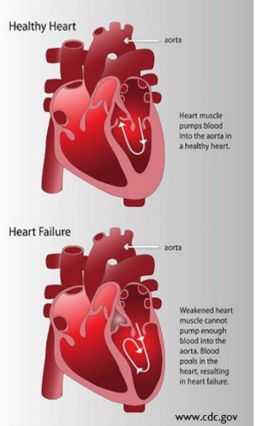
What Is Heart Failure?
Adequate cardiac functioning requires that each side of the heart pump out equal amounts of blood from the ventricles.
HF can involve one or both sides of the heart.
Left sided HF usually happens first since the left ventricle has the greatest workload of ejecting blood against the resistance of the aorta
Right and left sides of heart work together as a closed pumping system, failure of one side will eventually lead to failure of the other side
Notes:
https://www.osmosis.org/learn/Congestive_heart_failure:_Clinical_sciences
HHVNA Circulatory System Procedure (VNAA)

Slide 6
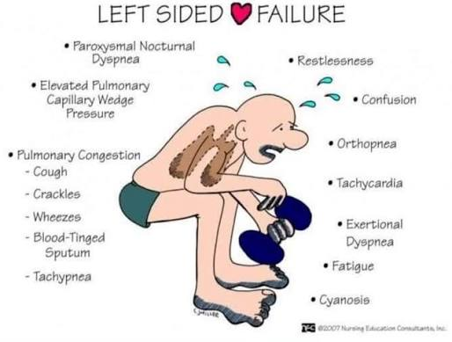
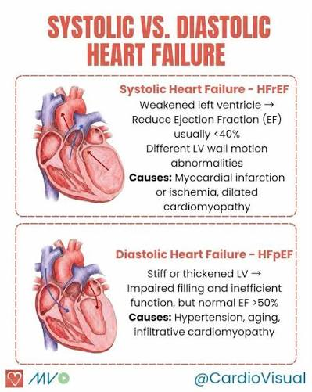

Blood backs up from the left
the ventricle→into the left atrium to the pulmonary veins→Pulmonary pressure forms→ reduced gas exchange=DIASTOLIC HEART FAILURE
LEFT SIDED HF
SIGNS & SYMPTOMS
Ventricles cannot relax and fill with enough blood prior to contraction=SYSTOLIC HEART FAILURE
Ventricles cannot pump blood with enough force to meet the body’s needs of oxygen and nutrients→ S/S related to the back up of blood in the lungs→ symptoms not related to lungs generally caused by right sided Heart Failure
REMEMBER LEFT=LUNGS
googleimages.com, 2026
Notes:
https://www.osmosis.org/learn/Congestive_heart_failure:_Clinical_sciences
HHVNA Circulatory System Procedure (VNAA)

Slide 7

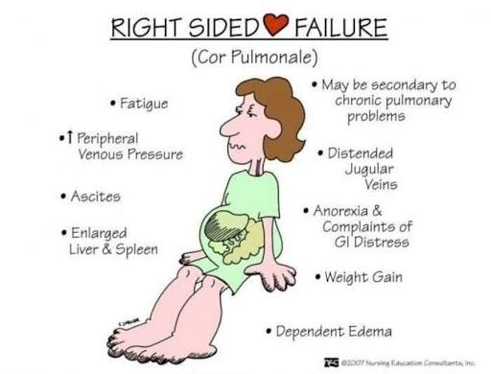
RIGHT SIDED HEART FAILURE
Occurs when the Left ventricle fails, causing increased fluid pressure back through the lungs, damaging the right side of the heart.
Ineffective pumping of the
right heart results in fluid
retention in the Abdomen,
Legs, Feet and Jugular Veins
SYMPTOMS
Related to the backup of blood into the peripheral circulation.
Acute decompensated heart failure with progressive signs and symptoms of fluid retention and activity intolerance
Think R &R
Right side=Rest of the Body
googleimages.com, 2026
Notes:
https://www.osmosis.org/learn/Congestive_heart_failure:_Clinical_sciences
HHVNA Circulatory System Procedure (VNAA)

Slide 8

Heart Failure- Signs/Symptoms
Shortness of breath (SOB)
Dyspnea on exertion (DOE) (BORG SCALE)
Orthopnea and Tachypnea
Lower extremity edema and ascites
Weight gain
  (2lb in 24 hr. or 5lb in a week)
Jugular vein distention (JVD)
Weakness and fatigue
Decreased alertness and frequent
falls
Dizziness, rapid heart rate (Tachycardia)
Nausea, poor appetite, and abdominal pain
Cough with frothy sputum
Wheezing
Chest pain/tightness
Arrhythmia, murmur
Cyanosis and hypoxia
googleimages.com, 2026
Notes:
https://ourhearthub.ca/what-is-heart-failure/
SOE, DOE, PND: Shortness of breath, dyspnea on exertion, paroxysmal nocturnal dyspnea (SOB that wakes you up), orthopnea (SOB laying down), tachypnea (fast HR)
Highlighted = most common

Slide 9
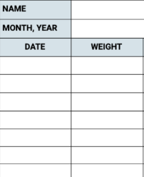
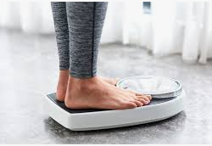
Heart Failure- Weight Monitoring
Weight gain is often the first warning sign that HF is
starting to decompensate
Educate patient to obtain DRY WEIGHT daily- early in the
morning, after urinating, before eating or drinking,
wearing the same amount of clothes
Report increase of 2lb/day or 5lb/week or per MD orders
We are often able to keep the patient out of the hospital by completing a full assessment and having orders for changes in diuretics.
  IVP Lasix orders available (See IV LASIX P/P-MD order and special training required.)
googleimages.com, 2026

Slide 10

Heart Failure- Pulmonary Congestion
Abnormal breath sounds such as: Crackles and Wheezes,
may be audible with heart failure
Use Diaphragm of stethoscope to listen to Anterior, Lateral, and Posterior Chest
Auscultate Lung Sound upon Inspiration and through Expiration
Crackles (rales) in the bases of the lungs likely indicates Decompensated Heart Failure
Sounds of Heart Failure
https://tinyurl.com/359exmyj
googleimages.com, 2026
Notes:
1:28 min video sounds of HF cntrl +click

Slide 11
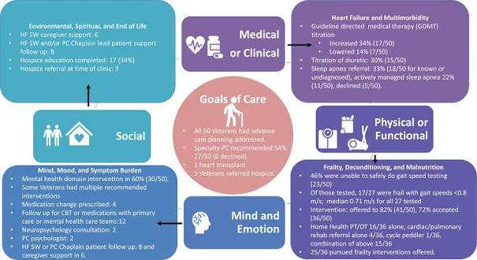
Heart Failure- Treatment
Goals
Treat the underlying cause of HF
Keep Co-Morbidities in check:
    CAD, HTN, D.M (Type 1/ Type II)
Keeping co-Morbidities stable, helps to slow HF progression and prevent further cardiac damage
Early symptoms recognitions for potential exacerbation of HF.
Improve overall quality of life
Prevent hospitalization (PRIORITY
GOAL)
googleimages.com, 2026
Notes:
Heidenreich PA, Bozkurt B, Aguilar D, et al. 2022 AHA/ACC/HFSA Guideline for the Management of Heart Failure: Executive Summary: A Report of the American College of Cardiology/American Heart Association Joint Committee on Clinical Practice Guidelines. Circulation. 2022;145(18):e876-e894. doi:10.1161/CIR.0000000000001062

Slide 12


Heart Failure- Treatment
WHAT IS RAAS?
WHY IS IT IMPORTANT TO UNDERSTAND?
TEACH ME ABOUT RAAS
RAAS Video Link (5:04)
https://www.youtube.com/watch?v=9zV02cmNdEw
REMEMBERING RAAS THROUGH SONG
https://www.tiktok.com/@nextgennurseeducator/video/7620494690646789390
googleimages.com, 2026
Notes:
Heidenreich PA, Bozkurt B, Aguilar D, et al. 2022 AHA/ACC/HFSA Guideline for the Management of Heart Failure: Executive Summary: A Report of the American College of Cardiology/American Heart Association Joint Committee on Clinical Practice Guidelines. Circulation. 2022;145(18):e876-e894. doi:10.1161/CIR.0000000000001062

Slide 13
Heart Failure- Medications
Medication | Function
Ace Inhibitors (ACEI) (“-pril”) | Prevent the body from making the hormone Angiotensin II, which constricts blood vessels, resulting in lowered blood pressure
Angiotensin 2 Receptor Blockers (ARB) (“-sartan”) | Blocks receptors acted on by the hormone Angiotensin II, which constricts blood vessels, resulting in lowered blood pressure
Beta Blockers (“-olol”) | Slow heart rate and decrease heart’s demand for oxygen
Diuretics (“-semide”) | Manage fluid retention and control symptoms
Vasopressors (e.g. epinephrine, dopamine) | Increase vasoconstriction, which leads to increased perfusion to organs
Inotropes (e.g. Dobutamine, Milrinone) | Increase cardiac contractility which improves cardiac output
Notes:
Heidenreich PA, Bozkurt B, Aguilar D, et al. 2022 AHA/ACC/HFSA Guideline for the Management of Heart Failure: Executive Summary: A Report of the American College of Cardiology/American Heart Association Joint Committee on Clinical Practice Guidelines. Circulation. 2022;145(18):e876-e894. doi:10.1161/CIR.0000000000001062

Slide 14
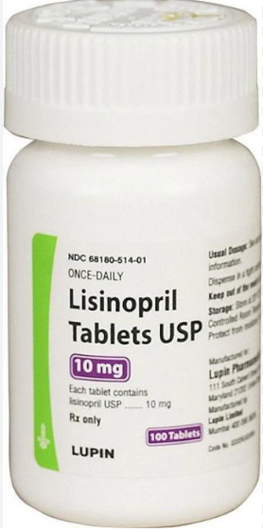
Ace Inhibitors (“-pril”)
Prescribed For:
HF, HTN, diabetic nephropathy, MI
Adverse Effects: angioedema, persistent dry cough, altered taste, fatigue, h/a, hyperkalemia, hypotension
Contraindications:
Impaired renal function, serious autoimmune disease, pregnancy/breast feeding
Nursing Considerations:
Monitor VS, WBC count, electrolytes, especially potassium
Give potassium supplements sparingly due to potential hyperkalemia
Monitor for dry, persistent cough (could also be a sx of worsening HF)
Monitor for/ educate on orthostatic hypotension
Common Medications: lisinopril, enalapril, captopril, benazepril, enalapril
Mechanism of Action:
Prevent the conversion of angiotensin I to angiotensin II, a vasoconstrictor, resulting in
vasodilation and decreased blood pressure
Decreases aldosterone production, resulting in reduced sodium and water retention, which results in lower blood pressure
Notes:
https://journals.lww.com/nursing/citation/2006/03000/fast_facts_about_ace_inhibitors.52.aspx#:~:text=Nursing%20considerations,-Observe%20your%20patient&text=Give%20potassium%20supplements%20and%20potassium,moexipril%201%20hour%20before%20meals.
Angioedema- swelling of deeper layers of skin, usually affects the eyes\
Cough caused by breakdown of bradykinin- accumulation of bradykinin in pulmonary tree causes cough

Slide 15
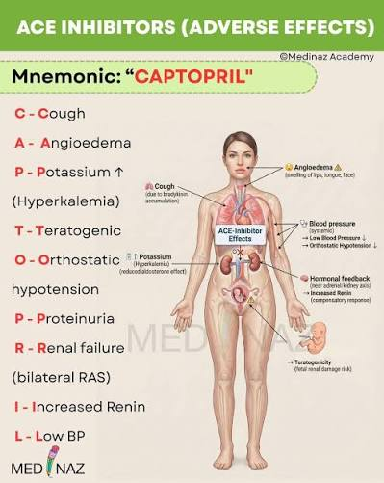

Ace Inhibitors (“-pril”)
TRY TO REMEMBER
googleimages.com, 2026
Notes:
https://journals.lww.com/nursing/citation/2006/03000/fast_facts_about_ace_inhibitors.52.aspx#:~:text=Nursing%20considerations,-Observe%20your%20patient&text=Give%20potassium%20supplements%20and%20potassium,moexipril%201%20hour%20before%20meals.
Angioedema- swelling of deeper layers of skin, usually affects the eyes\
Cough caused by breakdown of bradykinin- accumulation of bradykinin in pulmonary tree causes cough

Slide 16
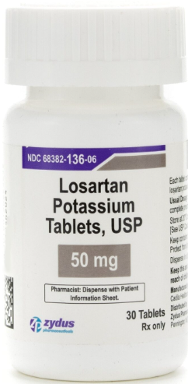
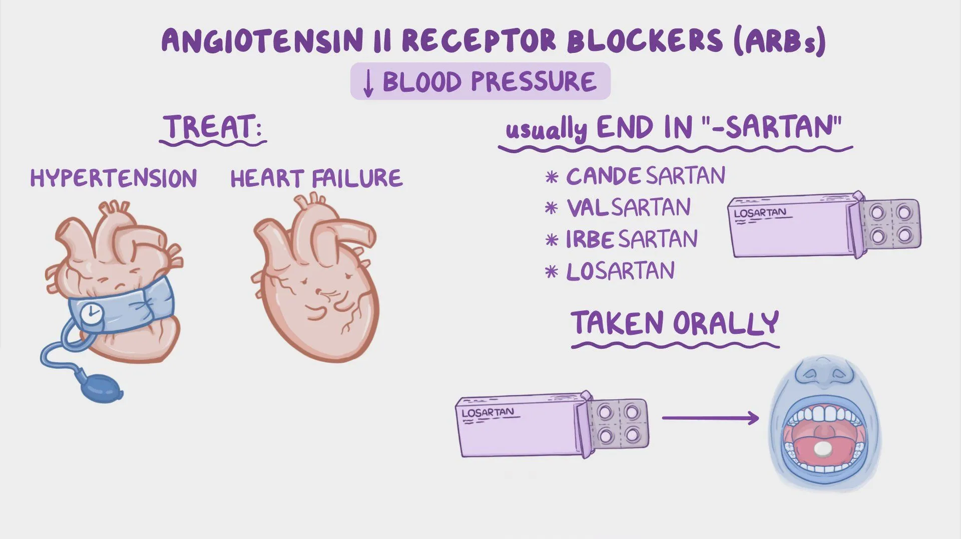
Angiotensin 2 Receptor Blockers (ARB) (“-sartan”)
Adverse Effects:
Hyperkalemia, H/A, Fatigue, Cough, Angioedema
Contraindications:
Pregnancy, lithium (can cause toxicity), fluconazole can increase
losartan, causing hypotension
Nursing Considerations:
Monitor VS, Weight, Electrolyte and Fluid Status, Orthostatic Hypotension
Common Medications:
Irbesartan, losartan, valsartan, candesartan
Mechanism of Action:
When the body has too much angiotensin II, the body retains fluids, which causes increases BP and constricted blood vessels
Angiotensin 2 Receptor Blockers (ARBs) work by blocking the receptor sites making it impossible for angiotensin to bind and constrict blood vessels. This action promotes a lowered blood pressure.
Prescribed For:
HTN, HF, kidney disease. Used as alternative to ACE Inhibitors when cough develops. Often with loop diuretics.
googleimages.com, 2026

Slide 17
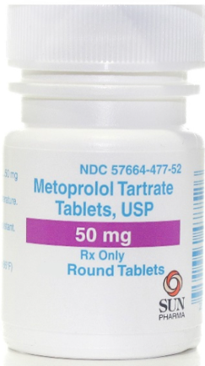
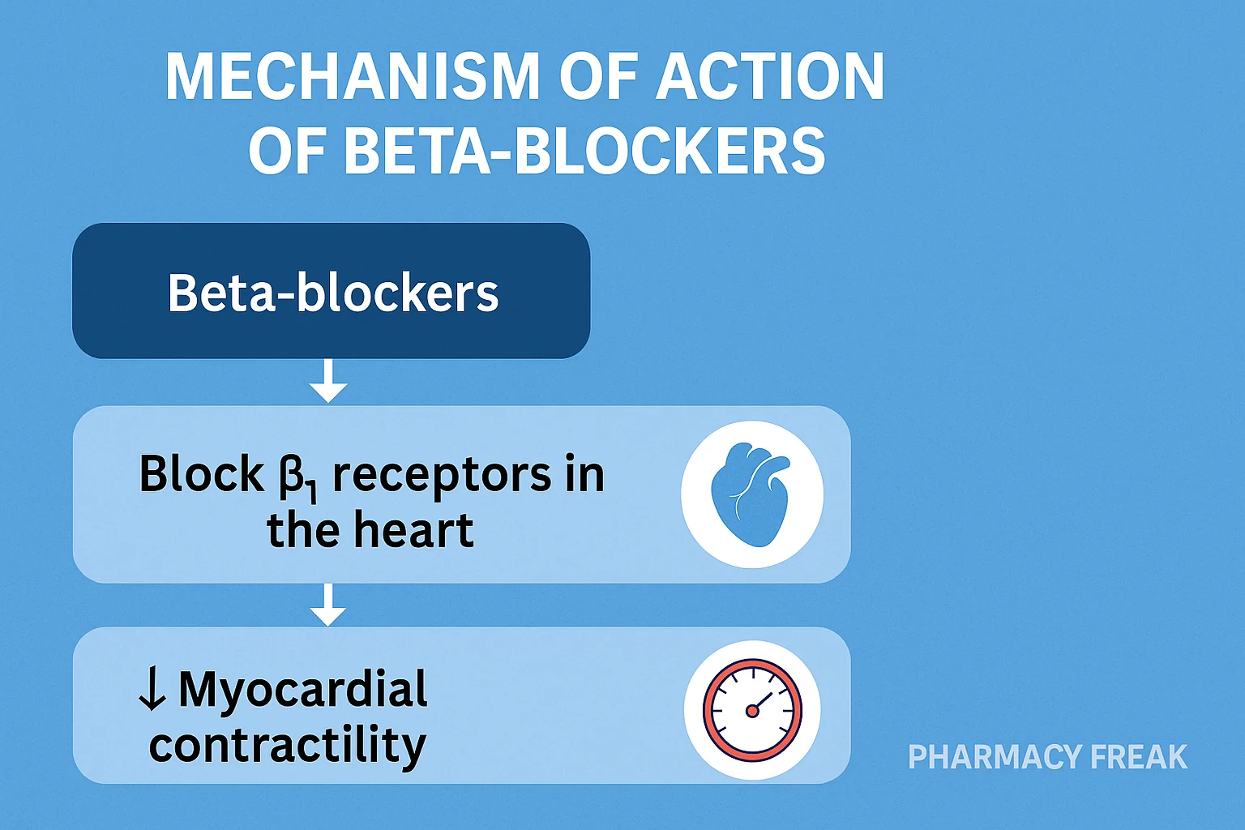
Beta Blockers (“-olol”)
Common Medications:
Bisoprolol, atenolol, metoprolol, labetalol, propranolol
Mechanism of Action:
Inhibit beta-1 adrenergic receptor sites in the
heart muscle and conduction system
Results in decreased heart rate, lower
demand for oxygen, decreased blood
pressure
Prescribed For:
HTN, ocular hypertension, vascular migraines
googleimages.com, 2026
Notes:
https://nursingcecentral.com/beta-blockers/

Slide 18
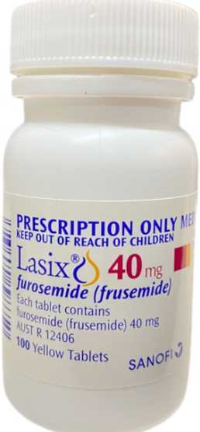
Diuretics- Loop (“-emide”)
Adverse Effects:
Hyponatremia, Hypokalemia, Increased
calcium excretion (avoid if osteoporosis)
Contraindications:
electrolyte abnormality, dehydration, oliguria/anuria
Nursing Considerations:
Monitor VS
Monitor intake and output
Monitor electrolyte levels- especially potassium
Avoid Aminoglycosides (Gentamicin, Tobramycin, Streptomycin)- Can cause
Ototoxicity (hearing/balance problems)
Common Medications:
furosemide, bumetanide, torsemide, ethacrynic
acid
Mechanism of Action:
Target the Loop of Henle in the
kidney nephron- inhibits the Na/K/Cl
transporter
Prescribed For:
First line therapy for acute relief of
pulmonary and peripheral edema due to HF
Edema associated with liver cirrhosis and renal
disease
googleimages.com, 2026
Notes:
https://www.nursingcenter.com/ncblog/october-2021/5-classes-of-diuretics
Anuria- lack of urine production

Slide 19
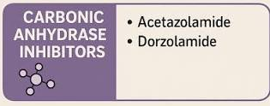
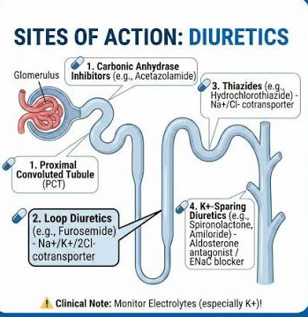

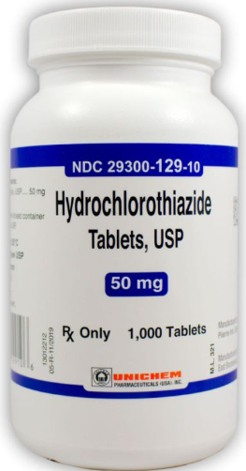

Diuretics- Other
Potassium-Sparing Diuretics
      Spironolactone, Triamterene
  Interrupt Na reabsorption in the collecting duct
  Used with thiazide or loop diuretic to enhance its action; weak diuretic when used alone
  Risk of hyperkalemia
Osmotic Diuretics
  Mannitol
Increase urinary flow by osmotic retention of water throughout the nephron
Used to decrease ICP and cerebral edema
Given by IV injection
Carbonic Anhydrase Inhibitors
  Acetazolamide
  Dorzolamide
Mechanism of Action
Decrease Na+ and Bicarbonate reabsorption in proximal tubule
Also used for other diseases- glaucoma, altitude sickness, epilepsy
Adjunctive therapy to treat edema in HF
googleimages.com, 2026
Notes:
https://www.nursingcenter.com/ncblog/october-2021/5-classes-of-diuretics
Torsade de points (type of ventricular tachycardia)

Slide 20
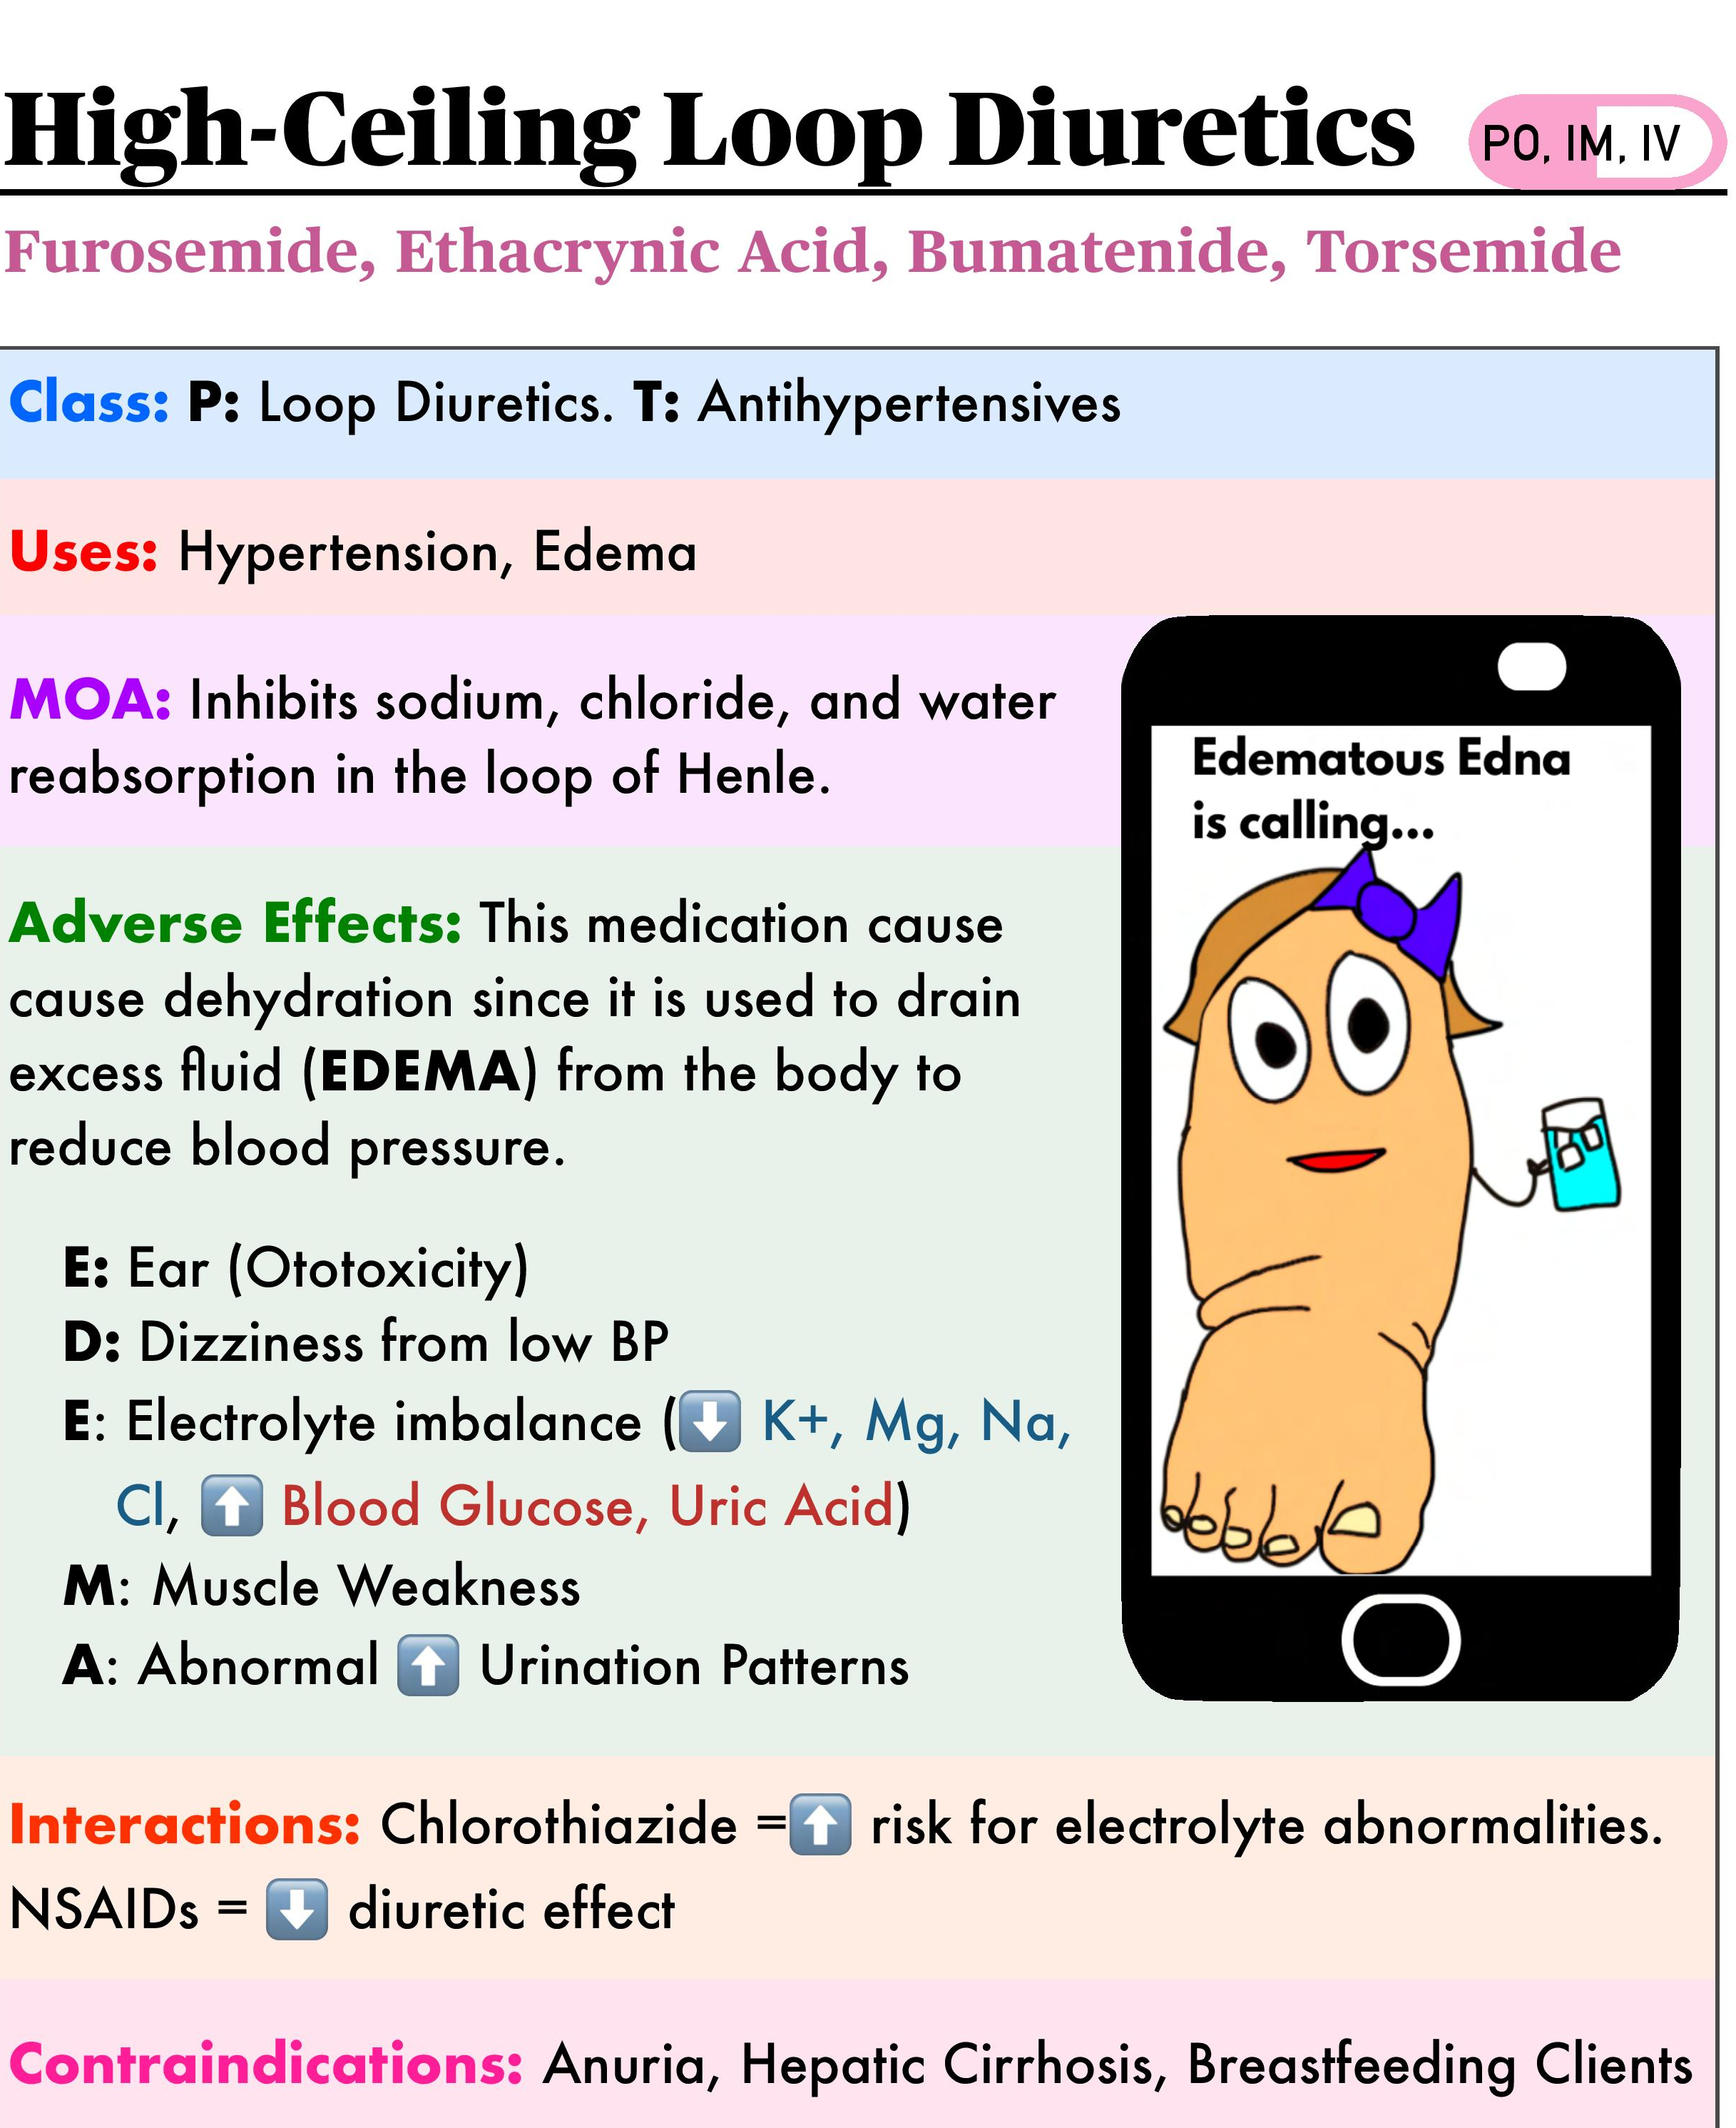


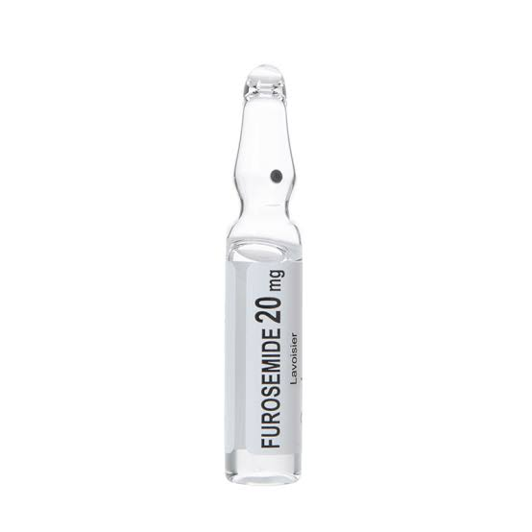
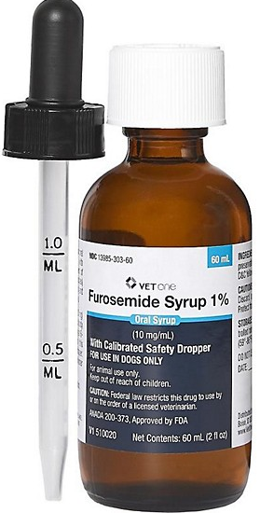
Diuretics- Loop
(“-emide”)
googleimages.com, 2026
Notes:
https://www.nursingcenter.com/ncblog/october-2021/5-classes-of-diuretics
Anuria- lack of urine production

Slide 21
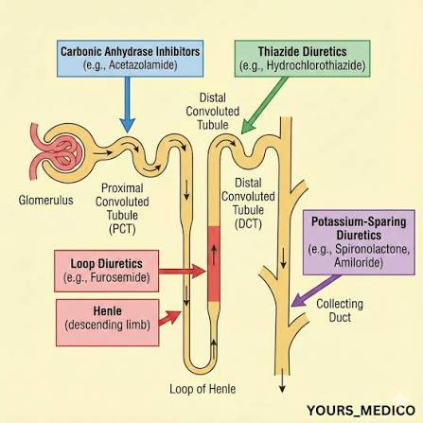
ALL TOGETHER NOW
googleimages.com, 2026
Notes:
https://www.nursingcenter.com/ncblog/october-2021/5-classes-of-diuretics
Anuria- lack of urine production

Slide 22
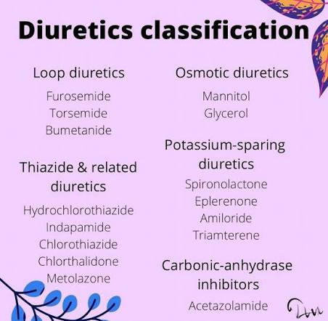
googleimages.com, 2026
Notes:
https://www.nursingcenter.com/ncblog/october-2021/5-classes-of-diuretics
Torsade de points (type of ventricular tachycardia)

Slide 23
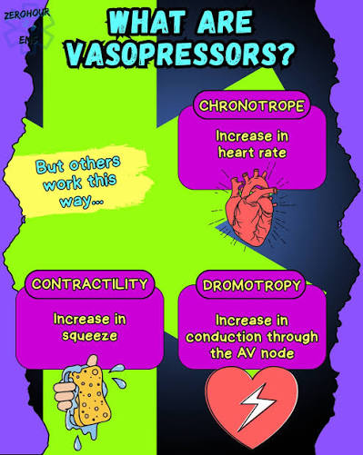
VASOPRESSORS
Vasopressin, Phenylephrine, Epinephrine, Norepinephrine
Epi-pen contains epinephrine, nasal decongestants contain
ephedrine/pseudoephedrine, many cold meds (e.g., Sudafed)
contain phenylephrine
MECHANISM OF ACTION
Create vasoconstriction or increase cardiac contractility,
resulting in increased perfusion to organs
PRESCRIBED FOR:
Shock, Systolic HF, Pulmonary Hypertension, Sepsis,
Hypotension, MI, Used During Resuscitative Efforts (CPR)
ADVERSE EFFECTS:
Arrhythmias, Severe Hypertension,
Blood Clot-No major contraindications
NURSING CONSIDERATIONS:
Typically administered IV, preferably by central line
googleimages.com, 2026
Notes:
https://www.ncbi.nlm.nih.gov/books/NBK482411/

Slide 24
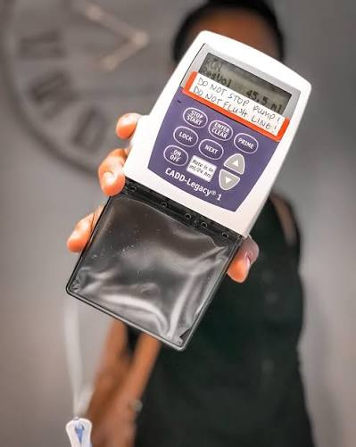
Inotropes
Dobutamine & Milrinone
  MECHANISM OF ACTION
  DOBUTAMINE
    Stimulates B1-adrenergic receptors, resulting in increased heart rate and contractility, increasing cardiac output
  MILRINONE:
    Inhibits cAMP phosphodiesterase-3 enzyme, which prevents breakdown of cAMP in cardiac and peripheral smooth muscle, resulting in vasodilation and increased cardiac contractility
    Preferred in patients taking beta blocker 2/2 works without b1-adrenergic receptor stimulation
    More effective for right sided HF
PRESCRIBED FOR
  End stage HF
  Patients' w/ symptoms at rest despite use of conventional HF medications
  Used to improve quality of life
  Decompensation/hospitalization
ADVERSE EFFECTS:
  Cardiac Arrythmia, Hypotension
CONTRAINDICATIONS:
  Renal disease (Milrinone)
NURSING CONSIDERATIONS:
  Administered Int/Cont. IV for patients awaiting: LVAD, Heart Transplant, or Long-Term Plan if not Candidate For Surgery (Poor prognosis 9-18 mos. )
  Hospice: Palliative-EOL→ Out Hosp.
  Taper or DC for s/s worsening→ more traditional medication treatment (Morphine, Lorazepam)
  googleimages.com, 2026
Notes:
Ginwalla M, Tofovic DS. Current status of inotropes in heart failure. Heart Failure Clijn. 2018; 14:601-616
Tariq S, Aronow WS. Use of inotropic agents in treateement of systolic heart failure. Int J Mol Sci. 2015 Dec4;16(12); 29060-8

Slide 25
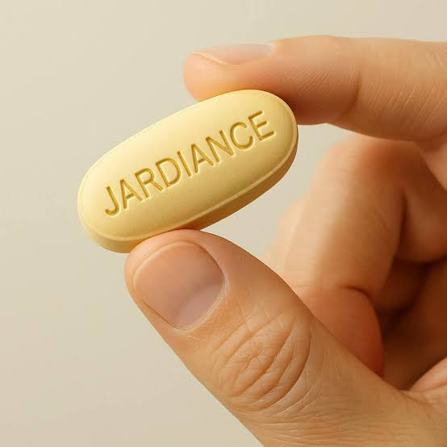
Jardiance
Jardiance has been approved by the US Food and Drug Administration to reduce the risk of cardiovascular death plus hospitalization.
For heart failure in adults with reduced ejection fraction.
Jardiance triggers the utilization of alternative energy sources within heart cells, potentially enhancing their function and resilience.
Can lower BP, alleviating stress on the heart and blood vessels.
googleimages.com, 2026

Slide 26
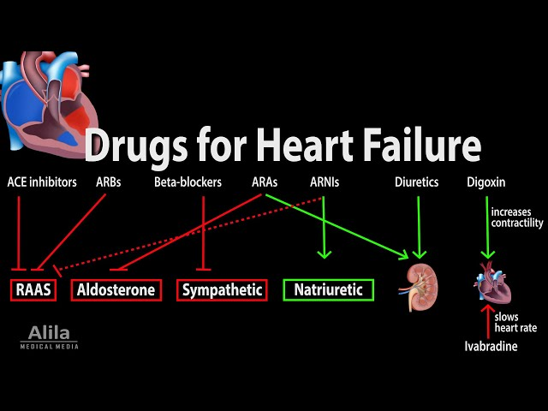
Notes:
https://ourhearthub.ca/what-is-heart-failure/
Shortness of breath, dyspnea on exertion, paroxysmal nocturnal dyspnea

Slide 27


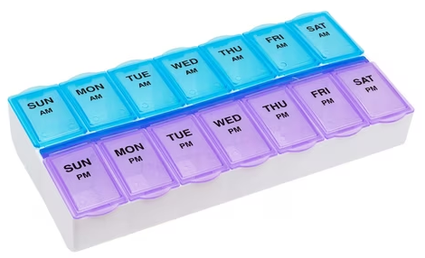
ROADBLOCKS
Identify Barriers to Medication Adherence:
Cost
Fear of Side Effects
Confusing Instructions
Large # of Meds
Difficult schedule
Intervention
Assist with Filling Med Planner to Ease Adherence
  Have The Patient Demonstrate Filling Properly Prior To Discharge
Teach-back:
  To Demonstrate Understanding Of Purpose, Side Effects, etc..
Explore Other Medication Aids:
Prepackaged Medications, Automated Pill Dispensers, Phone Alarms for Reminders
googleimages.com, 2026

Slide 28
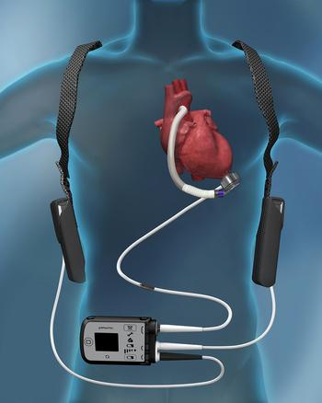
Left Ventricular Assist Device (LVAD)
The LVAD Is A Pump Used for Patients who have Reached End-Stage Heart Failure
LVAD
  Surgically Implanted, Battery Operated, Mechanical Pump
  Helps the Left Ventricle Pump Blood to the Rest of the Body
LVAD Can Be Used For:
    Bridge To Transplant Therapy:
      Patient can use until heart becomes available
      In some cases, LVAD can restore the failing heart,
    eliminating need for transplant
  Destination therapy
    If patient is not a candidate for heart transplant,
    LVAD can be long term treatment to prolong and
    improve patient’s life
  VIDEO HOW LVAD WORKS
  https://www.youtube.com/watch?v=mOZIYoq32SQ
YouTube and googleimages.com, 2026
Notes:
https://stanfordhealthcare.org/medical-treatments/l/lvad.html

Slide 29
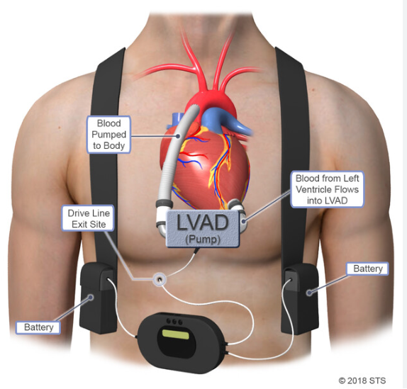
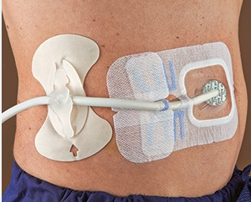
Left Ventricular Assist Device (LVAD)
Dressing change under sterile technique, like changing central line dressing
How Often ???
New LVAD patient should have detailed instructions and family member trained on dressing change
POLICY TECH P/P
https://tuftsmedicine.navexone.com/content/dotNet/documents/?docid=3989&app=pt&source=search
Notes:
https://careguides-videos.med.umich.edu/media/t/1_gu4g5b2v/130689761
10 min video, driveline dressing change

Slide 30
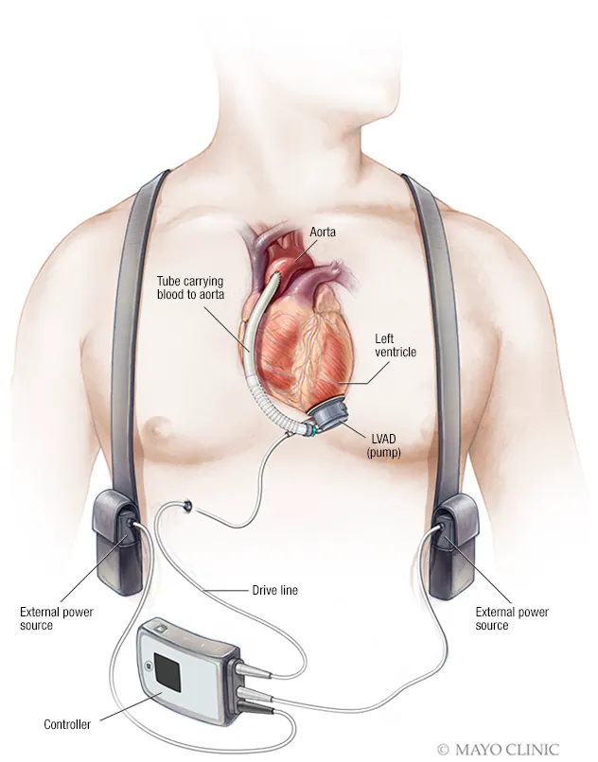




Left Ventricular Assist Device (LVAD)
Pump
Internal
Connected to left ventricle which pulls blood into the pump
The pump then sends blood to ascending
aorta
The aorta then sends the blood to the body
with the heart having to do minimal work
Driveline
Internal and External.
There is a tube connecting pump to the
controller
The controller contains power cables.
The tube exits through skin on right or
left side of abdomen.
Driveline dressing requires periodic changing.
Controller
External
Operates the pump and alarms if power is low or malfunctioning.
Can be worn around waist or over the shoulder
Batteries
Rechargeable.
Patient should always carry extra fully charged batteries when leaving the home. May be carried in pack with controller or in holster over the shoulder
AC power connection while sleeping
May have DC adaptor to power VAD in car
googleimages.com, 2026
Notes:
https://www.slideshare.net/allison2007/left-ventricular-assist-device

Slide 31
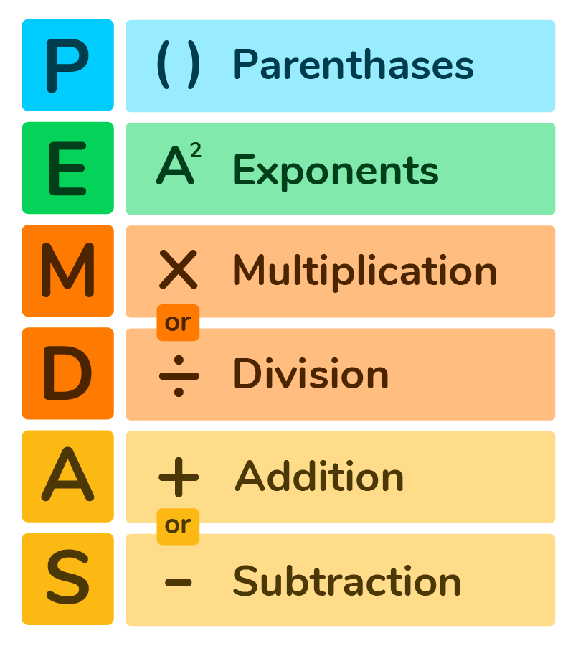
ASSESSING THE LVAD-WHY CHECK MAP?
Monitor Orthostatic Blood Pressure
Measure the Mean Arterial Pressure (MAP)
Formula MAP=SYSTOLIC +2 (DIASTOLIC) / 3
  REMEMBER THE ORDER OF OPERATION
Example
  MAP = (Systolic)120 + 2x (Diastolic 80) / 3
  (Systolic) 120 + (Diastolic 80) multiplied x 2 =160) Divided by / 3
  (Systolic 120+ Diastolic 160/divided by 3)
  280 / 3≈ 93.3 mmHg MAP
    The MAP goal is 60 mm Hg to 90 mm Hg
    UNDERSTANDING MAP
    Elevated MAP decreases flow and perfusion
        If MAP is too high, the patient may require antihypertensive drugs, such as metoprolol, hydralazine, and isosorbide dinitrate
        These drugs may need to be adjusted until the goal MAP is reached. Always check with the provider before holding any medications due to a low MAP
        Always check with the provider before holding any medications due to a low MAP googlimages.com, 2026
googleimages.com, 2026
Notes:
https://www.slideshare.net/allison2007/left-ventricular-assist-device

Slide 32
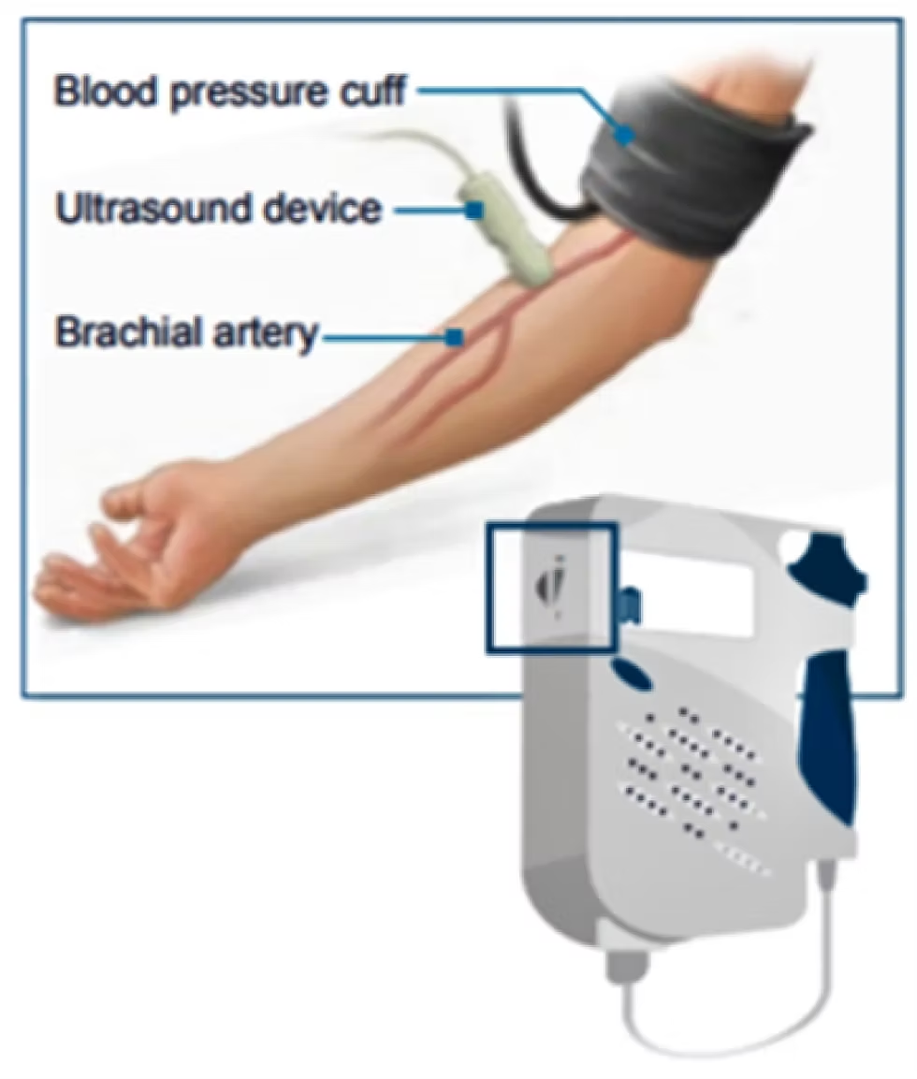
Listening for Blood Pressure =MAP
https://www.youtube.com/watch?v=kIcQuFIseTE
googleimages.com, 2026
googleimages.com, 2026
Notes:
https://www.slideshare.net/allison2007/left-ventricular-assist-device

Slide 33
ASSESSING THE LVAD
Check the LVAD each time you assess the patient’s vital signs.
You will not hear a traditional heartbeat LUB-DUB but rather you will hear the CONTINUOUS HUMMING
SOUND (you won’t hear or feel heartbeat) of the pump when auscultating the heart.
Make sure the battery-charging station is plugged into the wall and at least two spare batteries are in
the charge station.
    A green light indicates a full charge
    Additional safety checks include Assessing the driveline to ensure it’s securely in place and confirming there’s a backup system controller in the room.
The LVAD may be connected to the power module, which is plugged into the wall or to allow more
mobility, the patient may wear the batteries in a holster.
When the device is plugged into the module, several numbers on the system monitor indicate
    Pump Flow, Pump Speed, Pulse Index, and Power.
If the patient is wearing a battery holster, the numbers must be read from the controller.
googleimages.com, 2026
Notes:
https://www.slideshare.net/allison2007/left-ventricular-assist-device

Slide 34
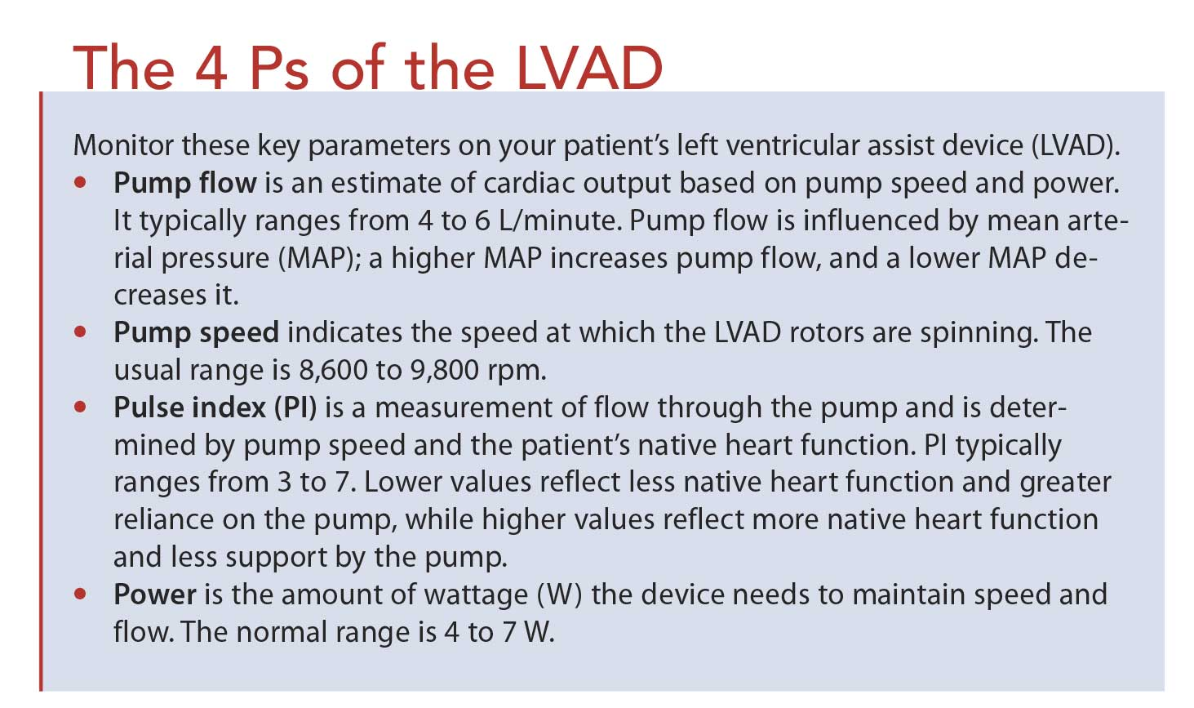
googleimages.com, 2026
Notes:
https://www.slideshare.net/allison2007/left-ventricular-assist-device

Slide 35
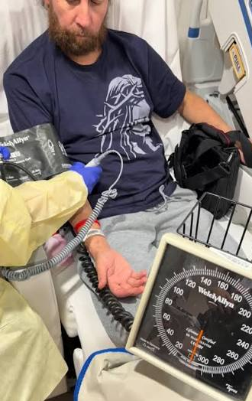

Assessment of Patient with LVAD
ASSESSING FUNCTION OF THE PUMP (See previous slide 4 Ps)
A. PERFUSION
  Check if the patient is Alert, Awake, and Warm with Good Skin Color.
  B. BLOOD PRESSURE
    May not be able to get a blood pressure. (Manual BP Cuff & Doppler over the
    Brachial or Radial Artery)
    Inflate the cuff and slowly deflate until you hear a continuous buzzing sound (the opening pressure), this represents the Mean Arterial Pressure (MAP).(G=60-90)
  C. PULSE AND RESCUSITATION
    If patient is UNCONSCIOUS, UNRESPONSIVE, PULSELESS, listen to the
    patient’s chest.
    If you hear the HUMMING SOUND, DO NOT PERFORM CPR
    If you CANNOT HEAR THE LVAD DEVICE, CPR CAN BE PERFORMED
        DEFIBRILLATION IS OKAY WITH LVAD PATIENTS
D. Medications
  Patient will likely be on HF Medications And Blood Thinner to Prevents Clots
E. Notify Fire Department of patient with new LVAD googleimages.com & YouTube, 2026
What an LVAD sounds like: https://www.youtube.com/shorts/WIZcRPxOCjI
Notes:
https://www.slideshare.net/allison2007/left-ventricular-assist-device

Slide 36

HF INTERVENTIONS
Teach Self Management:
  Low sodium diet
  Medications
  Exercise
  Stop smoking & reduce alcohol intake
Orthostatic Bp On Admission
  Repeat at intervals if patient has dizziness, change in medication, or other reason to suspect orthostatic hypotension
Teach/monitor daily weight:
  Establish parameters with physician for reporting (e.g., >2lb/day, >5lb/week)
Cardiac Auscultation
Auscultate For Apical Pulse
  Assess for irregularities:
  Tachycardia, Extra Sounds (S3, S4), Bounding and Gallop
  https://www.youtube.com/shorts/pCrE_gFxQMg
Pulmonary Auscultation
  Listen for crackles that do not clear with cough
  Assess for peripheral edema
  https://www.youtube.com/watch?v=uHKdaDGIypY
Notes:
https://ourhearthub.ca/what-is-heart-failure/
Shortness of breath, dyspnea on exertion, paroxysmal nocturnal dyspnea

Slide 37
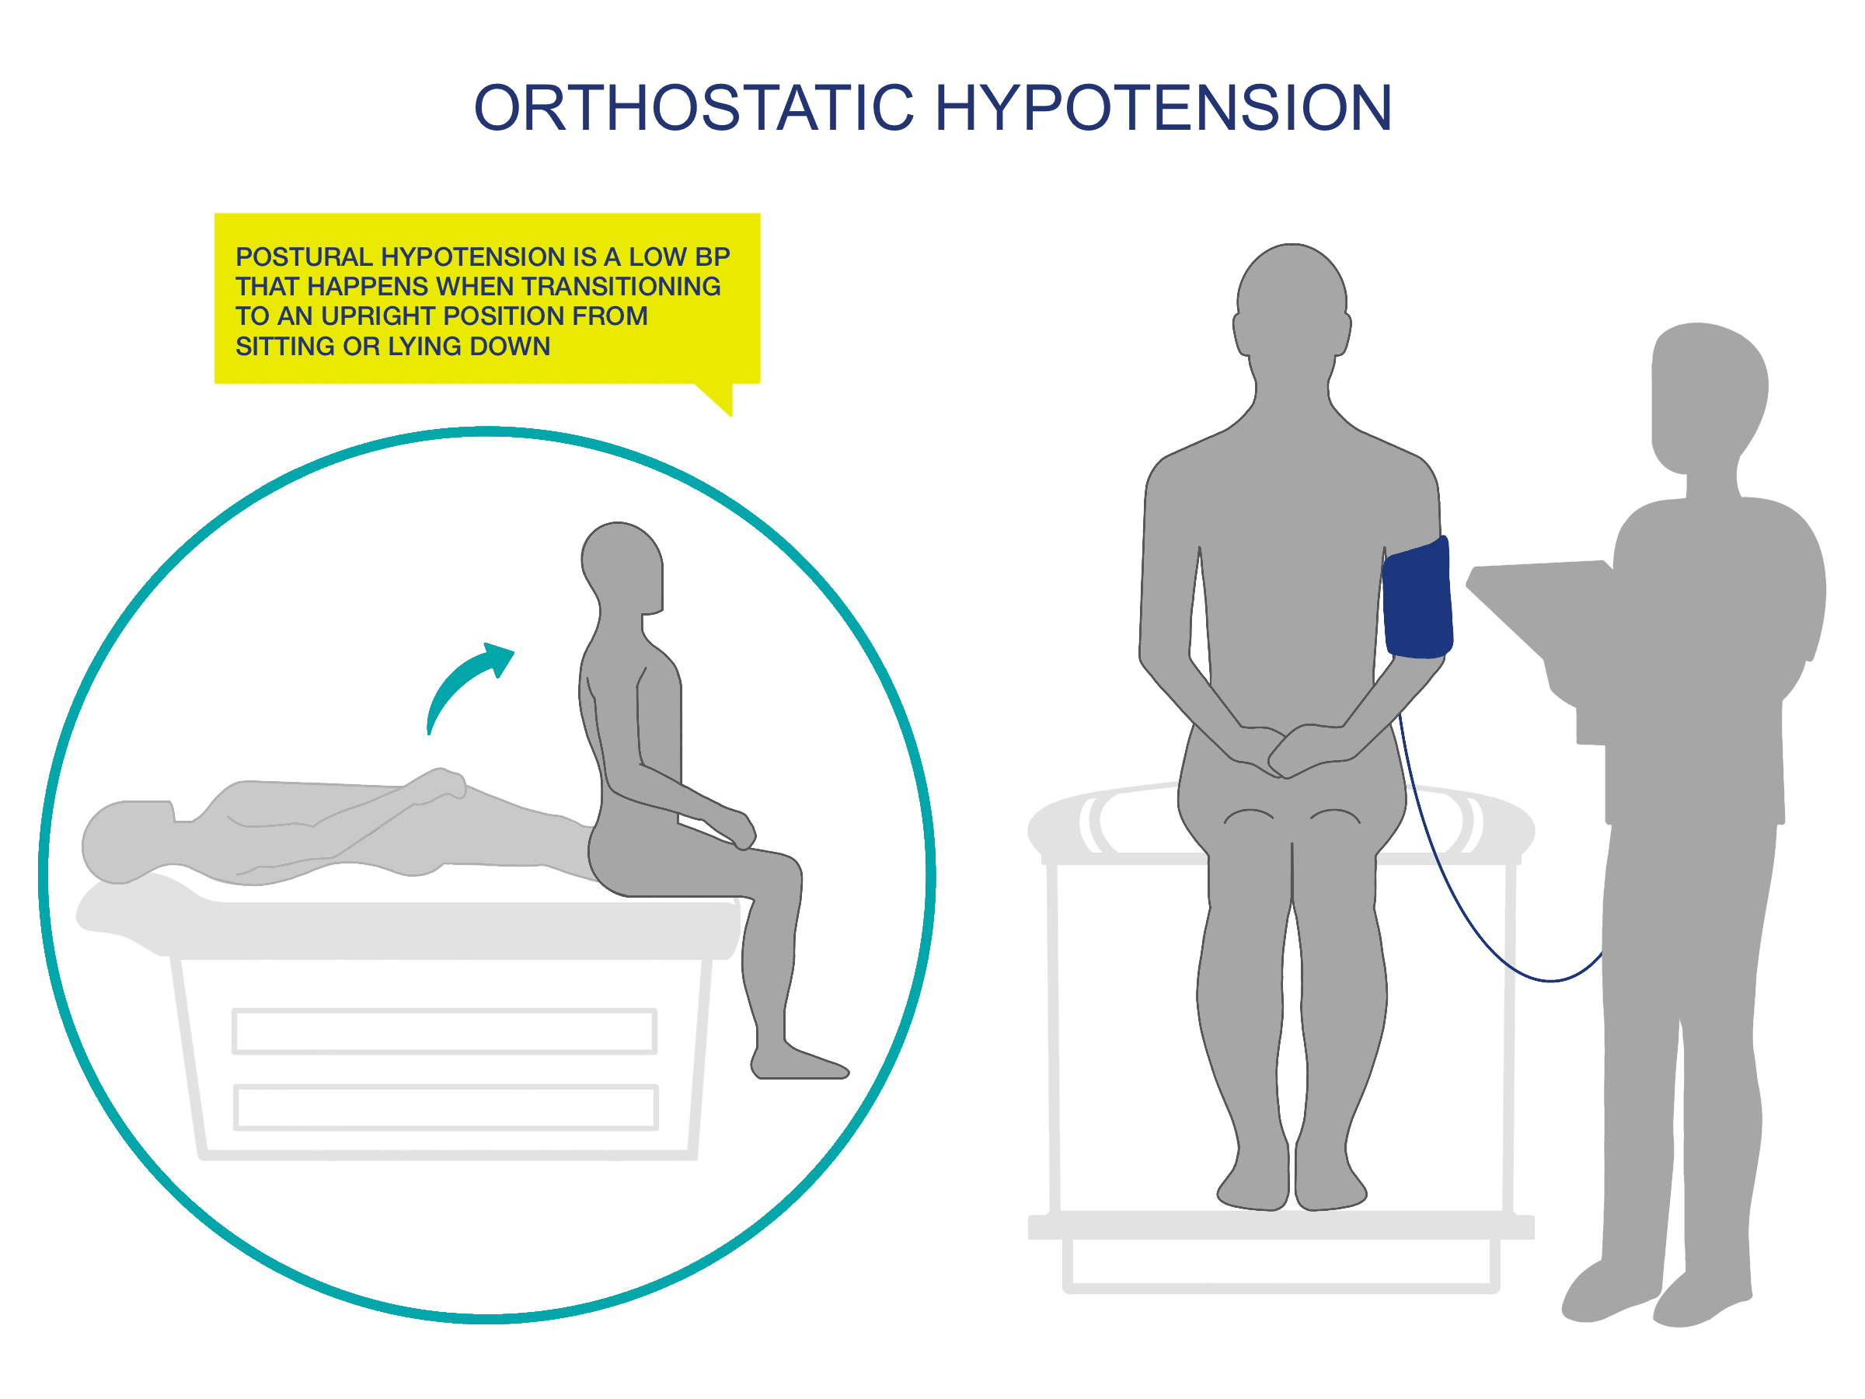
Orthostatic Hypotension
Orthostatic hypotension is defined as a decrease in Systolic pressure > 20 mmHg or decrease in Diastolic pressure >10 mmHg within 1 and 3 minutes of changing from supine to erect position
Orthostatic hypotension occurs when blood pools into the abdomen and legs when quickly changing from lying to upright position
Many conditions, such as aging and cardiovascular medications, interrupt the compensatory mechanisms, which normally stabilize the blood pressure
On Admission:
Measure BP in both arms (6% of patients have differences between arms)
Make subsequent readings on arm with higher reading
googleimages,com,2026

Slide 38
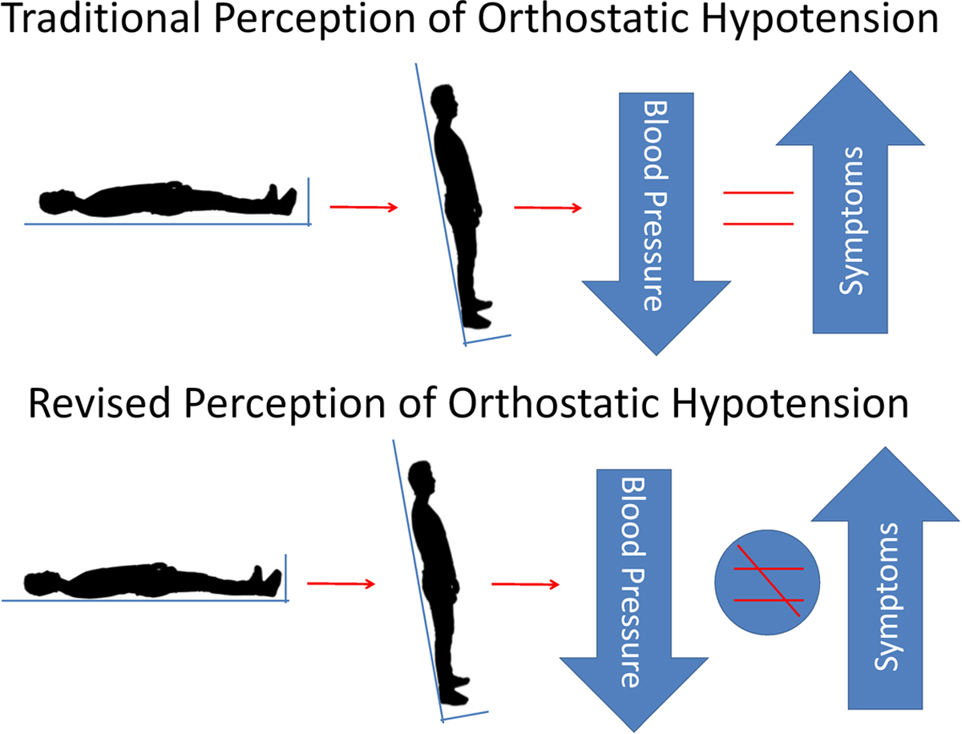
Measuring Orthostatic Blood Pressure
Have patient lie supine for at least 5 minutes
Take pulse and BP. Keep BP cuff in place until readings completed
Instruct patient to sit
Immediately take pulse and BP again
Instruct patient to stand (guard patient in case of dizziness)
Support patient’s arm in yours, so it is at the same angle as when supine
Take pulse and BP again at one and three minutes
If significant change in BP or pulse is noted, take additional measure in 2-5 minutes
googleimages.com, 2026

Slide 39
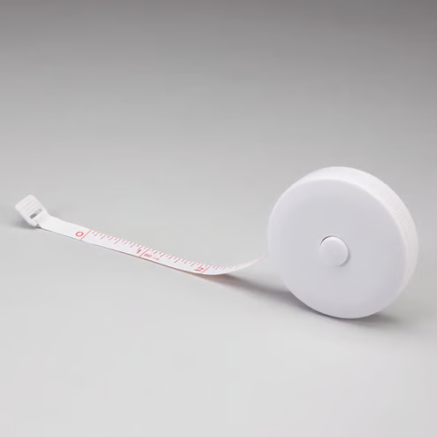
Measuring Edema
Multiple ways of measuring peripheral edema have been suggested in the literature Currently, the literature does not agree on the best methods, and no method passes the test for a reliable, valid standardized tool that can be used in clinical practice
The use of digital pressure measurement may be used only as a secondary description of pitting edema
Not just edema is it: 1+, 2+, 3+ or 4+ (quantify!)
TMCAH has determined that, for consistency, the measurement of extremities will be used for all pitting and non-pitting edema
See Policy Tech Heart Care
googleimages.com, 2026

Slide 40

Measuring Edema
Procedure: HHVNA Circulatory- ASSESSMENT: EDEMA
Measurement can be obtained on one or more of the following anatomical areas:
To ensure consistency of documentation, start with the right extremity instep, ankle, then calf
Instep: 12.5 cm from big toe
Ankle: 10 cm from heel
Lower leg (calf): 28 cm from heel
Abdominal girth: at the level of the umbilicus
Notes:
https://jeanlamantia.com/lymphedema-vs-edema/

Slide 41
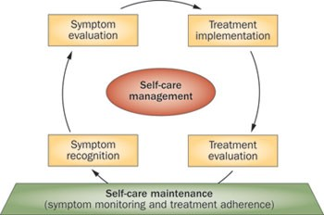

Goals of Self Management
Monitor symptoms
Maintain daily dry weight log
Restrict sodium and possibly fluid intake
Take medications as directed- pill box, reminders, smartphone apps, etc.
Exercise
Keep follow-up appointments
When to Refer in Other Disciplines
Decreased activity endurance
Unsafe with ADLS due to fatigue/SOB
MSW if difficulty paying for medications
Spiritual needs
googleimages.com, 2026

Slide 42
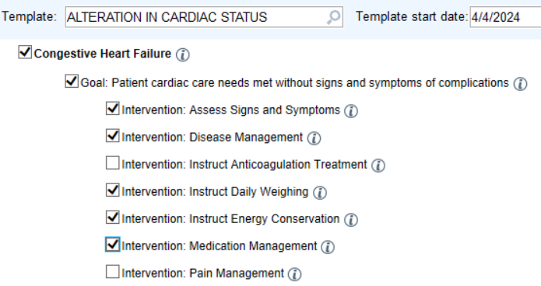
Care Plan for Heart Failure
Screen shot EPIC

Slide 43
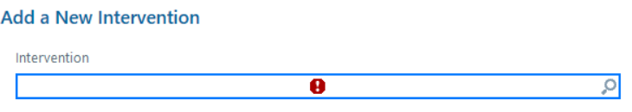
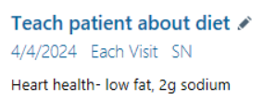
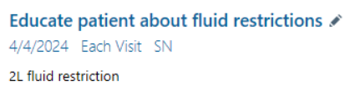
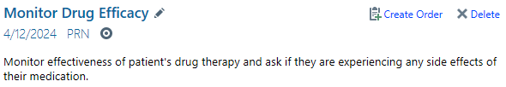


Care Plan for Heart Failure- What else?
EPIC screenshot
Notes:
Fall prevention, safety, respiratory, pain/comfort

Slide 44
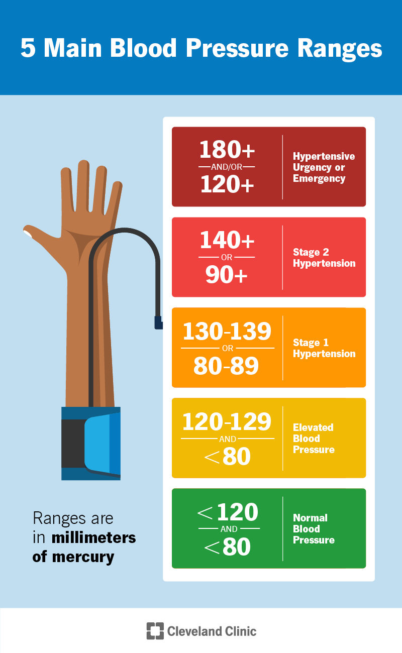
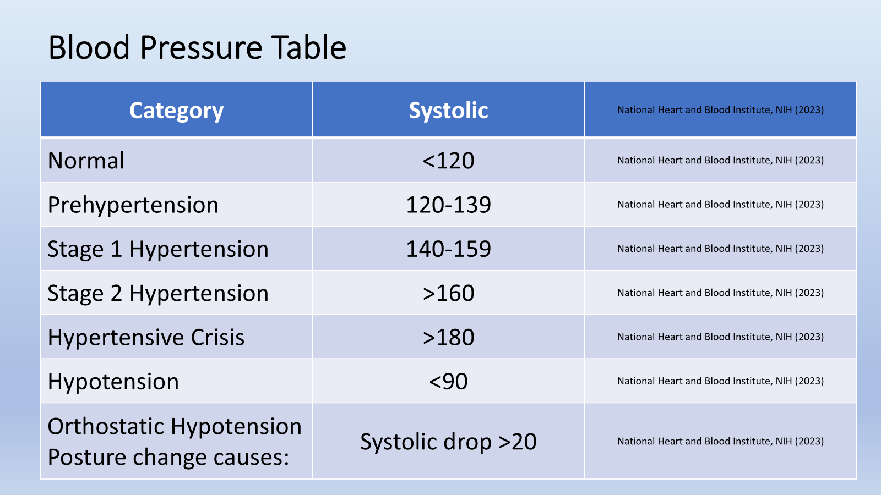
Blood Pressure Table
CLVEVELAND CLINIC
NHI BLOOD PRESSURE SCALE 2023
googleimages.com, 2026
Notes:
Source: National Heart and Blood Institute, NIH (2023)

Slide 45
Blood Pressure Table
CLVEVELAND CLINIC
NHI BLOOD PRESSURE SCALE 2023
googleimages.com, 2026
Notes:
Source: National Heart and Blood Institute, NIH (2023)

Slide 46
Modified Borg Dyspnea Scale
Tell me how you are breathing right now.
Measure | Description | How do I feel?
0 | No difficulty at all | I am comfortable and breathing easily
½ | Very, very slight
1 | Very slight
2 | Slight | My breathing is a bit light, and I am beginning to feel some difficulty breathing
3 | Moderate
4 | Somewhat severe
5 | Severe | I am having a lot of trouble catching my breath. It is hard to carry on a conversation
6
7 | Very severe
8 |  | I am completely breathless. I need medical help right away.
9 | Very, very severe
10 | Maximum
How is your breathing difficulty now compared to your breathing the last time you were asked?
Much less difficulty breathing | A little less difficulty breathing | About the same difficulty breathing

Slide 47
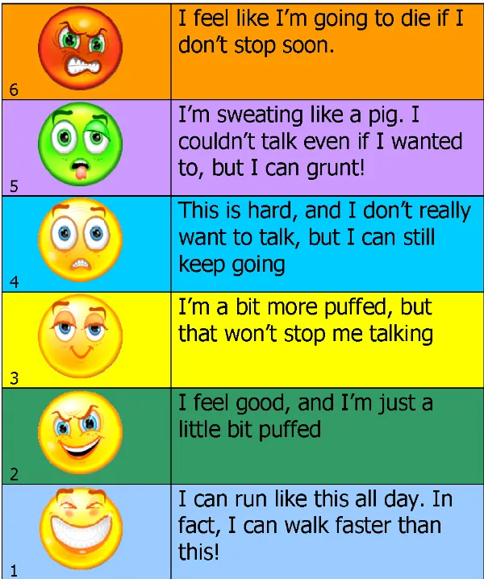
Modified Borg Dyspnea Scale
Tell me how you are breathing right now.
googleimages.com, 2026

Slide 48
SBAR Communication
S Situation | Identify yourself and the patient. Briefly state the problem, when it happened, how it started, how severe it appears to be “This is Nurse Susan from TMCAH, calling about Jane Doe, DOB 01/01/50. She was admitted 2 weeks ago with primary dx of HF exacerbation”
B Background | Provide pertinent background information related to the situation. May include other diagnoses, current medication, recent lab results. “Patient has developed new onset of crackles in bilateral lung bases and has gained 5 lbs in the past 7 days. She is taking her medications as ordered. Current dose of Lasix is 20mg daily.”
A Assessment | What you think the problem is. State specifically why you are calling and what the issue is today “I believe patient is retaining fluid and will continue worsening if not treated.”
R Recommendation | State recommendation or what you want, or ask MD what they would like to do if you do not know “Would you like patient to take an additional dose of Lasix today? Would you like an labs drawn? Should there be any change to her potassium dose? We will continue to monitor her fluid status and keep you updated on her condition.”
Notes:
(not in toolkit)

Slide 49
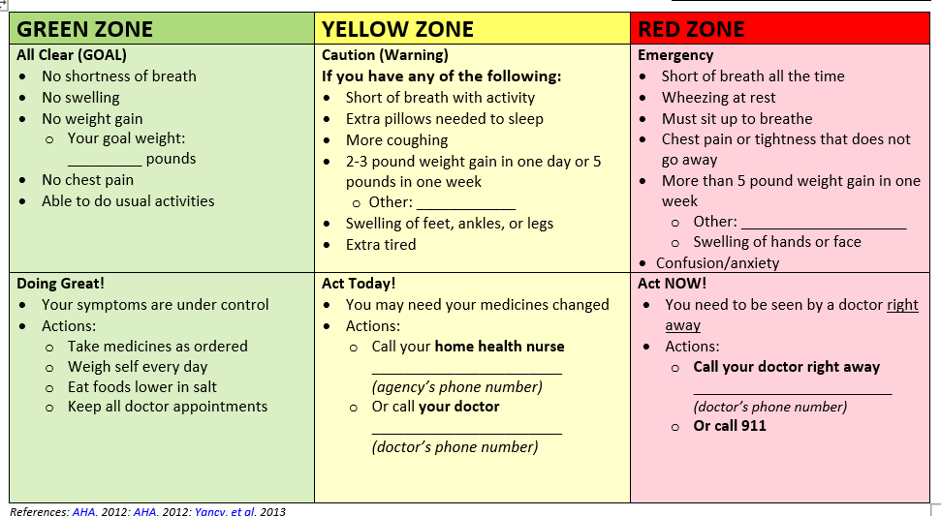
Heart Failure Zone Tool
Notes:
*******DIFFERENT HANDOUT IN FOLDER********

Slide 50
reference
Ginwalla M, Tofovic DS. (2018) Current status of inotropes in heart failure. Heart Failure Clinic journal.; 14:601-616
Multiple images in PowerPoint uploaded from googleimages.com (07/2026)
Tariq S, Aronow WS. (2015). Use of inotropic agents in treatment of systolic heart failure. Int J Mol Sci. Dec4;16(12); 29060-8
(U) (2018) Blood flow through the heart in two minutes. Neural Academy. Video search 07/2026: sourced from: https://www.youtube.com/watch?v=jBt5jZSWhMI
Yancy, C., MD, MSc, FACC, FAHA, Jessup, M. MD, FACC, FAHA, Bozkurt, B. MD, PhD, FACC, FAHA, Butler, J. MBBS, FACC, FAHA, Casey, D. Jr. MD, MPH, FACP, FAHA, Drazner, M.H. MD, MSc, FACC, FAHA, Fonarow, G. C. MD, FACC, FAHA, and Wilkoff, B.L, MD, FACC.
Summary: A Report of the American College of Cardiology Foundation/American Heart Association Task Force on Practice Guidelines, V 128 (16). Retrieved from: https://doi.org/10.1161/CIR.0b013e31829e8807
(U) (Date Not Dated) Left Ventricular Assist Device | LVAD | Nucleus Health. Nucleus Medical Media. Retrieved from: YouTube: https://www.youtube.com/watch?v=mOZIYoq32SQ
Thomas, A. & Smith, K., MSN, (2024). What is Mean Arterial Pressure. Simple Nursing Blog. Retrieved from google search-How to calculate MAP. https://simplenursing.com/what-is-mean-arterial-pressure/#toc1
(U) (2020 uploaded). What does my heart sound like? YouTube Video. Retrieved from: https://www.youtube.com/shorts/WIZcRPxOCjI
Notes:
*******DIFFERENT HANDOUT IN FOLDER********

Slide 51
reference
Um J, Yancy CW, Thinh D, Barsuk JH. Ventricular Assist Device Driveline Dressing-Change Protocols: A Need for Standardization. A Report from the Sim VAD Investigators. J Card Fail. 2019 Aug;25(8):695-697. doi: 10.1016/j.cardfail.2019.06.009. Epub 2019 Jun 24. PMID: 31247286; PMCID: PMC7249259.
Notes:
*******DIFFERENT HANDOUT IN FOLDER********

