Slide 1
Total Parental Nutrition
(TPN)
First-Dose Training
Safe Practice for Home Infusion
Clinical Staff Development: Nicole M. Tsoukalas, MSN, APRN, FNP-C
August 2025

Slide 2
Pre-Training Knowledge Check

Slide 3
Knowledge Check: Question 1
Only Registered Nurses (RNs) may administer the first dose of TPN in the home setting.
  True or False?
Answer: TRUE
Rationale
Both Massachusetts and New Hampshire regulations, along with the Infusion Nurses Society (INS) Standards of Practice, specify that the first dose requires RN administration due to complexity, monitoring requirements, and potential for severe adverse events.

Slide 4
Knowledge Check: Question 2
Which type of access device is appropriate for TPN administration?
      Peripheral IV line
      Midline catheter
      Central venous access device (PICC, tunneled catheter, implanted port)
      All of the above?
Answer: Central Venous Access Device
Rationale
TPN solutions are hyperosmolar and require central venous access for safe administration.
Peripheral IVs and midlines carry high risk of phlebitis, infiltration, and tissue necrosis.

Slide 5
Knowledge Check: Question 3
Which of the following must be checked before initiating TPN?
    Recent lab results (electrolytes, glucose, renal function)
    Central line patency
    Clinician order
    All of the above
Answer: D - All of the above
Rationale
Safe initiation of TPN requires lab review, line patency verification, and order verification.
Skipping any of these steps could result in electrolyte derangements, infusion complications, or administration errors.

Slide 6
Knowledge Check: Question 4
TPN solutions can safely run with compatible IV antibiotics through the same lumen.
True or False?
Answer: FALSE
Rationale
TPN must run through a dedicated line due to high risk of precipitation, incompatibility, and infection.
No co-infusion is permitted except in rare circumstances dictated by a pharmacist and prescribing clinician.

Slide 7
Knowledge Check: Question 5
When programming the Solis CADD pump, which of the following is MOST important?
Verify order against pharmacy label
Ensure tubing is primed and filter is in place
Double-check infusion rate and volume
All of the above
Answer: D – All of the above
Rationale
Pump safety requires a multi-step verification process: matching the label to the order, ensuring tubing and filters are correct, and double-checking infusion parameters.
Any missed step could result in a serious infusion error.

Slide 8
Knowledge Check: Question 6
During a TPN infusion, the patient develops shortness of breath and hives. What is your immediate action?
Pause the pump and observe
Stop infusion and assess airway, breathing, circulation
Call the dietician
Document and wait for symptoms to pass
Answer: B – Stop infusion and assess airway, breathing, circulation
Rationale
The first priority is to stop the infusion and assess ABCs, then escalate (call 911, notify provider, initiate emergency protocol).
Observation alone delays life-saving care.

Slide 9

Let’s Begin!
LET’S BEGIN

Slide 10
Learner Objectives
By the end of this training, participants will be able to:
Identify regulatory requirements, as well as CMS and Joint Commission standards for first-dose TPN.
Explain the clinical rationale and risks associated with initiating TPN therapy in the home setting.
Recognize the nurse’s role in first-dose administration, including patient monitoring, emergency preparedness, and documentation.
Demonstrate safe setup and operation of a CADD Solis pump for TPN administration.
Apply appropriate clinical judgment during first-dose monitoring and respond effectively to complications.

Slide 11
TPN Basics

Slide 12
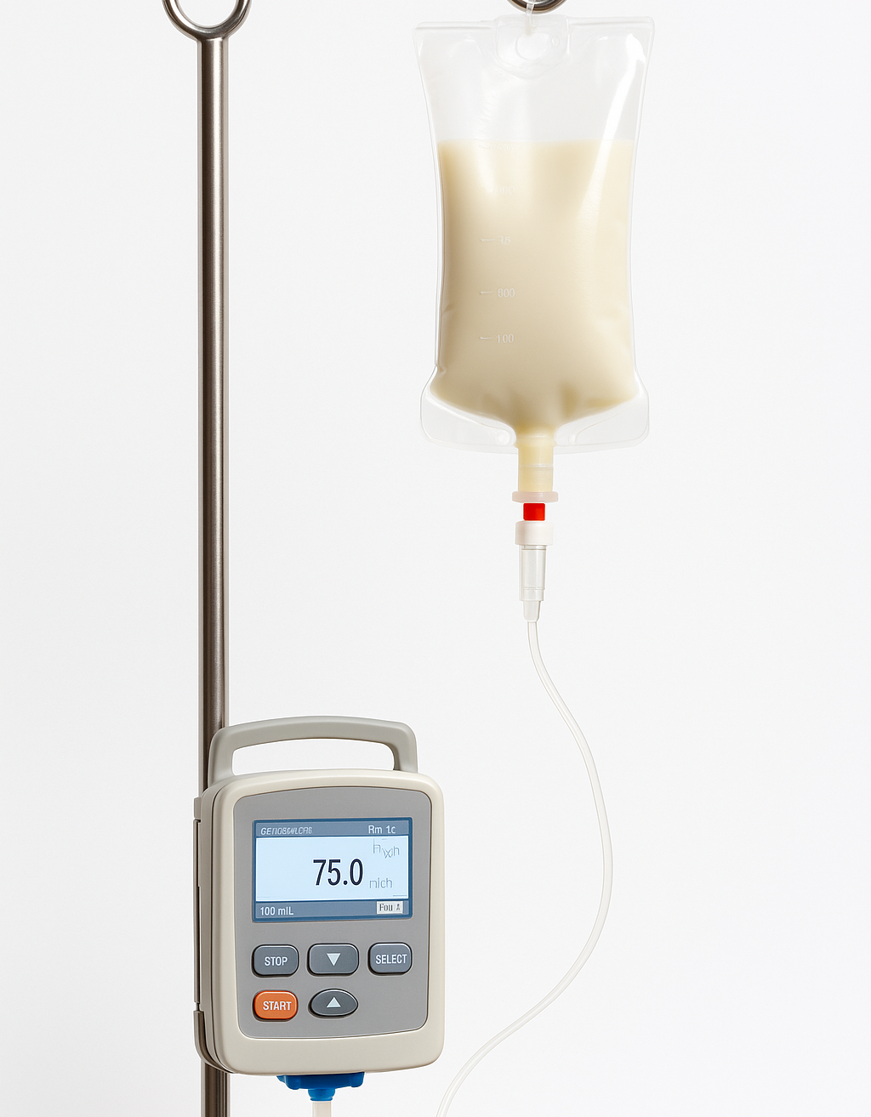
What is TPN?
Total Parenteral Nutrition
    Complete IV nutrition when an individual’s gastrointestinal (GI) tract fails or is impaired.
Components:
    Macronutrients: Carbohydrates (dextrose), Proteins (amino acids), Fats (lipid emulsions)
    Micronutrients: Electrolytes, trace elements, vitamins, minerals
    Water (fluid balance)
  Goal
    Maintain or restore nutritional status
    Promote healing
    Prevent Malnutrition

Slide 13
Indications for TPN
When enteral feeding is not feasible due to GI dysfunction:
    Bowel Obstruction
    Short bowel syndrome
    Severe Irritable Bowel Disease (IBD) flare (Crohn’s Disease, Ulcerative Colitis)
    High-output fistula
    Severe malabsorption or intolerance to enteral nutrition
    Severe malnutrition pre/post major surgery or ins critical illness

Slide 14
Mechanisms of Action of TPN
Direct IV Nutrition
Protein & Nitrogen Balance
Energy Supply
Electrolyte & Fluid Homeostasis
Micronutrient Support
Bypassing Impaired GI Function
TPN works by providing complete system nutrition intravenously, bypassing the gut, to meet metabolic demands, prevent catabolism, and maintain organ and immune function until oral or enteral feeding becomes possible.

Slide 15
Amino Acids
~ 15-20%
Lipids
~ 20-30%
Carbohydrates
~ 50-60%
Electrolytes
Vitamins
Trace Elements

Slide 16
Mechanisms of Action
Carbohydrates
Source: Provided as dextrose monohydrate in sterile water.
Concentrations: Common stock solutions are 40%, 50%, and 70%.
Caloric Value: 3.4kcal per gram of dextrose.
Glucose Utilization: Maximum safe infusion rate is </= 5-7 mg/kg/min (varies with metabolic stress, critical illness, and diabetes).
Complications of Excess: Overfeeding carbohydrates can cause hyperglycemia, increased CO2 production, respiratory stress, hepatic steatosis, and hypertriglyceridemia
Lipids
Supplied as intravenous lipid emulsions (ILEs), typically soybean oil, mixed-oil, or fish-oil-based formulations.
Provide a concentrated energy source (I kcal per gram) and are essential for preventing essential fatty acid deficiency (EFAD).
EFAD can develop within ~ 2-3 weeks of intravenous fat is omitted.
Usually provide 25-30% of total daily calories.
Typical Dosing: 0.7-1.3g/kg/day, individualized to patient tolerance and triglyceride levels.
Monitor for complications such as hypertriglyceridemia, impaired immune response, or infusion reactions, especially at higher doses.

Slide 17
Mechanisms of Action
Proteins
(Amino Acids)
Provided as an amino acid solution containing both essential and non-essential amino acids (arginine and glutamine are typically excluded).
Supplies 4 kcal per gram.
Healthy adults require approximately 0.8-1.0 g/kg/day.
Requirements vary by clinical condition (e.g., critically ill, CKD, hemodialysis, acute hepatic encephalopathy).
Goals: Maintain nitrogen balance, support tissue repair, and prevent muscle catabolism.
Micronutrients
(Electrolytes, Trace Elements, Vitamins)
Includes electrolytes, trace elements, and vitamins, essential for metabolic and cellular function.
Trace elements and vitamins are typically dosed according to recommended daily requirements (RDA).Electrolyte recommendations (per liter of PN solution):
    Sodium (Na⁺): 100–150 mEq/L
    Potassium (K⁺): 50–100 mEq/L
    Calcium (Ca²⁺): 10–20 mEq/L
    Magnesium (Mg²⁺): 8–24 mEq/L
    Phosphorus (Phos): 15–30 mEq/L
Electrolyte dosing should be individualized based on labs, fluid balance, and clinical status.

Slide 18

What’s So Special About First-Dose TPN?
Higher Risk: First infusion carries the highest risk for adverse events including hypersensitivity, electrolyte shifts, and sepsis.
Regulatory Requirement: Only RNs may administer first dose; prescriber order required.
Patient Safety: RN must remain present, assess closely, and intervene if complications occur.
Continuity of Care: Thorough teaching and monitoring builds confidence for future doses.

Slide 19
First Dose vs. Subsequent Doses
First Dose = Highest Risk
for a Side Effect
NEW Therapy: Patient’s metabolic and infusion tolerance is unknown
Risk of infusion reaction, electrolyte derangement, fluid shifts
Requires RN presence and continuous monitoring
Subsequent
Doses
Typically managed by caregiver at home (after training)
RN role shifts to monitoring, education reinforcement, troubleshooting
Risk is lower BUT ongoing vigilance is needed

Slide 20
Unlike routine IV medications…
TPN is high-alert, high-risk, and patient-specific.
The 10 Rights of Medication Administration serve as a checklist that forces you (the RN) to validate every safeguard (order → compounding → line → monitoring → documentation)

Slide 21
Home TPN

Slide 22
Patient Selection: Indications
Intestinal/Bowel Obstruction
Bowel Pseudo- Obstruction (with food intolerance)
GI Fistulas with High Flow (rest the bowel)
Infant GI system immaturity or congenital GI malformation
Post-op bowel anastomosis leak
Severe diarrhea/vomiting and inability to maintain nutritional status
Hypercatabolic state (due to sepsis, polytrauma, and/or major fractures)
NPO status >7 days (e.g., inflammatory bowel disease, critically ill patients)

Slide 23
Patient Selection: Contraindications
Infants with less than 8cm of the small bowel
Critical cardiovascular or metabolic instability – which would require correction before administering IV nutrition
When GI feeding is possible (e.g., enteral feedings)
If/when nutritional status is “good” – TPN is no longer needed
TPN should not be sued to prolong life when death is inescapable

Slide 24
TPN
Ordered
Shipped
to the
Patient’s
Home
Patient
stores TPN
in Fridge
(35°F)
RN Arrival: Confirm TPN mixture to TPN order, expiration date; confirm fridge-room temperature
RN:
Prearrival Checklist
Prepare and Infuse
Patient &
Caregiver Teaching
Document

Slide 25
TPN
Administration
Guidelines

Slide 26
Nursing
Practice
BORN
MA/NH
Nurse Practice Act
Department of Public Health (DPH/DHHS))
CMS
FDA
OSHA
Joint Commission
INS
ASPEN

Slide 27

RNs Only
RNs: Initial patient assessment & care planning
First dose of TPN must be RN-led due to complexity & need for clinical judgment

Slide 28
ASPECT | FIRST DOSE | SUBSEQUENT DOSES
Who Can Administer | RN Only | Trained caregiver (with RN oversight)
Monitoring Intensity | Continuous: Vitals every 15 to 30 minutes | Routine, per protocol
Risk Level | Highest (reaction, electrolyte shifts) | Lower, but infection/metabolic risk
RN Role | Direct infusion, emergency readiness | Reinforcement, troubleshooting
Documentation | Full Details: Order, labs, teaching, assessment (including vitals) | Tolerance, adherence, ongoing issues

Slide 29
TPN: Delivery & Access
Must be given via central venous access device (CVAD)
    PICC
    Tunneled catheter (Hickman, Broviac)
    Implanted port
  Why?
    You cannot use a peripheral line due to the hyperosmolar contents – risk of phlebitis and/or tissue damage
  Administration Method
    Continuous (24-hours) or cyclic (12 to 18-hour infusion)
        On day 1 of TPN, it is not unusual for a patient to receive only ½ the expected dose (until tolerance/stability is known).
        On first-dose, confirm starting dose and time – as it is expected to be SLOWER for X amount of minutes
    RNs use sterile technique for dressing changes, proper catheter site cleaning (chlorhexidine use), flushing protocols, locking techniques, and hub/connector disinfection (“scrub the hub”)

Slide 30
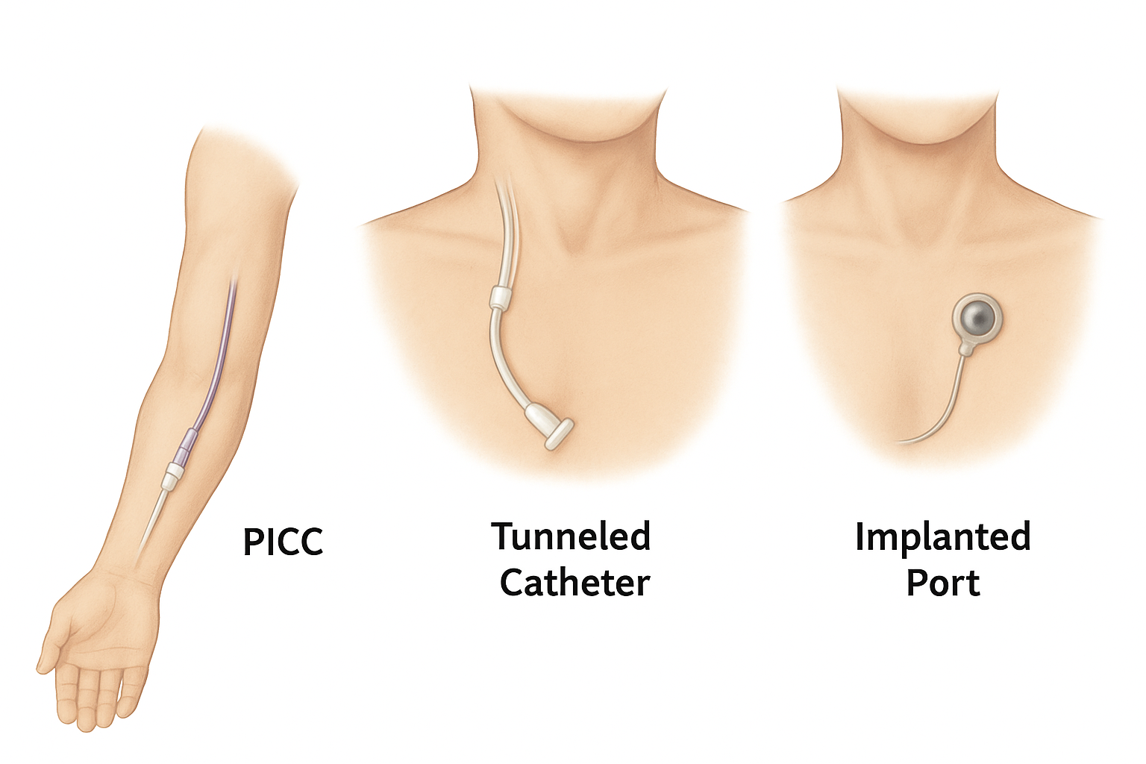

Slide 31
TPN Delivery in
Home Care

Slide 32
RN Role During First Dose
RN stays with the patient during infusion initiation (coordinate your time appropriately)
Observe pump function for accuracy, alarms, flow
Reinforce caregiver education on pump basics, alarms, and who to call after you leave
Document: Pump settings, start time, teaching provided (and to whom), and patient tolerance of treatment

Slide 33
RN Role Continued….
Verify orders, labs, and solution label
Complete baseline assessment, including vitals
Set up and start infusion (first dose = stay for monitoring period)
Provide ongoing patient/caregiver teaching
Document all assessments, infusion details, education, and tolerance in the medical record
** First Dose: Highest risk for complications ** Patient’s tolerance is unknown (Metabolic and infusion-related) ** RN presence ensures early recognition and rapid intervention ** Oversight required by MA/NH regulations, INS, ASPEN, and CMS standards

Slide 34
10 Rights of Medication Administration
First-Dose TPN (1-5)
Right Patient
    Confirm patient identify using two identifiers (Name, DOB).
    For TPN: Verify patient’s central line access device matches the order (correct lumen, correct patient).
  Right Medication (Solution)
    TPN is a custom-compounded sterile solution
    Compare prescribers order, pharmacy label, and MAR carefully – TPN must match the individualized formula
  Right Dose
    Dose = the volume and composition of TPN solution.
    First Dose: Double-check macronutrient concentration (dextrose %, lipid %, electrolytes) against order.
    Wrong dose – electrolyte shifts, hyperglycemia, or fluid overload
  Right Route
    TPN must be infused via central venous access (PICC, tunneled, or port) – never peripheral
    Verify the patency and that TPN runs through a dedicated lumen only.
  Right Time
    Initiate at the prescribed time, starting slowly for the first dose (per order/protocol)
    Monitor closely during the first 30 to 60 minutes (highest risk for infusion reactions)

Slide 35
10 Rights of Medication Administration
First-Dose TPN Continued…(6-10)
Right Patient/Caregiver Education
    For first dose: RN must explain what TPN is, expected monitoring, and possible side effects.
    Teach caregiver about pump alarms, what to watch for (rash, shortness of breath, chest pain), and when (and who) to call for help.
  Right Documentation
    Document: Order verification; Central line assessment; Vitals before, during, and after infusion; Patient education provided; and Any adverse events or interventions
  Right to Refuse
    Patients (or caregivers) have the right to refuse therapy.
    RN must assess reasons (fear, misunderstanding), re-educate, and notify the prescriber if refusal persists.
  Right Assessment
    Before first dose: Review labs (electrolytes, glucose, renal/hepatic function, triglycerides)
    During infusion: Monitor vitals, infusion site, and patient tolerance.
    Ongoing: Weight, Input/Output (I&O), labs daily/weekly.
  Right Evaluation
    After infusion: Evaluate patient’s tolerance, metabolic response, and central line condition.
    For first dose: Ensures no signs of hypersensitivity or fluid/electrolyte imbalance before concluding monitoring.

Slide 36
First-Dose TPN In-Home Checklist
Arrival & Pre-Infusion
Verify patient identifiers (name, DOB)
Confirm provider order and pharmacy label match (components, volume, rate, additives, expiration)
Review most recent lab: (CBC, electrolytes, glucose, renal/hepatic (CMP),magnesium, phosphate, triglycerides)
Assess home environment: Clean workspace, refrigeration, safe disposal area.
Pre-Infusion
Perform hand hygiene and don PPE
Inspect TPN bag: Clarity, no precipitate, intact, within expiration time (not expired)
Confirm TPN bag was stored refrigerated and has warmed to room temperature (1-2 hours out of the fridge prior to infusion)
Ensure emergency readiness: 911 access, providers on call, infusion company contact, spare batteries

Slide 37
Safety Considerations
Line Safety:
Dedicated lumen ONLY for TPN (do NOT piggyback medications)
Filters:
0.2 micron (without lipids)
1.2 micron (with lipids)
Aseptic Technique:
Critical to prevent infection
CLABSI: A lab-confirmed bloodstream infection
Daily Checks:
Bag integrity
Solution clarity
Expiration date
Baseline labs:
Electrolytes, glucose, liver/kidney function (CMP), triglycerides

Slide 38
Central Line Access & Care
Inspect Site
    Redness
    Swelling
    Drainage
    Dressing Intact
Verify patency before infusion (blood return, flush without resistance)
  Dressing Care: Changed every seven (7) days (or sooner if soiled/loose)
  Dedicated lumen for TPN only

Slide 39
Monitoring During Infusion
Stay with patient during infusion initiation
Recheck vital signs at 15-30 minutes, then per policy
Observe for:
    Hypersensitivity reaction (rash, shortness of breath, chest pain, wheezing)
    Infusion-related reactions (fever, chills, back/chest pain)
    Fluid overload (edema, crackles, hypertension)
    Electrolyte imbalance symptoms (weakness, arrythmias, confusion)
  Check pump function: Correct rate/volume, no alarms

Slide 40
Be Prepared
TPN mixture should be removed from the refrigerator 2 hours before use to allow it to be brought to room temperature
TPN mixture preparation should only be managed in a clean – sterile spot. Choose a smooth surface that is not near an open window or doorway. Clean the surface and dry with a paper towel.
Gather supplies
    A sterile barrier
    TPN solution administration set
    1 or 2 (10 mL) syringes
    Insulin syringe (if needed)
    Alcohol wipes
    Multivitamin infusion (MVI), as ordered
    A sharps container
    Trash disposal

Slide 41
Be Prepared (continued)
Perform hand hygiene
Place sterile barrier on clean surface
Prepare alcohol wipes
Remove syringes from wrappers, push in the plungers, place on a sterile barrier
Take the TPN out of its protective bag. Check for cloudiness, particles or change in color. If lipids (fat) have been added to the bag, check the solution for fat or separation of the lipids from the solution – If any of these is detected DO NOT USE the mixture and return it to infusion company
Place the solution bag on the sterile barrier
Remove the TPN administration set from its container. Close the roller clamp and place the set on the sterile barrier
Gather any prescribed medications and place them on the sterile barrier.
Declutter prior to administration, throw out any trash

Slide 42
Monitoring Requirements
Before Starting TPN
10 Rights of Medication Administration
Confirm baseline labs have been completed (within
24 hours pre-administration)
Assess Vital Signs
Assess line & patency
During Infusion
Monitor for fever, chills, shortness of breath, chest pain, rash
Pump alarms
Blood glucose levels (per order)
Ongoing
Daily weights
Input/Output (I&O)
Routine labs for electrolytes, triglycerides, liver enzymes

Slide 43
Standard of Care
STEP | STANDARD OF CARE
Baseline Labs | CMP, Mg, Phos, Ca, CBC, LFTs, triglycerides (within 24 hours (<72 hours if stable)
Follow-up Labs | Daily electrolytes/glucose x’s 3-4 days Weekly CBC, LFTs, triglycerides
Infusion Initiation (RATE) | ~ 50% goal rate on Day 1; advance over 2-3 days (adjusting for tolerance, electrolytes, and glucose control) DO NOT BOLUS TPN
RN Presence | Minimum 2 hours at bedside during first dose; longer if unstable/high-risk

Slide 44
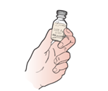
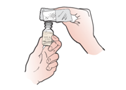
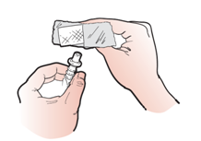
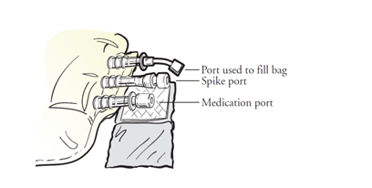
Preparing & Adding Medications to TPN
Check the medication label and expiration date.
Take the protective cover from the top of the medication bottle. Clean top of bottle with wipe.
Clean the medication port of the TPN bag with an alcohol wipe. The medication port may be located on the outside or middle of the TPN bag.
Open another alcohol wipe fully and put the clean medication port on a new alcohol wipe.
Using appropriate syringe prepare medication dose. Put the needle into the medication port on the TPN bag and inject. Dispose of syringe in sharps container. Repeat process for all medications prescribed.

Slide 45
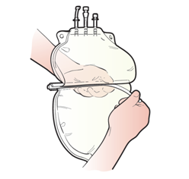
Preparing and Adding Medications to TPN (cont.)
Gently rock the TPN bag to mix the medication(s) into the mixture. The mixture will go from clear to yellow. Check for cloudiness or participates. If discoloration, cloudiness or particles are observed – do NOT use the bag. Prepare a new bag.
Note: If you added medication the middle divider can now be removed from the TPN bag, if you have one. Then gently rock the bag as above.

Slide 46
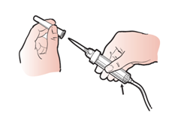
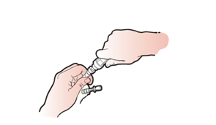
Attaching the administration set to the TPN Bag
Take the protective covering (pull-tab) off the TPN bag spike port and put it on the sterile barrier. Do not touch the exposed end or let it come in contact with anything.
Remove the protective covering.
Insert the tip of the administration set completely into the spik port of the TPN bag using a twisting motion.

Slide 47
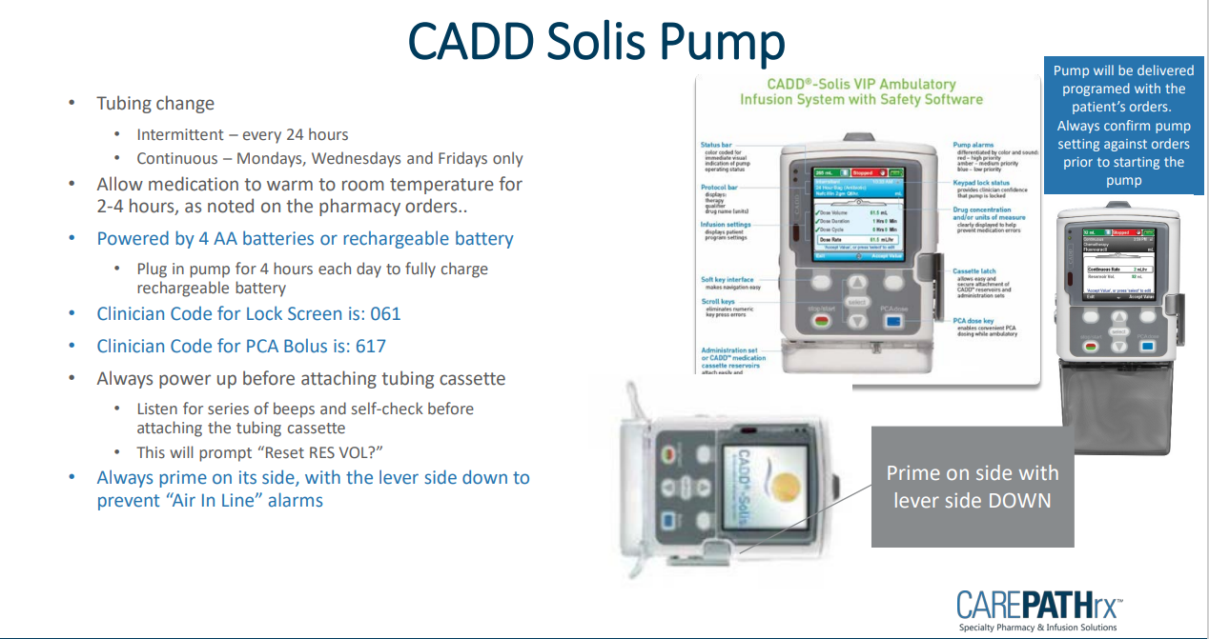

Slide 48
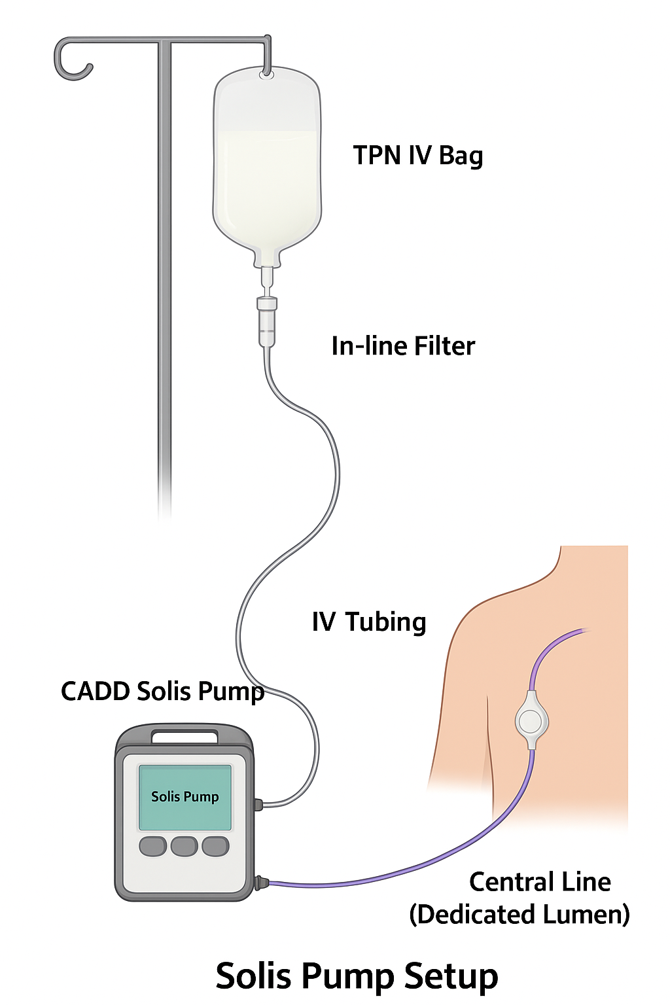
Pump Setup
Verify solution label vs. provider order before programming
Load tubing with in-line filter (0.2 micron without lipids; 1.2 micron with lipids)
Prime tubing fully to eliminate air
Connect to dedicated central line lumen
Double-check all programmed settings before starting infusion

Slide 49
Programming Steps
Turn pump on
Confirm battery or AC power connected
Select therapy mode (continuous or cyclic)
Enter volume to be infused (VTBI) and rate per order
Confirm with a second check (read-back of order vs. pump screen)
Start infusion and observe for initial flow

Slide 50
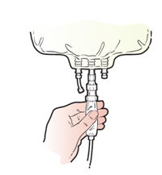
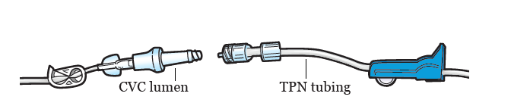
Infusion Process
Hang TPN bag on IV pole. With end of tubing over a trash (not touching) squeeze the chamber of the administration set 1 time
Open the roller clamp and let the solution fill the entire length of the tubing, including the filter. When the tubing is filled close the roller clam.
Thread the tubing through the infusion pump.
Clean the CVC connection at the end of the lumen with an alcohol wipe.
Flush the lumen that you will be using for infusion with 10 mL of normal saline
Remove the protective cap from the TPN tubing
Attach TPN tubing to the CVC lumen. If multiple lumen exist switch between them. Do not touch any open connections.

Slide 51
Disconnecting the TPN Tubing & Flushing CVC
When infusion is completed TPN will be disconnected.
Gather supplies
    One pre-filled 10 mL syringe of normal saline (1 syringe is needed per lumen)
    Nonsterile gloves
    Alcohol wipes
    One disinfection cap for each lumen
  Perform hand hygiene and apply PPE
  Turn infusion pump off
  Close claim on TPN tubing and disconnect the TPN tubing from the CVC
Unclamp lumen, remove any cap. If no disinfection cap is present, use alcohol wipe on end of needless connector for 15 seconds allow to air dry for 15 seconds
Push saline into lumen
Attach disinfection cap to the end of the needleless connector
Repeat for each lumen.
Throw away trash
Perform hand hygiene

Slide 52
Blood Glucose Monitoring
High dextrose concentration can cause hyperglycemia
First dose: Check blood glucose at baseline, then as ordered (often at the 1 to 2-hour mark)
Diabetic or high-risk patients: Close monitoring may be needed
Document results and provider notification (if abnormal)

Slide 53
Complications

Slide 54
ASPECT | HOSPITAL SETTING | HOME CARE SETTING
Environment | Controlled; Sterile Environment | Uncontrolled (pets, children, clutter, refrigerator)
Staffing | Continuous monitoring by multiple clinicians | Intermittent RN visits; Care-Giver led Care
Supplies & Equipment | Readily available (pumps, filters, emergency medications) | Limited to what is provided by infusion program
Emergency Response | Rapid response team Code Team available | RN must call 911 Delayed EMS response possible
Infection Control | Hospital Infection-Prevention Infrastructure | Dependent on patient/caregiver compliance and RN teaching
Documentation | Charted in EMR with frequent inpatient monitoring | Charted in EMR remotely by RN, less continuous oversight
This comparison table reinforces why homecare first-dose TPN requires strict adherence to protocol – because the safety net is thinner outside of the hospital

Slide 55
Emergency Readiness in the Home
Be prepared for infusion reactions (rash, shortness of breath, anaphylaxis)
Follow agency emergency protocol: Stop the infusion, maintain IV access, call 911, notify provider
Keep supplies available: Gloves, masks, extra tubing, batteries, sharps container
Caregiver must know when/how to call RN or emergency services

Slide 56
Risks & Complications
Metabolic
Electrolyte Shifts (K, Mg, Phos)
Infections
Central line-associated bloodstream infection (CLABSI)
Mechanical
Allergic reaction (lipids)
Infusion-Related
Hyper/Hypoglycemia
Liver dysfunction
Catheter occlusion
Dislodgement
Pump malfunction
Fluid overload
Venous Access
Pneumothorax; Air Embolism; Bleeding; Venous Thrombosis; Vascular Injury
Refeeding syndrome

Slide 57
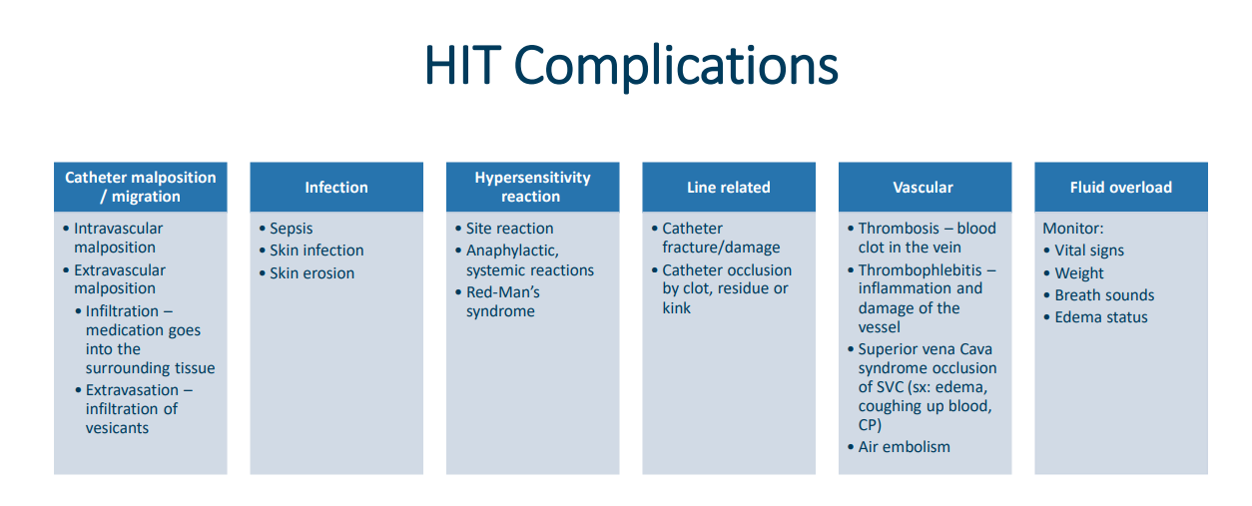
Recognizing and Preventing Infections

Slide 58
Refeeding Syndrome
Metabolic Complication
Refeeding syndrome can occur in severely malnourished and cachectic individuals when feeding is reintroduced and can lead to severe electrolyte instabilities.
Refeeding syndrome can correlate with hypophosphatemia, respiratory distress, rhabdomyolysis, and acute kidney injury.
Prevention of refeeding syndrome is critical and achievable with a slower initial infusion of TPN than expected.

Slide 59
Toxicity
Toxicity of TPN is related to the individual toxicity of its components.
Glucose and lipid excess can lead to hepatic toxicity
Glucose infusion rate greater than 5mg/Kg/min can result in fatty liver
Long-term usage of TPN, ranging from weeks to months, can be associated with rare complication of manganese toxicity

Slide 60
Alarms & Troubleshooting
Occlusion Alarm:
    Check clamps, catheter patency
Air-in-Line Alarm:
    Re-prime tubing, check connections
Low Battery:
    Plug into AC or replace batteries
Door Open / Set Not Loaded:
    Reload tubing correctly
You (the RN) are responsible if the alarm is unresolved → escalate to infusion company AND provider

Slide 61
Backup & Safety
Always plug into AC when possible
Carry spare batteries at each visit
Keep backup pump access available (through infusion company – know your phone numbers/access points)
Caregiver should know how to silence alarm, check screen, and call RN/Infusion Company for help

Slide 62
Emergency Response
Immediate action required if reaction is suspected:
Stop infusion
Maintain IV access with saline if ordered
Assess: Airway, Breathing, Circulation (ABCs)
Call 911 if severe or life-threatening
Notify provider per protocol
Document event, interventions, notifications, and patient outcome

Slide 63
Delivering TPN in the Home
Patient and Caregiver Education/Training
Assess, Set Goals with Patient, Teach-back, Repeat = Patient Engagement and Goal Attainment

Slide 64
Patient & Caregiver Teaching:
Why it Matters
Essential for safe long-term home TPN
Reduces complications (infection, metabolic instability)
Promotes patient independence and confidence
Required by CMS, Joint Commission, and State DPH/DHHS for safe discharge and ongoing care

Slide 65
Core Teaching Topics
Purpose of TPN and why it is needed
Central Line Care: (hand hygiene, site checks, aseptic technique)
Pump Operation Basics: Start, stop, silence alarms
Recognizing Complications: Fever, chills, rash, chest pain, shortness of breath
Daily Monitoring: Weight, temperature, glucose (if ordered)
Supply Management: Safe storage and disposal

Slide 66
Patient Education
Procedure for medication administration, to incorporate infection control, standard precautions for caregivers, aseptic non-touch technique (ANTI), hand hygiene
Risks, benefits, side effects and goal of treatment
Activity precautions
Proper care of access
Routine site inspection for redness, swelling or pain
Educational materials provided for the dispensed medication(s)
Set up, features, routine use, cleaning and troubleshooting infusion pump and supplies
Signs and symptoms of access device complications
Adverse effects of treatment
Safe storage of medications (appropriate conditions of light and temperature) and supplies
Disposal of medications, supplies and equipment
How to contact the appropriate personnel

Slide 67
Pump Teaching
Demonstrate pump setup with RN present
Teach how to start/stop infusion
Review common alarms (occlusion, low battery, air-in-line)
Caregiver must know how to silence alarms temporarily and when to call RN/infusion company

Slide 68
Complication Recognition
Call RN/MD immediately if:
    Fever, chills, rash, chest pain, shortness of breath
    Line site redness, swelling, leakage
    Pump alarms that can’t be resolved
Call 911 if:
    Difficulty breathing, severe chest pain, anaphylaxis symptoms

Slide 69
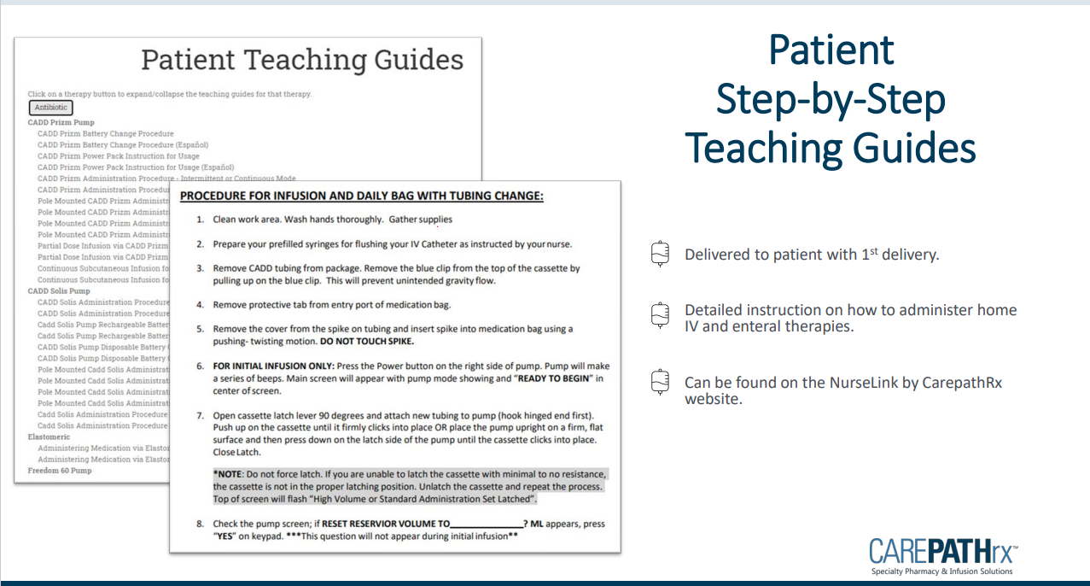

Slide 70
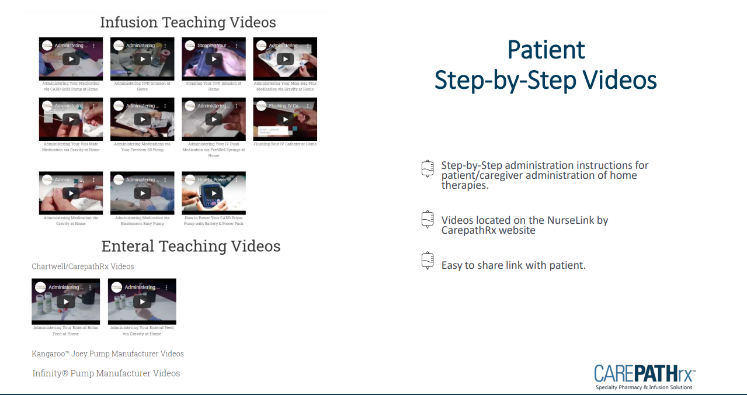

Slide 71
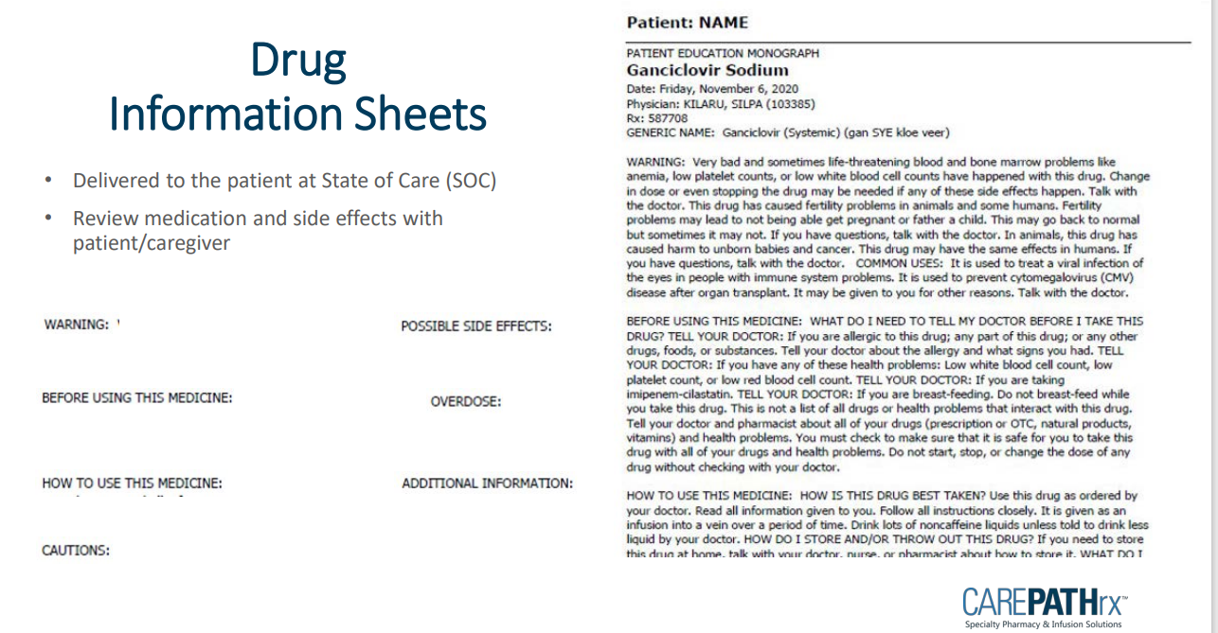

Slide 72
Teaching Strategies
Teach-Back Method: Patient/caregiver explains or demonstrates steps back to RN
Return Demonstration: Patient/caregiver sets up tubing and pump with RN observing
Written Materials: Leave checklists and visual instructions
Reinforce teaching at each visit

Slide 73
Post-Infusion / Departure
Verify pump is running correctly at ordered rate
Reassess vitals and patient tolerance before leaving
Confirm central line secure and dressing intact
Ensure supplies are safely stored/disposed of
Reinforce education and provide opportunity for questions
Document in EMR: Pre-checks, infusion details, vitals, patient response, teaching provided, caregiver demonstration, and any provider notifications
Confirm follow up labs – Expect daily labs until patient is stable on TPN Infusions

Slide 74
Documentation
&
EPIC

Slide 75
RN Role & Documentation
RN must remain in home during entire first-dose monitoring window
Document
    Pre-infusion checks (order, labs, line, baseline vitals)
    Vitals and observations during infusion
    Patient/caregiver teaching provided
    Any adverse events and interventions
Ensure documentation needs CMS, Joint Commission, and DPH standards

Slide 76
Documentation in EPIC
Pre-Infusion:
    Verify MD order and labs.
    Confirm central line patency.
During Infusion:
    Record vitals (per policy).
    Monitor for adverse reactions.
    Document infusion settings.
Post-Infusion:
    Document start/stop times.
    Record patient tolerance.
    Note teaching provided.
    Log any notifications/escalations.

Slide 77
Documentation of Teaching
Document in patient’s record:
    Topic(s) taught to patient/caregiver
    Patient/caregiver response
    Return demonstration outcomes
    Any re-education required
  Supports regulatory compliance and quality tracking

Slide 78
Policy
&
Standard Operating Procedures

Slide 79
Policy: In Process
Tufts Medicine Care at Home – NH Home Health
SUBJECT: FIRST-DOSE TPN DELIVERY IN THE HOME SETTINGS IN (MA)
PURPOSE: To ensure safe and standardized administration of the first dose of Total Parenteral Nutrition (TPN) in the home setting, in compliance with Massachusetts Nurse Practice Acts, SMC Conditions of Participation, Joint Commission standards, Infusion Nurses Society (INS) guidelines, and ASPEN/ESPEN parenteral nutrition best practices.
POLICY: First-Dose Total Parenteral Nutrition (TPN) Administration in the Home Setting
SCOPE: This policy applies to Registered Nurses (RNs) employed by Tufts Medicine Care at Home who are trained and validated as competent to initiate first-dose TPN infusions in the home setting.

Slide 80
RESPONSIBILITIES:
Registered Nurse: Perform all steps of TPN first-dose delivery, monitoring, education, documentation, and emergency response.
Pharmacist: Compound TPN per provider order, ensure labeling accuracy, and verify stability/compatibility.
Physician/Prescriber: Provide signed TPN order, review labs, and be available for urgent consultation.
Patient/Caregiver: Participate in teaching, provide safe home environment, and comply with monitoring instructions.
REQUIRED EQUIPMENT:
TPN solution with pharmacy label and provider order
Central line access supplies (saline flushes, alcohol/CHG swabs, sterile gloves, masks, dressing supplies)
IV administration set with appropriate filter (0.2 micron without lipids, 1.2 micron with lipids)
Solis CADD infusion pump, AC power cord, spare batteries
PPE (gloves, mask)
Emergency contact information and phone access
Sharps container and clean workspace

Slide 81
PROCEDURE:
STEP ONE: Pre-Visit Preparation:
    Review physician orders, pharmacy compounding sheet, and patient’s most recent labs.
    Confirm TPN bag is available, intact, refrigerated at 2–4°C, and within expiration.
    Ensure all supplies and emergency numbers are available.
STEP TWO: Pre-Infusion Safety Checks:
    Identify the patient with two identifiers (name, DOB).
    Verify provider order matches pharmacy label (components, volume, infusion rate, additives, expiration).
    Perform hand hygiene and don PPE.
    Assess central line site: verify dressing integrity, absence of redness/swelling, and line patency with flush/blood return.
    Obtain and document baseline vital signs (BP, HR, RR, Temp, O2 sat).
    Confirm emergency protocol readiness: 911 access, provider availability.
STEP THREE: Equipment Setup:
    Remove TPN bag from refrigerator 1–2 hours prior to infusion to warm to room temperature.
    Inspect IV bag for clarity, precipitates, separation, or leaks.
    Spike bag with administration set and attach correct filter (per lipid content).
    Prime tubing completely to remove air.
    Load tubing into Solis CADD Pump, program per order (VTBI, infusion rate, duration).
    Double-check programmed settings against provider order and pharmacy label.

Slide 82
STEP FOUR: Initiating Infusion:
    Connect tubing to the dedicated lumen of central line.
    Start infusion via Solis CADD Pump.
    Remain with patient for monitoring period (minimum first 30–60 minutes).
    Reassess vital signs at 15–30 minutes, then per policy.
STEP FIVE: Monitoring During First Dose:
    Observe for:
      Hypersensitivity (rash, SOB, chest pain, wheezing)
      Infusion reactions (fever, chills, back/chest pain)
      Fluid overload (edema, crackles, hypertension)
      Electrolyte imbalance symptoms (arrhythmia, weakness, confusion)
      Monitor pump function and alarms.
      Check blood glucose as ordered (baseline + 1–2 hours).
STEP SIX: Emergency Response (If Adverse Event Occurs):
    Stop infusion immediately.
    Maintain IV access with saline if ordered.
    Assess Airway, Breathing, Circulation (ABCs).
    Call 911 for severe/life-threatening reactions.
    Notify provider of events and interventions.
    Document all findings, interventions, and notifications in EMR.

Slide 83
STEP SEVEN: Patient & Caregiver Education:
    Teach purpose of TPN, infusion schedule, daily monitoring (weight, temp, glucose).
    Review pump operation basics (start, stop, silencing alarms).
    Review infection prevention (hand hygiene, hub scrub, site monitoring).
    Teach signs/symptoms requiring RN/provider call vs. 911.
    Confirm learning with teach-back and return demonstration.
STEP EIGHT: Post-Infusion Care:
    Stop pump at completion and disconnect tubing using aseptic technique.
    Flush and secure central line per protocol.
    Dispose of supplies: Use a sharps container for sharp objects (e.g., needles) and trash containers for all other supplies.
    Perform final assessment: vitals, central line site, patient tolerance.
    Reinforce patient/caregiver teaching.
STEP NINE: Documentation:
    Pre-infusion safety checks (order verification, labs, baseline vitals, line assessment).
    Infusion details: start/stop times, pump settings, filter used.
    Patient response and tolerance.
    Teaching provided and caregiver demonstration.
    Any adverse events and interventions.
    Notifications and follow-up plan.

Slide 84
QUALITY AND COMPETENCY:
    RN must be validated for competency (written test + skills simulation) before performing independently.
    Competency revalidation required annually or if practice gap identified.
    Random audits of documentation and technique by QA department.

Slide 85
Regulatory Oversight
For your information….

Slide 86
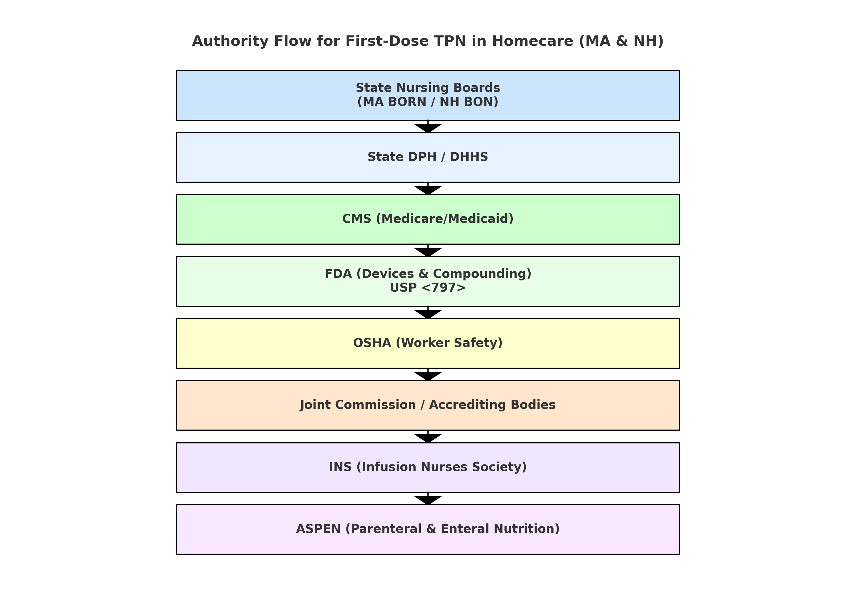

Slide 87
State-Level Oversight
MA Board of Registration in Nursing (BORN)
    Regulates RN and LPN practice under the Nurse Practice Act. Sets scope of practice, delegation rules, medication administration, and competency requirements.
  NH Board of Nursing (NH BON)
    Equivalent regulatory authority in NH, with its own Nurse Practice Act, administrative rules, and advisory rulings.
  State Departments of Public Health (DPH / DHHS)
    MA DPH: Oversees home health agency licensing, infection control, and clinical standards
    NH DHHS: Similar oversight for home health and hospice programs.
    Both establish requirements for home infusion services, including safety and reporting expectations.

Slide 88
Federal Oversight
Centers for Medicare and Medicaid Services (CMS)
    Sets Conditions of Participation (CoPs) for home health agencies.
    Requires adherence to patient rights, infection control, quality assessment, medication management, and skilled nursing standards.
    Documentation and monitoring parenteral nutrition falls under these CoPs.
  U.S. Food and Drug Administration (FDA)
    Regulates the compounding and labeling of parenteral nutrition solutions.
    Oversees infusion devices (e.g., CADD Solis pumps) as Class II medical devices
  Occupational Safety and Health Administration (OSHA)
    Governs nurse workplace safety, including handling of IV equipment, hazardous drug exposure, and sharps disposal.

Slide 89
Accrediting and Standard-Setting Organizations
The Joint Commission (TJC)
    Accredits home health agencies and infusion programs
    Requires compliance with national patient safety goals, infusion therapy policies, and competency validation
  Infusion Nurses Society (INS)
    Publishes the Infusion Therapy Standards of Practice (2021 updates).
    Considered the “gold standard” for IV therapy, central line care, compatibility, and parenteral nutrition best practices.
  American Society for Parenteral and Enteral Nutrition (ASPEN)
    Provides evidence-based guidelines for PN safety, monitoring, and clinical decision-making.
    Addresses compounding, stability, catheter care, and interdisciplinary team roles.

Slide 90
Homecare Agency / Employer / CAH
Agencies must develop policies and procedures that:
Meet or exceed CMS, Joint Commission, and state rules.
Standardize competency assessment for first-dose TPN (including simulation).
Ensure emergency response protocols and clear prescriber communication pathways

Slide 91
Professional Accountability
Nurse’s individual license obligations:
Practice within RN scope under the Nurse Practice Act.
Uphold professional standards of care and ethics (ANA Code of Ethics).
Maintain current competencies in infusion therapy and TPN administration.

Slide 92
References

Slide 93
REFERENCES
American Society for Parenteral and Enteral Nutrition. (2018). Guidelines for the provision and assessment of nutrition support therapy in the adult critically ill patient. Journal of Parenteral and Enteral Nutrition, 42(3), 508–534. https://doi.org/10.1177/0148607115621863
Boullata, J. I., Guenter, P., Mirtallo, J. M., & ASPEN Board of Directors. (2016). ASPEN safe practices for enteral nutrition therapy. Journal of Parenteral and Enteral Nutrition, 41(1), 15–103. https://doi.org/10.1177/0148607116673053
Gorski, L. A., Hadaway, L., Hagle, M. E., McGoldrick, M., Orr, M., Doellman, D., … Infusion Nurses Society. (2021). Infusion therapy standards of practice. Journal of Infusion Nursing, 44(1S Suppl), S1–S224. https://doi.org/10.1097/NAN.0000000000000396
Massachusetts Board of Registration in Nursing. (1994). Advisory ruling on nursing practice: 92-04 – Infusion therapy. Commonwealth of Massachusetts. https://www.mass.gov/orgs/board-of-registration-in-nursing
National Institute for Health and Care Excellence. (2017). Nutrition support for adults: Oral nutrition support, enteral tube feeding and parenteral nutrition (Clinical Guideline 32, updated August 2017). NICE. https://www.nice.org.uk/guidance/cg32
New Hampshire Board of Nursing. (2023). Nurse Practice Act, RSA 326-B. State of New Hampshire. https://www.oplc.nh.gov/scope-practice
Pironi, L., Boeykens, K., Bozzetti, F., Joly, F., Klek, S., Lal, S., … Van Gossum, A. (2020). ESPEN guideline on home parenteral nutrition. Clinical Nutrition, 39(6), 1645–1666. https://doi.org/10.1016/j.clnu.2020.03.005
U.S. Centers for Medicare & Medicaid Services. (2023). Medicare and Medicaid programs; conditions of participation for home health agencies. 42 CFR Part 484. https://www.ecfr.gov/current/title-42/chapter-IV/subchapter-G/part-484
U.S. Centers for Disease Control and Prevention. (2017). Guidelines for the prevention of intravascular catheter-related infections. U.S. Department of Health and Human Services. https://www.cdc.gov/infection-control/hcp/intravascular-catheter-related-infection/index.html
The Joint Commission. (2023). Comprehensive accreditation manual for home care. Oakbrook Terrace, IL: The Joint Commission.

Slide 94
Thank You for
Learning!
Tufts Medicine Care at Home
Clinical Staff Development
847 Rogers Street, Suite 201
Lowell, MA 01852

