Slide 1
EPIC Downtime Tools

Slide 2
Goal
To ensure that all Epic users are informed of the downtime communication plan and the following downtime procedures to be used any time normal access to the system is interrupted.
The goal is to enable ongoing operations before and during execution of disaster recovery.
BCA
Business Continuity Access is the system of prevention and recovery to deal with potential threats to the Tufts Medicine System for Health, in this case, in the event of Epic Downtime.
Responsibility
What is my responsibility in the event of unplanned downtime?
The first responsibility is to notify the Help Desk that there is a problem with the Epic system. The Help Desk will escalate the problem appropriately so that Information Services can solve the problem as quickly as possible. IT Helpdesk: (617) 636 -1100
When calling the Helpdesk for downtime, be sure to state that the issue is Critical.

Slide 3
Communications:
Generally, all Enterprise downtime communications either go to All Users via email or to the Epic TM Downtime Distribution email list serve and will include information about the type of downtime we are experiencing and the recommended tool to use.
The Epic team will also update the ‘Message Of the Day’ that displays upon Epic login with important information during and surrounding the downtime.
Communication pathways differ slightly based on the type of outage…
Unplanned:
o If site-specific issue, your local IT department leaders will communicate using their current methods
o If an enterprise issue, large outages will be communicated to all end users via email distribution list. Updates regarding unplanned outages will be made to our Epic TM Downtime Distribution list hourly until the outage is resolved.
o All Clear will be sent to all end users via email.
Planned:
o All epic maintenance will be planned and impact all sites. An All Tufts Medicine communication will be sent about it via email several times prior to the date of the outage.
o Key Updates regarding planned outages will be made to our Epic TM Downtime Distribution list hourly until the outage is resolved.
o All Clear will be sent to all end users via email.

Slide 4
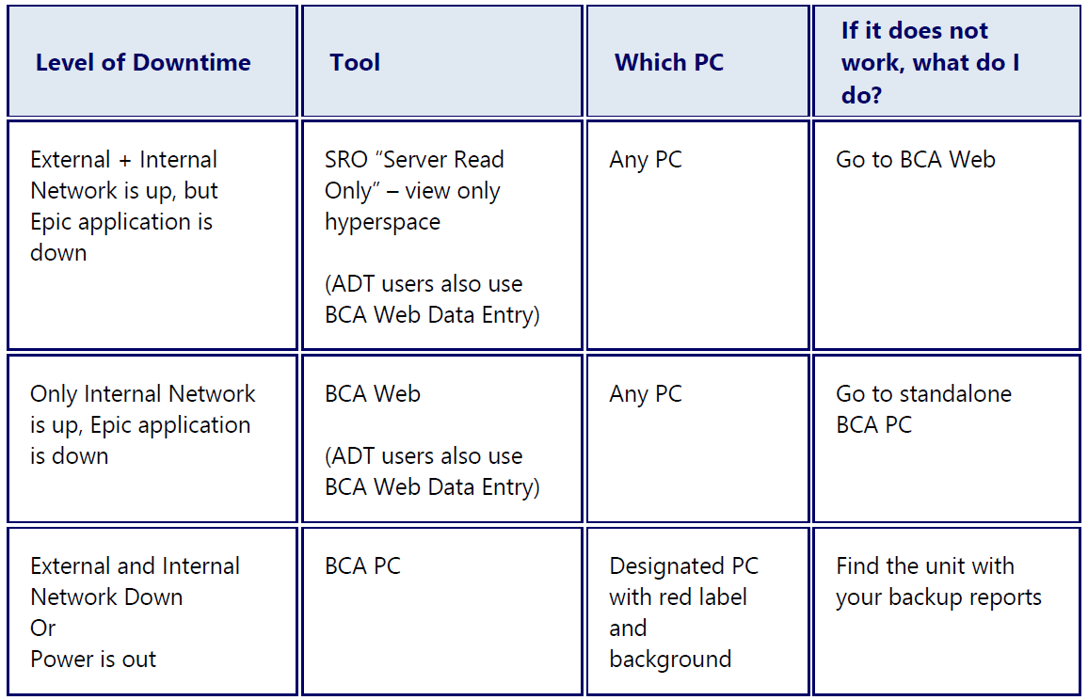

Slide 5
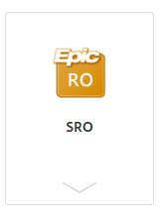

  SRO
  SRO is short for “Read Only/Server Read Only” version of Epic hyperspace.
This server you can use when Epic is down, but our access to RO is still up. Use to view patients and all activities Epic, in a view only mode.
Access SRO/RO through the SRO shortcut on your desktop, Tufts Medicine apps
or within Citrix: https://access.well-net.org/.
2. Once launched, login as you would to Epic.
3. You will have most of the same activities you normally do, but in read-only view.

Slide 6
How does the SRO Work?
SRO allows end users to access data via Hyperspace in read-only mode during downtime. The environment is hosted on a shadow server, which means the data is a near real-time copy of the production environment. The term "supports read-only" indicates whether a given Hyperspace activity can be used on a shadow environment in read-only mode.

Slide 7
What about High Point House?
MAR reports can be printed proactively or from the BCA Web
When users access the BCA machine it should have a MAR report included for each one of their patients, as well as several other reports:
HSPC Census - Patients with Active Episodes
HSPC Department Appointment BCA Report
HSPC Staff Daily BCA Report
Single Patient List - High Pointe House - BCA IP Clinical Summary
Single Patient List - High Pointe House - BCA MAR
Single Patient List - High Pointe House - BCA IP Extended Info
Single Patient List - High Pointe House - BCA IP Slp Patient Summary

Slide 8
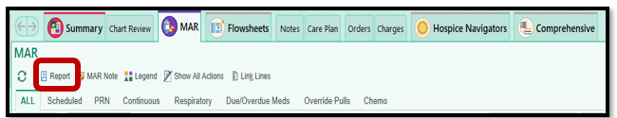
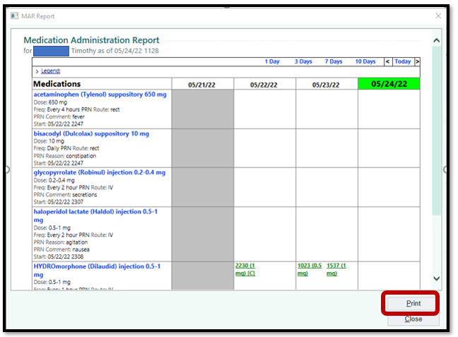
To Print the MAR from Hyperspace
Navigate to the MAR and select Report:
Then Select Print:

Slide 9
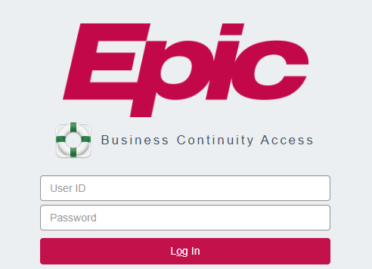
BCA WEB
Access the online downtime reports through the “Epic BCA Web” shortcut on your desktop.
Alternatively, access the reports by going to Internet Explorer and entering the following address:
HHF
https://hhfbcawebprd.homehealthfoundation.org/BCAWeb/

Slide 10
BCA PC INTSTRUCTIONS
BCA (aka Downtime PCs) are PCs designated in your department to receive hard copies of necessary reports in the event of a full internet and/or power outage. These PCs should be labeled with a red and black label “DOWNTIME PC”, indicating it is a downtime pc, and it should have a local printer attached. Both the PC and printer should be connected to emergency red power outlets or a UPS battery in the event the power is out.
1. On the desktop, click the “Downtime Printing” Icon
2. Login using your Epic username and password
3. Use the search bar or filters on the lefthand side to find the appropriate reports.

Slide 11
  Remote Client
  Users may access remote client as usual during downtime, but they will not be able to access chart review or sync.
  Questions?

Slide 12
Critical tickets for Multi- user downtime should be called into the central Helpline, 617-636-1100 and routed to the ECSA team.

Slide 13
Thank You
  Home Health Foundation

