Slide 1
Home Health Patient Care Plans
Care at Home

Slide 2
New Care Plans coming in September 2024
In order to align Epic Remote Client Care plans with best practices and clinician tool kit contents, the following Care Plans have been created or updated. The target date for release into Remote Client Productions is September 16, 2024.
HH General
HH Heart Failure
HH Diabetes
HH COPD
HH Pneumonia
These interdisciplinary care plans have been created for ease of entry for the admitting clinician.

Slide 3
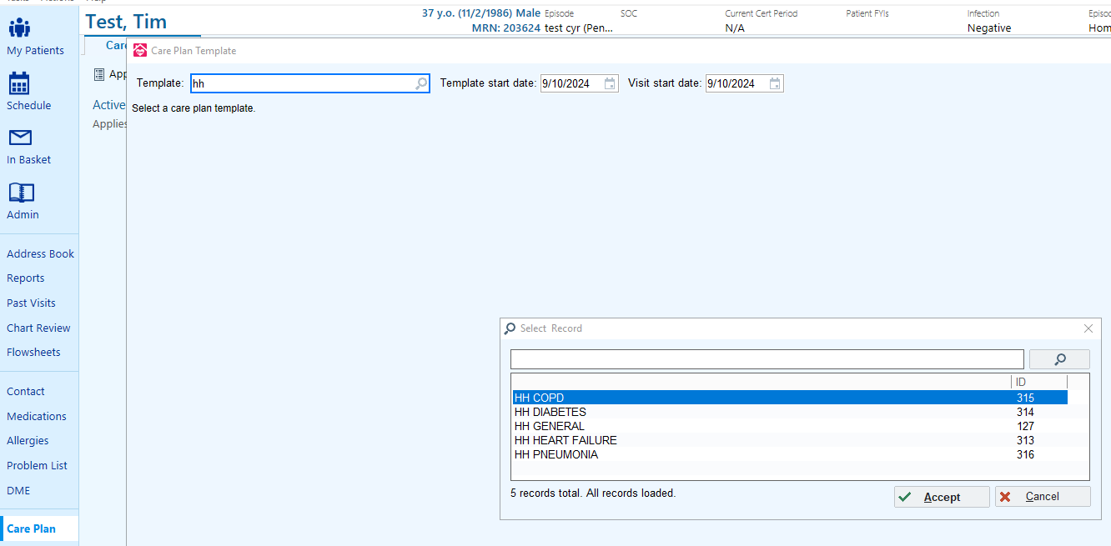
Where do I find the new Care Plans
Select Care Plan then Apply Template.
Enter HH to see all the new versions of the Care Plans that are available.

Slide 4
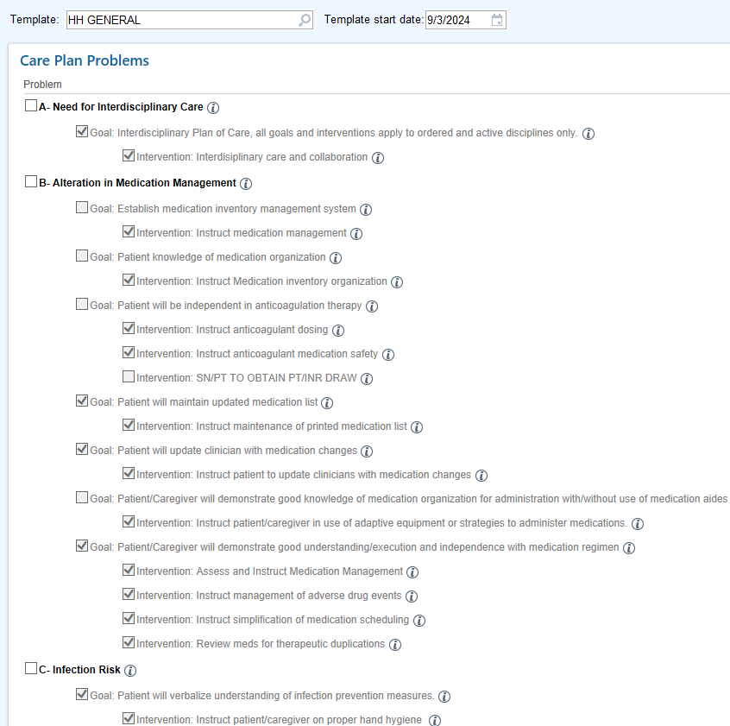
What new in HH General?
The HH General Template has been enhanced to include items that may apply to a patient with any diagnosis. Those items that start with alphabetical letters from A-H are required on every Home Health Plan of Care. The following problems have been added to the HH General Care Plan template.
The following are items:
A- Need for Interdisciplinary Care- this new intervention states that the Care plan items only apply to ordered and active disciplines so there will be no need to update the discipline defaults on the goals due to a discipline not being ordered at the start of care.
B- Infection risk
C- Pain/Comfort Assessment
D- Alteration in Medication Management- This is an enhanced version of the current medication management goals and interventions found in the skilled nursing and therapy care plans. Items default checked must be included on every plan of care.
E- Patient Care and Rehospitalization Risk management – Required next visit planning intervention to be addressed each visit. Replaces the smart text in the narrative for revisits.
F- Need for patient centered plan of care- These interventions are discipline specific. Select your discipline and complete the patient goals and care preferences.
G- Patient Safety/Fall risk- addresses emergency planning and safety/fall risks.
H- Discharge needs

Slide 5
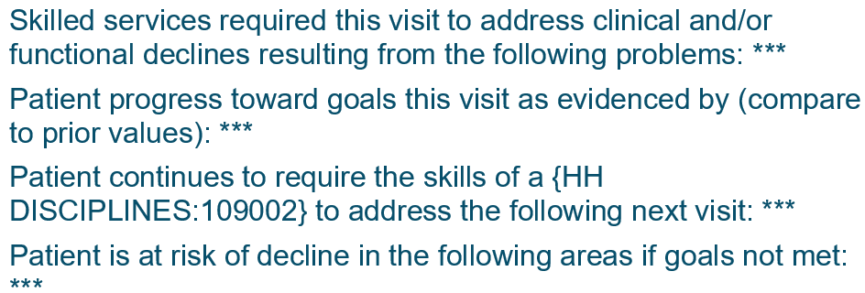
Patient Care and Rehospitalization Risk Management
The Patient Care and Rehospitalization Risk Management problem contains the Next Visit Planning intervention.
The Next Visit Planning Intervention contains a Visit Comment text that is required on all revisits.
The Visit Comment text contains the Visit Narrative Template:
The visit narrative template in this intervention replaces the need for a Narrative Note in revisits.
The Narrative Note will continue to be a requirement for all other visit types. Add the appropriate template to the narrative for the Start of Care, Resumption, Recert and Discharge visits.

Slide 6
HH General Optional Items
Identified Social Determinants of Health issues that may impact healthcare goals- Use this new goal and intervention to address SDOH issues impacting the patient plan of care.
Need for Interpreter- Apply when language barrier is present
Oxygen deficit- Updated care plan for patients using oxygen
Psychosocial Status- Apply to patient with depression, anxiety or need for smoking cessation.
Risk for Skin Breakdown- apply to any patient at risk for pressure ulcers or skin breakdown for other reasons such as incontinence.
X Additional Home Health orders-Changed to Vital sign Parameters
Removed default checks- the default selected Problems will no longer default check, eliminating the need to remove duplicate care plan items.

Slide 7
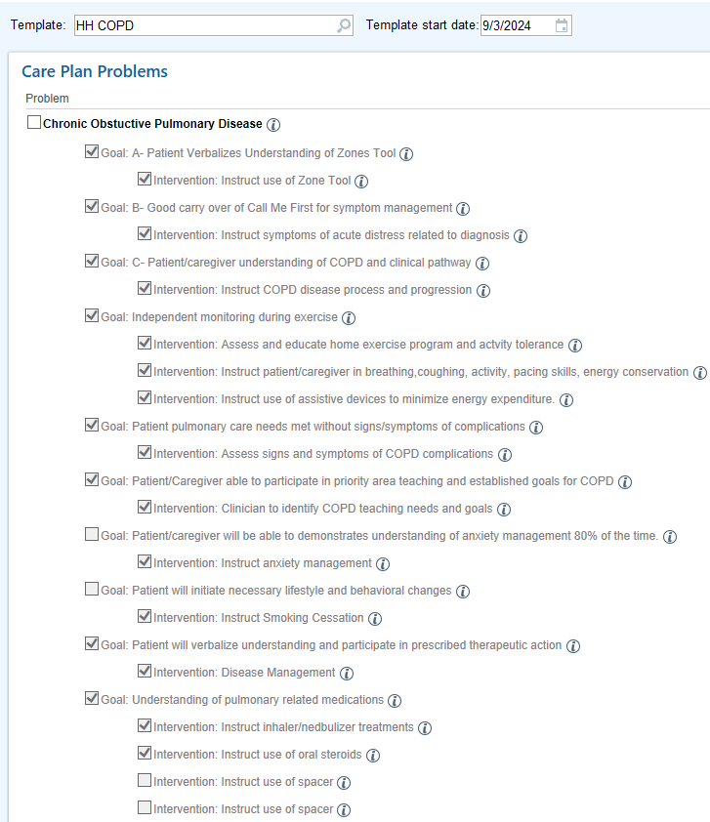
HH COPD
One click selects the goals and interventions for the patient with COPD

Slide 8
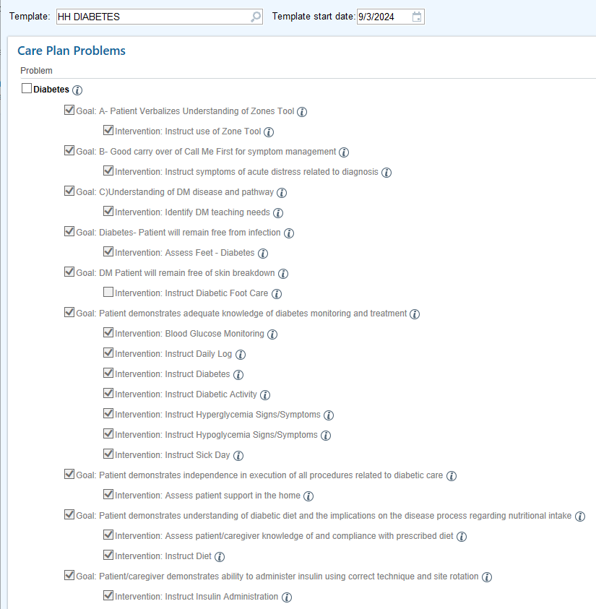
HH Diabetes
One click selects the goals and interventions for the patient with Diabetes

Slide 9
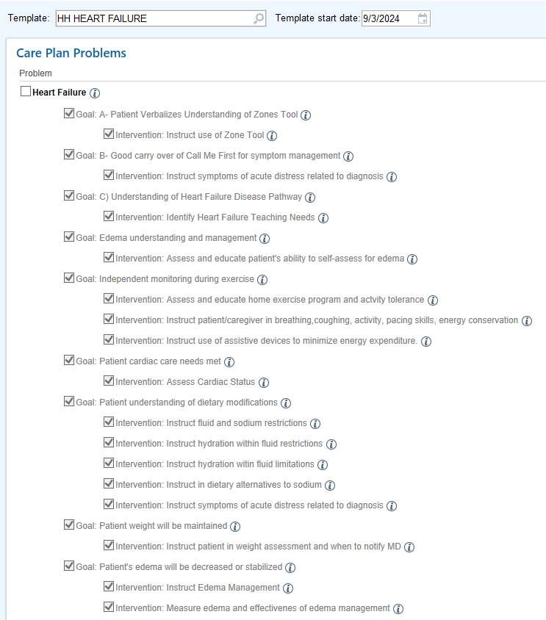
HH Heart Failure
One click selects the goals and interventions for the patient with Heart Failure

Slide 10
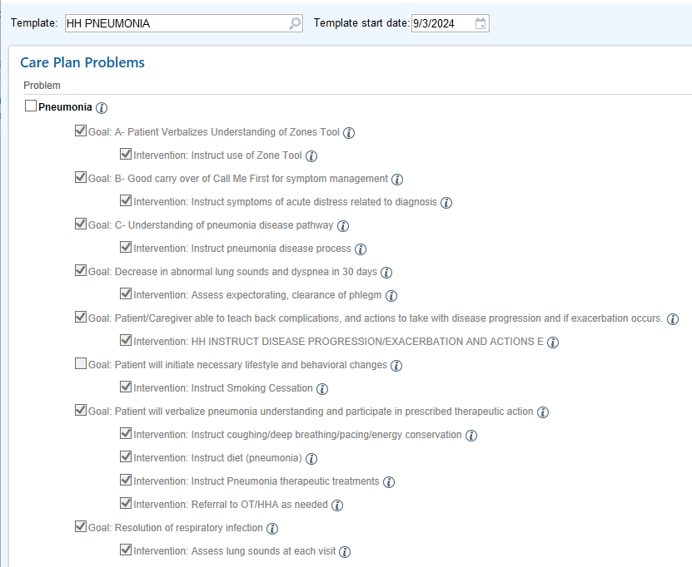
HH Pneumonia
One click selects the goals and interventions for the patient with Pneumonia

Slide 11
Best Practice Building the Care Plan
Go to the HH General Template. Select the required problems from the HH General template and any optional problems, goals and interventions that apply to your patient. Required HH General interventions start with the letters A-H.
Select your disease specific template if applicable. Check the Problem and review the Goals and Interventions. Hover the pointer over the “i” button to view the details.
Go to your discipline specific template if needed to select any additional problems, goals and interventions relative to your patient assessment.

Slide 12
Discipline Discharges and Interdisciplinary Care Plans
Interventions that apply to more than one discipline should NOT be resolved during a discipline discharge, when the remaining discipline should continue to address that intervention.
For example: Pain goal/intervention should not be resolved by the nurse during a discipline DC if PT or OT will continue to follow the patient and address the pain problem.

Slide 13
Need to know about Interdisciplinary Care Plans
The interdisciplinary care plans will apply only to the ordered/active disciplines
Can I update a discipline group? Should you feel the need to update a discipline group to add or remove a discipline, this can be accomplished by editing the goal at start of care only. Keep in mind that the Interdisciplinary Plan of Care intervention eliminates the need to update disciplines based on whether a discipline was ordered at start of care.
Can I change/edit goals and interventions? Edits may be made at start of care. Any changes to goals or intervention after the start of care requires the DC of the old intervention and adding a new intervention. While the new care plans were created with best practices in mind, care plan items can be edited to create patient specific content.
Can I deselect an item on a Care Plan if it does not apply to my patient? Yes, it is ok to deselect any items that do not apply to your patient, just as it is ok to select optional items that do not automatically select in the Care Plan.

Slide 14
Questions?
Get help in the Epic Support Zoom Room M-F, 10:00-10:00, via the TMCAH Epic Support link on your desktop or this link: Epic zoom room
Do you have clinical questions about care plans?
Contact your clinical manager or the clinical education team.

