Slide 1
Basic Wound Care
Wound Treatments

Slide 2
Basic Wound Care
Good Assessment Skills are necessary
What is your Goal for this Wound?
If the Wound is:
Wet: Dry it
Dry: Wet it
Has a Hole: Pack it
Utilize principles of moist
wound healing when 
considering treatment options.

Slide 3
Wound Treatments
Products
Cleansers
Wound cleanser
Normal Saline
Always DATE the container when opened! Dispose after 3 days OR if container has been opened and not dated.

Slide 4
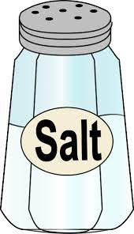
Normal Saline
Recipe for Normal Saline
Wash Hands
Preparing sterile solution
Equipment: 2 teaspoons of Salt
1 Quart of water
1 quart glass jar with lid
1 pot with lid
Method: Boil water and salt in the covered pot for 10 min
Boil glass jar and lid for 10 min
Let salt water and jars cool-pour into jars and cover
Label jar with date and contents of jar If refrigerated the solution will keep for 5 days

Slide 5
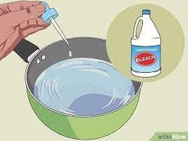
Dakin’s Solution
Recipe for Dakin’s Solution
Equipment:
5.25% Clorox or similar bleach
Baking soda
Clean tap water
1 quart glass jar with lid
Pan with lid
Measuring cup and spoons
Method:
Boil jar, lid, spoons, and measuring cup in pot for 10 minutes.
Boil 4 cups water for 15 minutes. Remove from heat.
Using sterile spoon add ½ teaspoon of baking soda to boiled water.
PLEASE NOTE MD ORDER FOR STRENGTH OF DAKIN’S

Slide 6
Dakin’s Solution
Dakin’s Solution: Full strength ½ strength ¼ strength 1/8 strength
Bleach: 3 oz 3T + ½ t 1T + 2t 2.5 t
Water: 32 oz 32 oz 32 oz 32 oz
Place solution in sterile jar and secure. Cover entir jar with aluminum foil to protect it from light. Solution is good for 48 hours. Unopened jars of solution can be stored for one month. Throw away any unused portion.

Slide 7
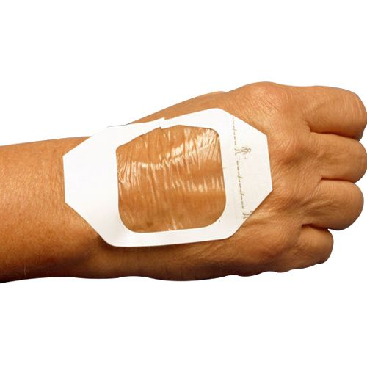
Wound Treatments
Transparent Film: Made of polyurethane or copolymer
Has porous adhesive layer that lets O2pass through to the wound and moisture evaporate. Impermeable to external fluid and bacteria.
Can be used as primary or secondary dressing
Indications:
Partial thickness wounds
Stage I or Stage II Pressure Ulcers
Superficial burns and donor sites
Not for use on 3rddegree burns or draining wounds
Change every 5-7 days

Slide 8
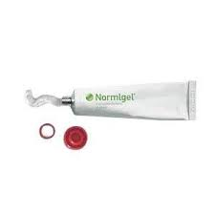
Wound Treatments
Hydrogel: donates moisture to the wound
Can be used for:
Stage I to Stage IV pressure injuries
Painful wounds
Skin tears
Necrotic wounds
Donor site
Do not use for moderately to highly exudative wounds
Change every 1-4 days

Slide 9
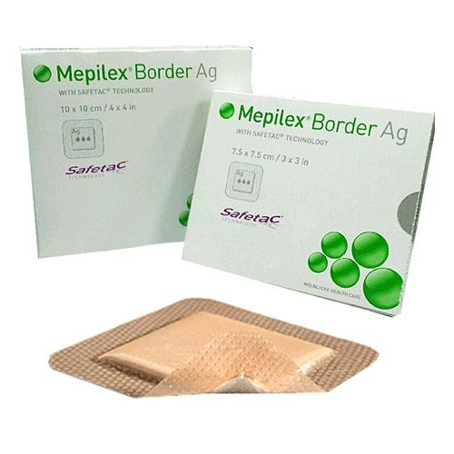
Wound Treatments
Foam: Polymers that pull fluid away from wound bed and hold it Can be used for:
Minimal to Heavy Drainage
Under Compression
Surgical Wounds
Infected or Non-infected Wounds
Partial and Full Thickness Wounds
Stage II to Stage IV Wounds
Change every 3-7 days

Slide 10
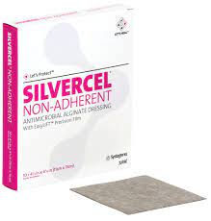
Wound Treatments
Calcium Alginate: CA+and NA+fibers made from seaweed Transforms to moist gel consistency
Can be used for:
Moderate to Heavy Drainage
Stage III or Stage IV Pressure Injuries Depending on Wound Bed Surgical Incisions/Dehisced Wounds
Partial and Full Thickness Wounds
Change every 1-3 days

Slide 11
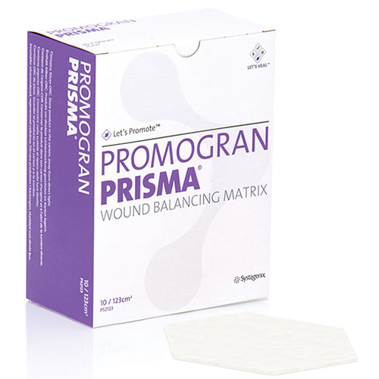
Wound Treatments
Collagens: usually derived from cowhide
Stimulates new tissue development
Can be used for:
Chronic non-healing granulated wounds
Skin Grafts
Donor Sites
Surgical Sites
Minimal to heavy exudate
Not for 3rddegree burns, eschar, sensitivity to bovine products
Change daily to every 4 days

Slide 12
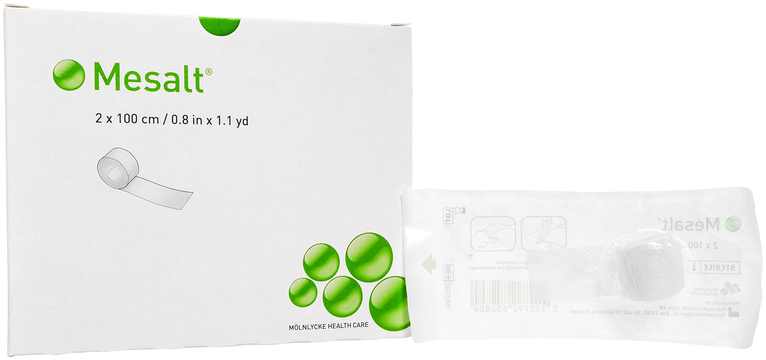
Wound Treatments
Impregnated Gauze
Mesalt: The exudate from wound releases NaClfrom dressing Stimulates wound cleansing by absorbing exudate, bacteria and necrotic material
For the management of wounds with heavy and /or infected discharge

Slide 13
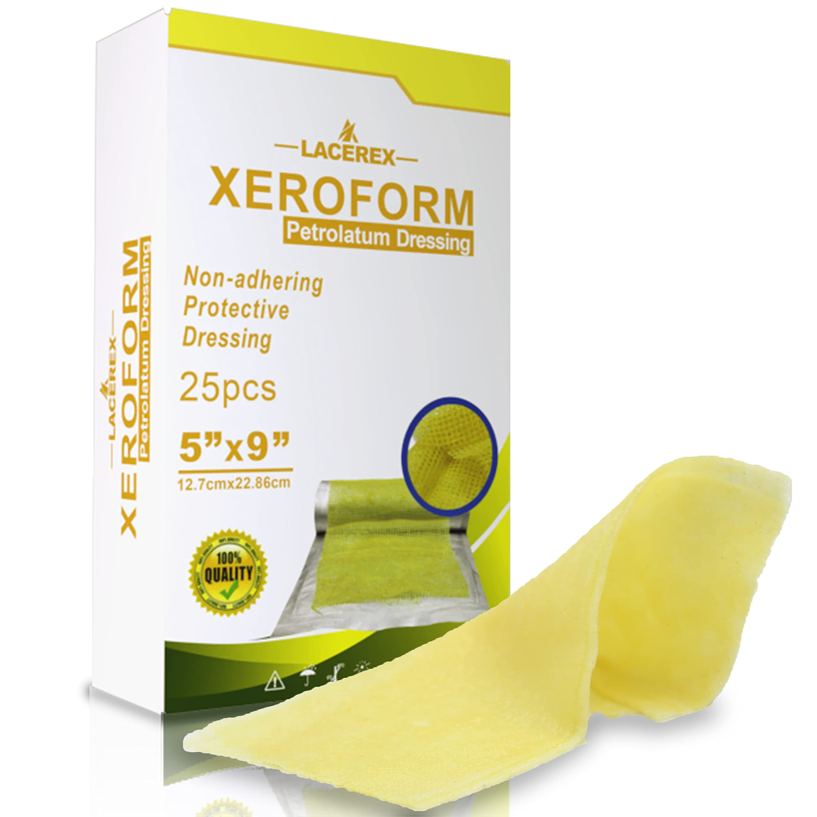
Wound Treatments
Impregnated Gauzes
Xeroform: Fine mesh gauze with petroleum and bismuth – deodorizes – not for highly exudating wounds
Adaptic: Prevents adherence of dressing to the wound to minimize pain and trauma. For dry to highly exudating wounds
Vaseline: Fine mesh gauze with white petroleum. Clings and conforms to wound without sticking

Slide 14
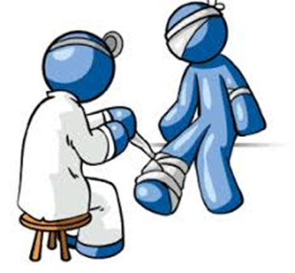
Advanced Wound Care
Compression dressings
Used for Venous Ulcers
Unna Boot
Multi-layer compression wraps
Setopress

Slide 15
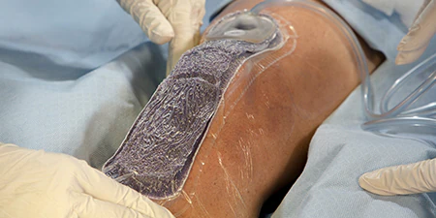
Advanced Wound Care
Products:
Negative Pressure Therapy
Can be used for
Full thickness wounds
Surgical wound
Flaps/Grafts
Diabetic-Arterial-Venous Pressure Injuries

Slide 16
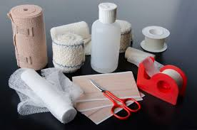
Wound Supplies
Ordering Supplies – Minimum of $10
Order only TWO weeks at a time
Order Everything that is necessary for the wound care
Consider number of wounds, size of wounds, and frequency of dressing changes
Order ancillary supplies
Applicators, syringes, tape, etc.

Slide 17
Ordering Supplies
McKesson
To order replacement stock for your bag
Contact Stacy Mahan to have an account set up for you if you do not have one
Charge your stock to the patient that you used your supplies on
For patient ordering :
Order supplies on laptop Remote Client: Parachute
Order for 2 weeks only, unless it’s a Medicaid product (then it’s a 30 day supply)
The closet offices have very few supplies but you can ask
Must sign out supplies for patient billing
Medicare PPS patients only

Slide 18
Infection Control
Home care is clean, not sterile!
Date saline bottles when opened
Good for 3 days then discard
Order accordingly
Used supplies must be double bagged in plastic and disposed of in the household trash
Syringes for irrigation are one time use only. DO NOT REUSE!!

Slide 19
You Own The Visit!
Every nurse is responsible for the whole visit
Update primary nurse
VM or Case Conference
Order supplies
Call MD for new orders or changes to POC
Complete documentation
Schedule the next visit
Right Dressing – Right Wound – Right Time

Slide 20
Visit Utilization
Take the initiative
Can you teach the patient or caregiver to participate in the wound care?
Is it time to change frequency?
Is it time to change the treatment?

