Slide 1
April is: Transfers

Slide 2
General Guidelines for Accurate Assessment:
Always score prior to any teaching or interventions
Score from the bottom up, starting from the most dependent level to the most independent level of functioning
Observation is required to obtain accurate information
Complete an OASIS Walk
The OASIS WALK includes: patient ambulation/or wheel chair mobility, transferring in/out of bed, transferring on/off the toilet or commode, and in/out of the shower, if it is safe to do so
Consider what the patient is ABLE TO DO SAFELY on the day of the assessment
Verbal cues, reminders, stand by assist, and hands on assist are all forms of supervision

Slide 3
Guidelines for Accurate Assessment Continued
Transfer includes…Going from a supine position, from current sleeping surface bed, recliner, couch etc. to a sitting position on the side of the bed, to a standing position, then doing a stand pivot or sliding board transfer to a sitting surface and back to a supine position on the sleeping surface
If there is not a seating surface next to the bed then the transfer now includes ambulating to the nearest seating surface
Assistive device can be a walker or a cane or any other item the patient uses, for example, the side of the bed, the arm of the chair etc.
Remember if the patient requires human supervision AND an assistive device and are safe they would be scored a level 2 for transfers

Slide 4
M1850 Transferring
Notes:
5. Unable to alleviate pressure. 4. can turn enough to alleviate pressure . 3 cant bear weight or cant pivot . 2 must be able to both bear and pivot .1 needs device or minimal human assist if pt needs assist and device they drop down to a 2 or if they need more than minimal assist they drop to a 2 .

Slide 5
Case Scenario
Mr. Jones needed a little boost to get out of his hospital bed safely, even after the bed was raised to bring him closer to a standing position. The assessing clinician considers the hospital bed to be an assistive device. Once on his feet he was able to safely sit on the commode next to the bed, but required standby assist due to weakness.
QA Discussion:
What would be the correct response to M1850?
Supporting reasons why?
Examples of documentation to support the OASIS answer
Notes:
2 needs assist and device to be safe

Slide 6
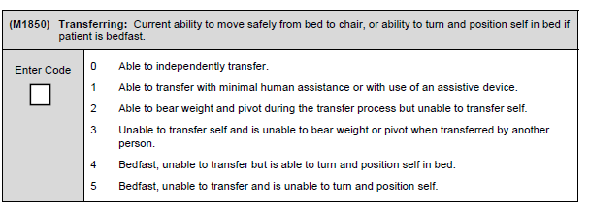
What would be the correct response to M1850?
Supporting reasons why?
Examples of documentation to support the OASIS answer

Slide 7
May is: Bathing

